Slide 1

Ludlow & District Beekeepers Association
Session 8 (Chapter 10 of the book)
An Introduction to Beekeeping:
Getting Started
Session 8: Getting Started
1

Slide 2
Aims and Objectives
Aim:
To ensure that you can consolidate what you have learned, can continue to learn and can move on to keeping bees safely
and with enjoyment.
Objectives:
  To know where to site your hive(s)
  To know what you now need to get started
  To continue your path to further learning about bees
  To have access to appropriate sources of further learning and information
  To understand the risks associated with keeping bees, to mitigate them, and to take appropriate safety steps
Session 8: Getting Started

Slide 3
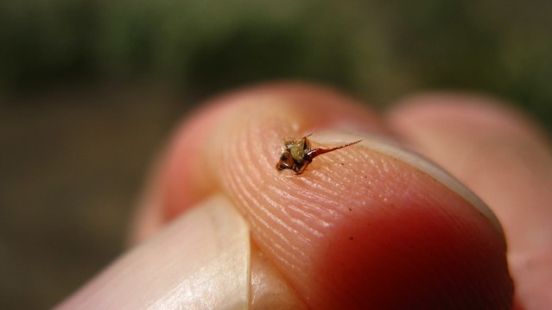
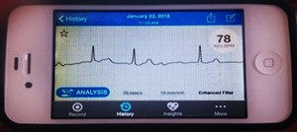
Getting Stung! – It will happen to you….
Bee and Wasp stings
The aftermath
The treatment
The prevention
Anaphylaxis
  Tingling – Breathing
  Danger of collapse!
Session 8: Getting Started

Slide 4
Getting Stung! – The safety rules
Preparations
  Who knows where you are?
  Where is your phone? Do you have signal?
  Where might the ambulance / helicopter come to?
  What three Words for your apiary?
  What do paramedics need to know?
  Response – Call an ambulance and mention Anaphylaxis
  Remove the sting – and prevent further stings!
  Adrenaline Auto injectors – Antihistamine
  Lie the person down with their legs raised
  Do not move even if you feel better – await an ambulance!
  https://www.nhs.uk/conditions/anaphylaxis/prevention/
Session 8: Getting Started

Slide 5
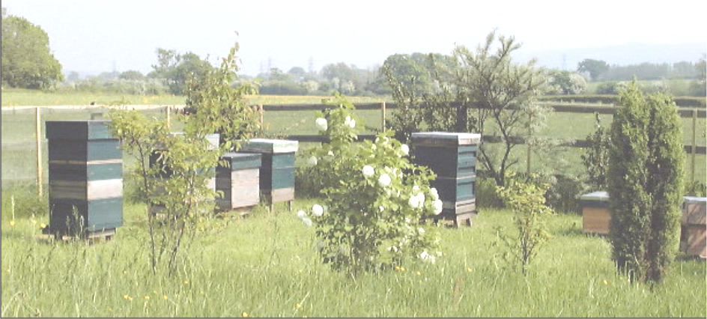
Setting up an Apiary
Home or out apiary?
Liaise with your neighbours
Easy access
Away from another beekeeper’s apiary
Hidden from road,
paths (& thieves)
Level ground
Early sun &
possible shade
at mid day
Water nearby
Plenty of room to work on the hive
Hives not in a regular pattern
Safe flight path
Session 8: Getting Started

Slide 6
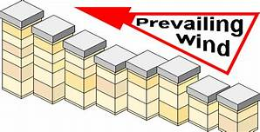
Factors to consider
Hives close together may be difficult for the bees to tell apart if they all look the same
Full foragers can ‘bribe’ their way in..
If there is a persistent wind (even if it is mild), then the downwind hive wins!
Face entrances in different directions
Session 8: Getting Started

Slide 7
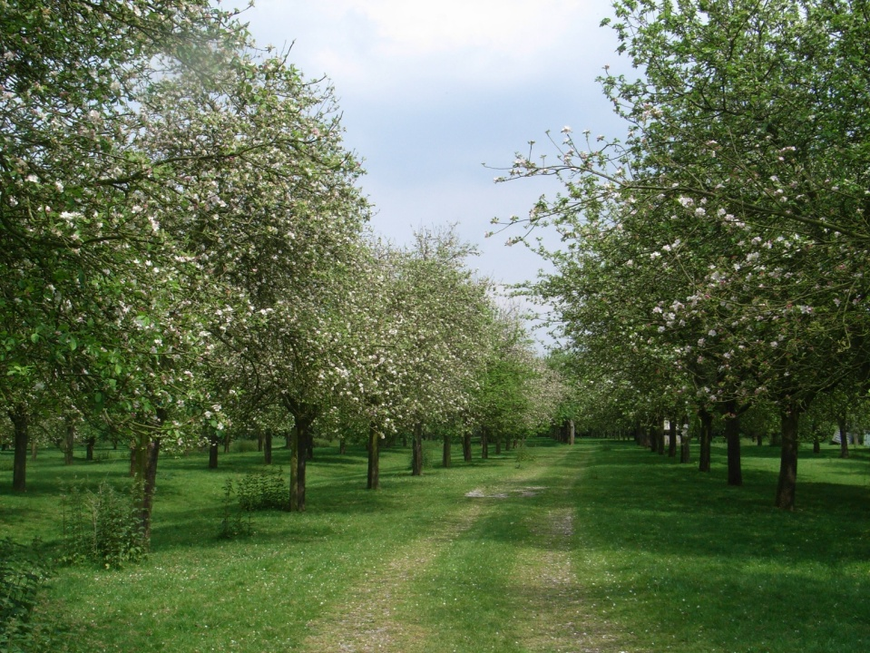
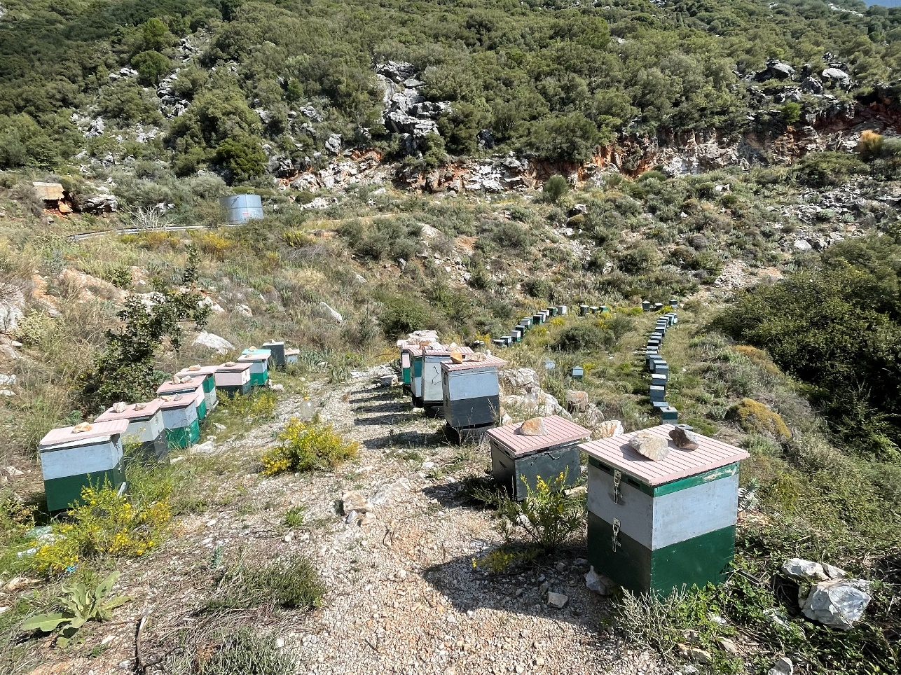
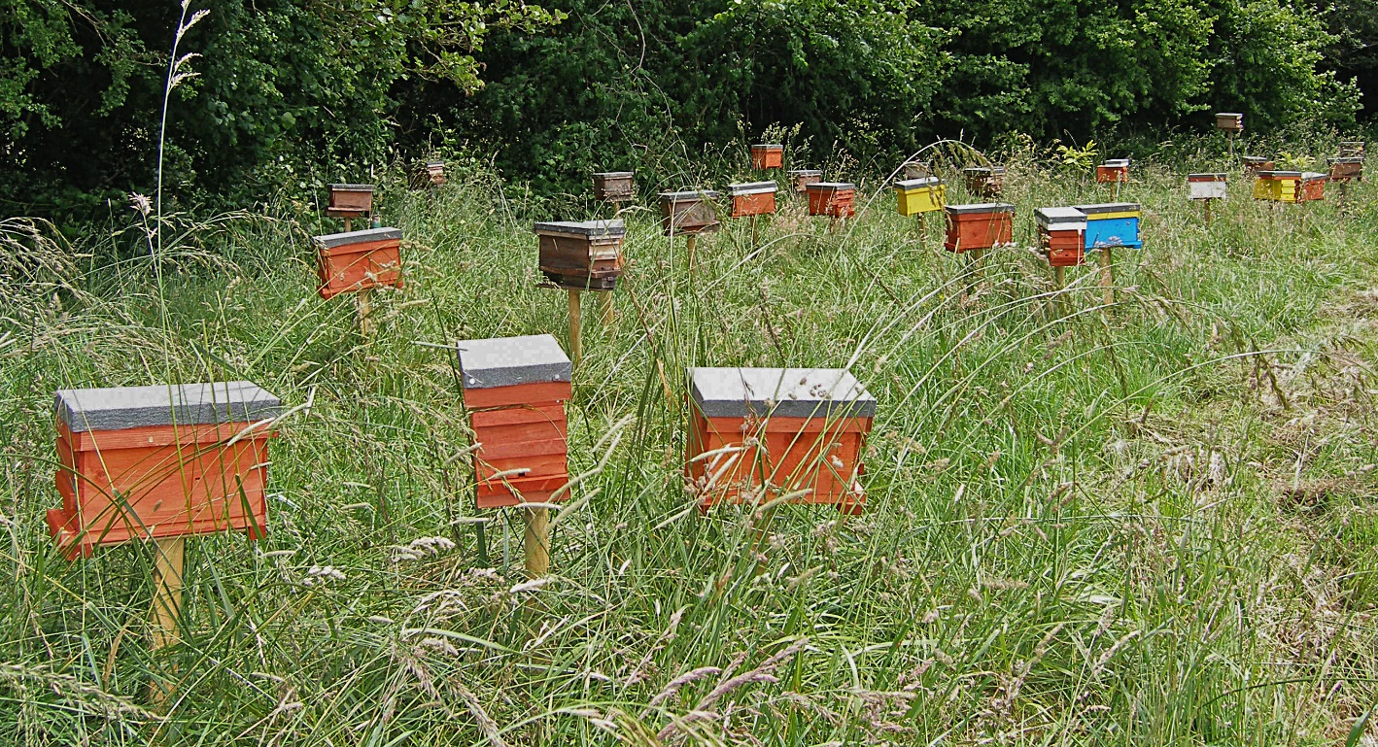
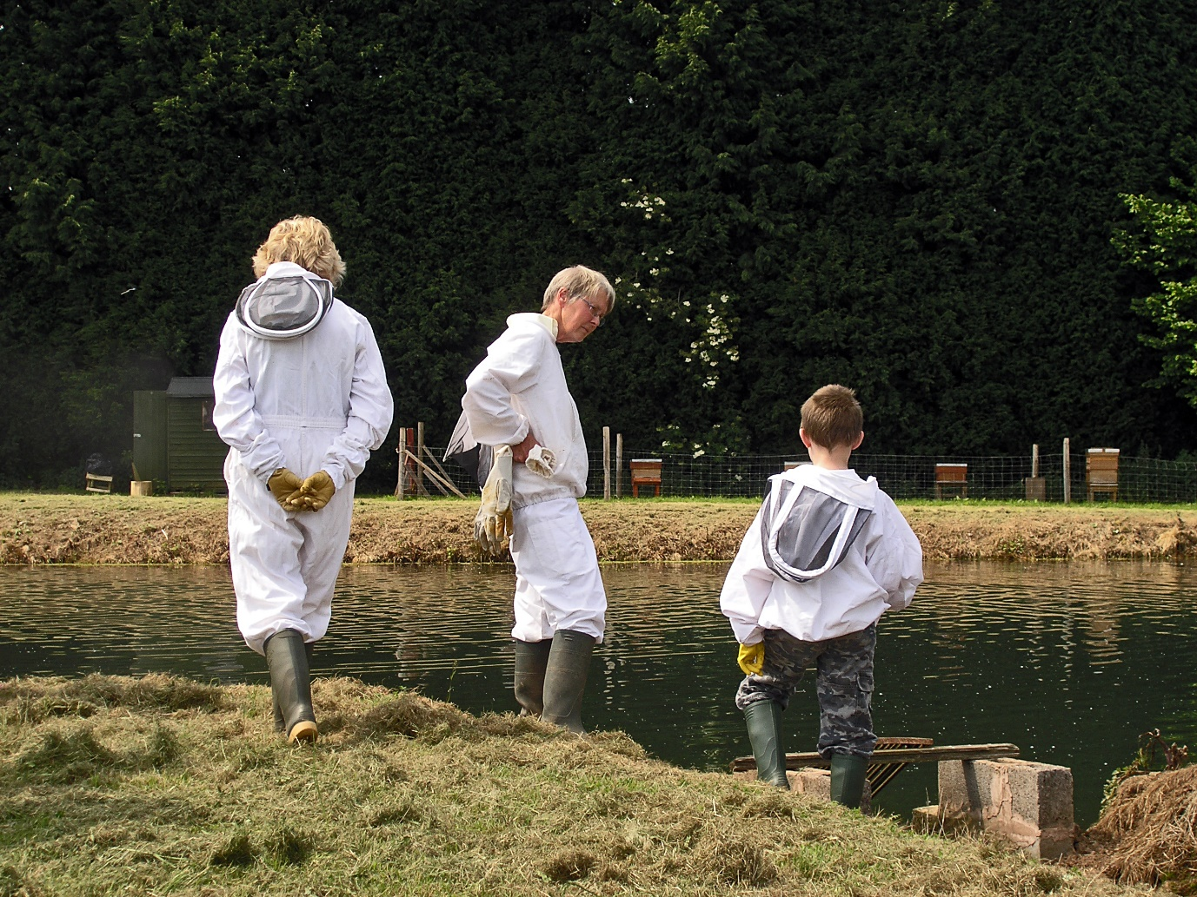
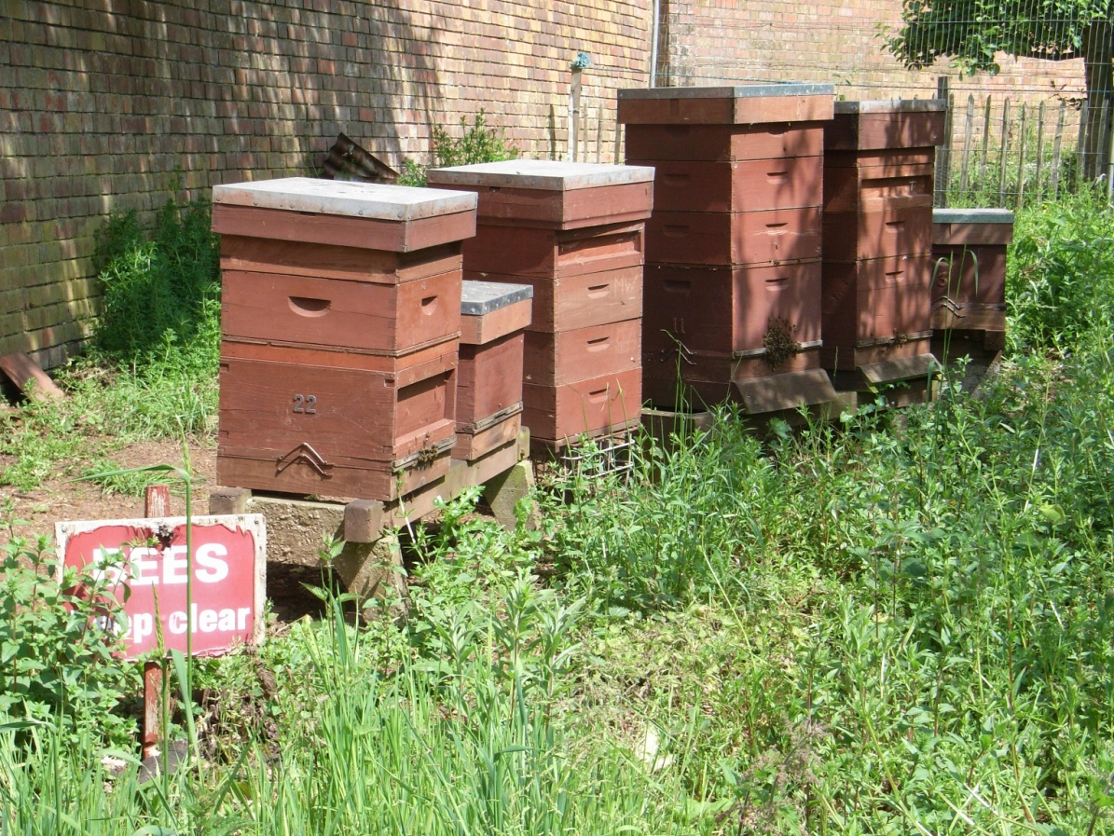
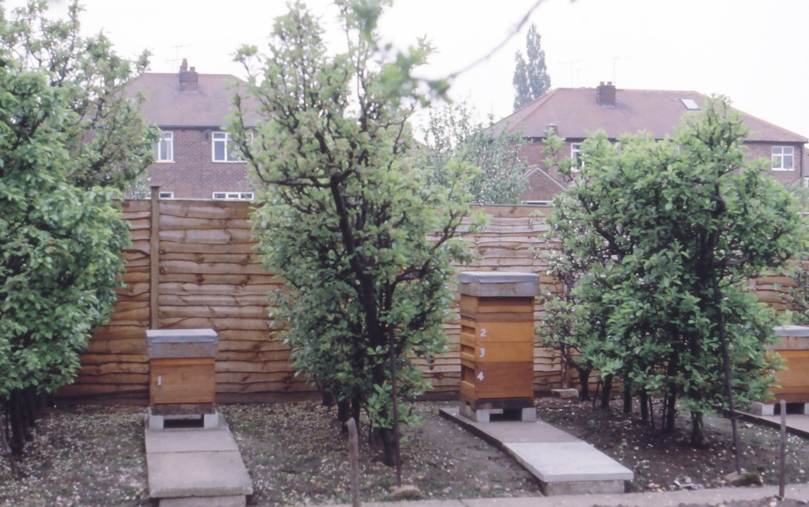
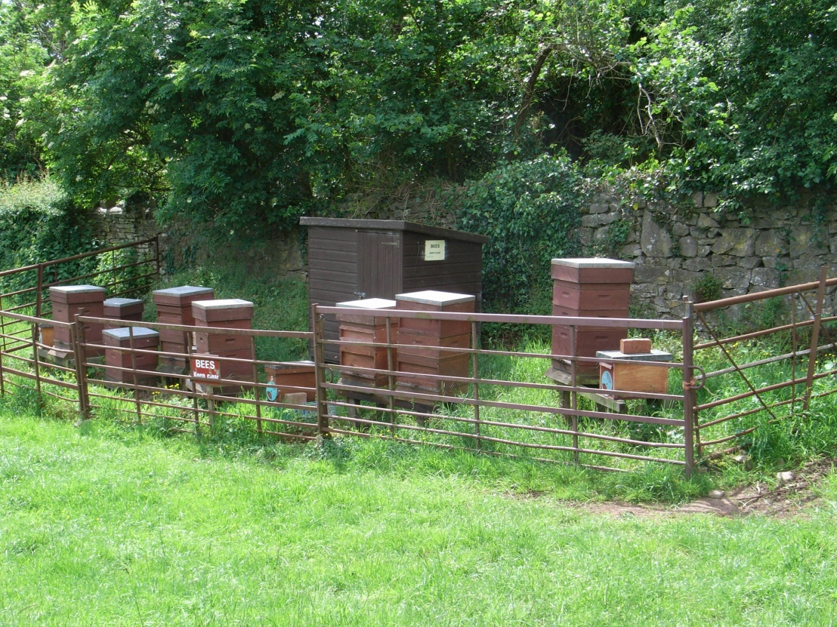
Examples of Apiary Sites
Session 8: Getting Started

Slide 8
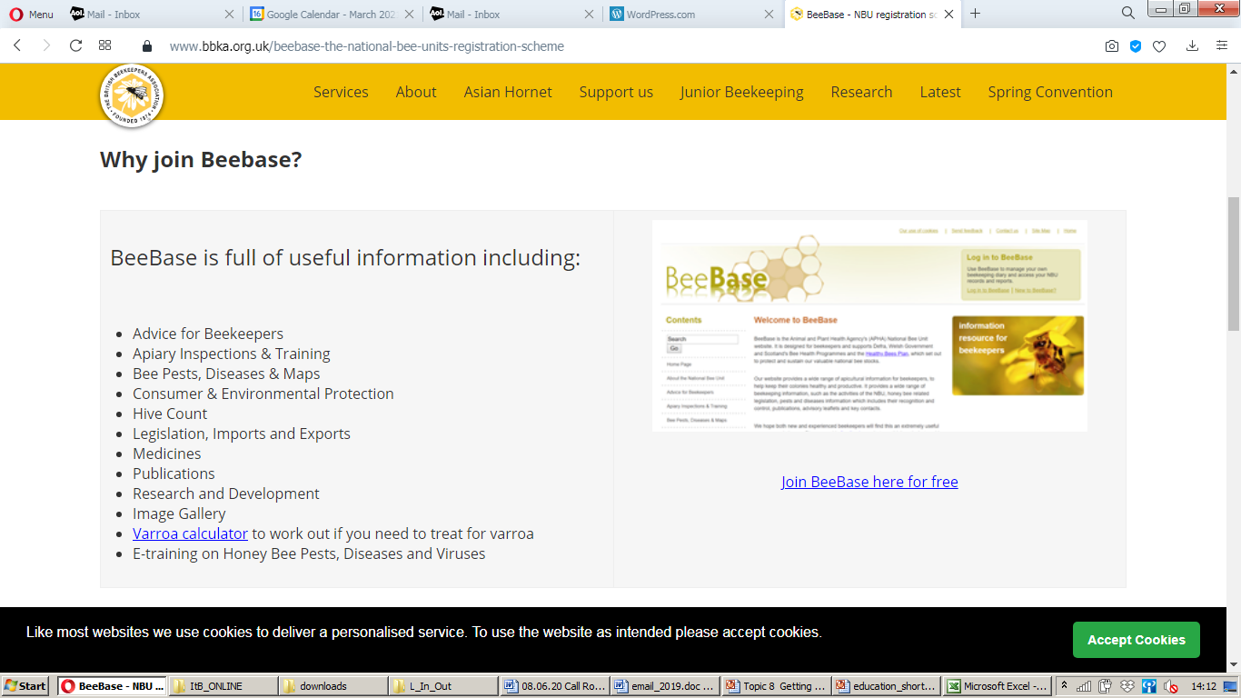
National Bee Unit Registration
Session 8: Getting Started

Slide 9
The Future
Beekeeping
is
Confidence
and
Knowledge!
Session 8: Getting Started

Slide 10
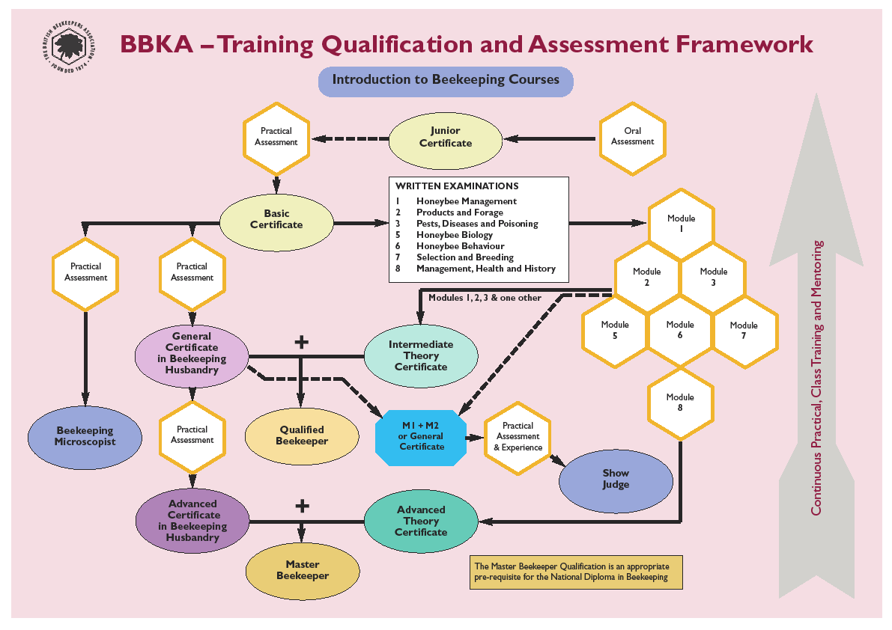
BBKA Qualifications
Session 8: Getting Started

Slide 11
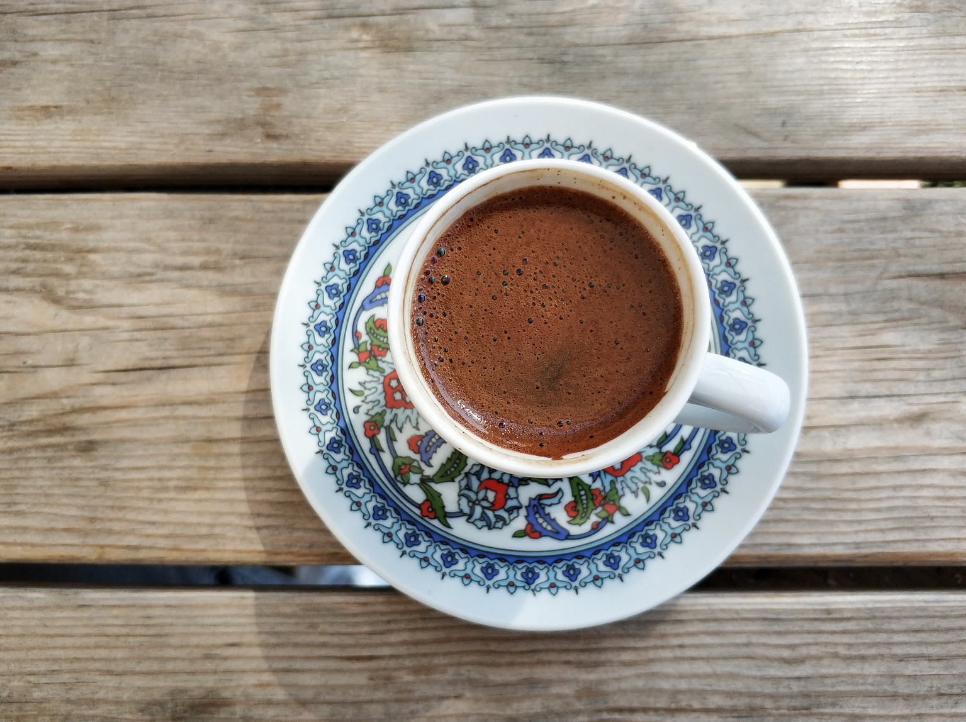
Coffee…..Now or shortly?
Session 8: Getting Started

Slide 12
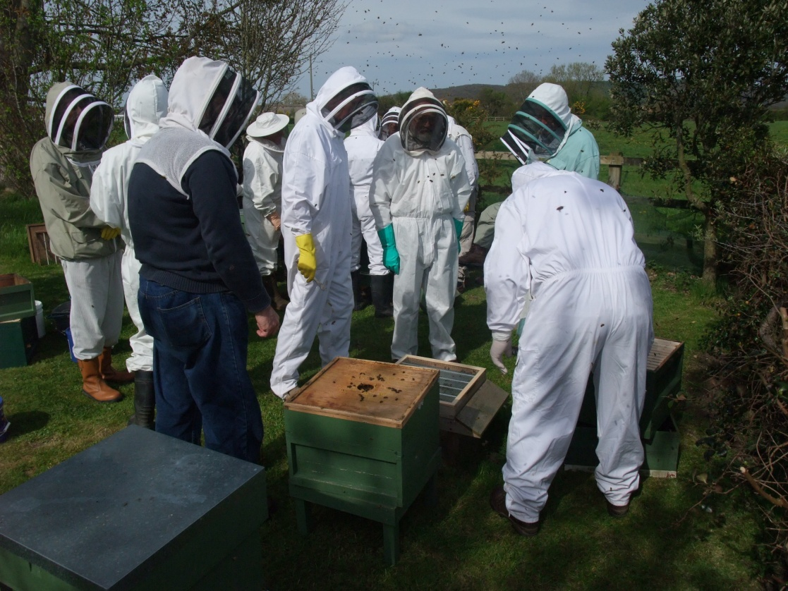
Getting Started
Join our local
Association
Wait until you are
sure you want to
keep bees
Start with a nucleus
in May/June
Obtain local bees from
a reputable source
Do not start with a
prime swarm
Obtain gentle bees rather than hard workers for the first year
Plan to have at least 2 hives in the second season
Make sure you have a mentor
Read and learn
Session 8: Getting Started

Slide 13
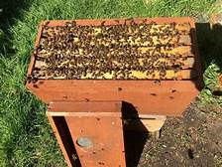
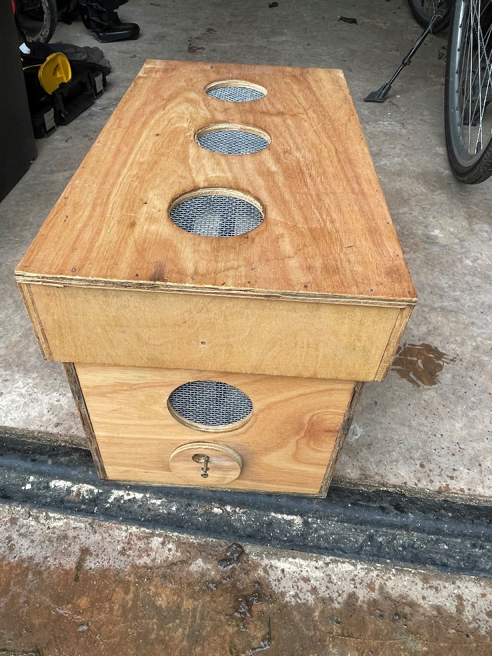
Getting Started
“Here are your bees,
I’ll come back in the summer”
“I was told they didn’t
have varroa”
“These bees are ideal,
they don’t swarm”
“You will find out what
works for you….”
Session 8: Getting Started

Slide 14
Equipment just to start….
Wellingtons
Bee suit
Marigold gloves
Hive tool
Smoker
Lighter / blow torch and fuel
Lidded buckets for waste wax and washing gloves and equipment – needs household soda
Hives, parts and nuclei
Session 8: Getting Started

Slide 15
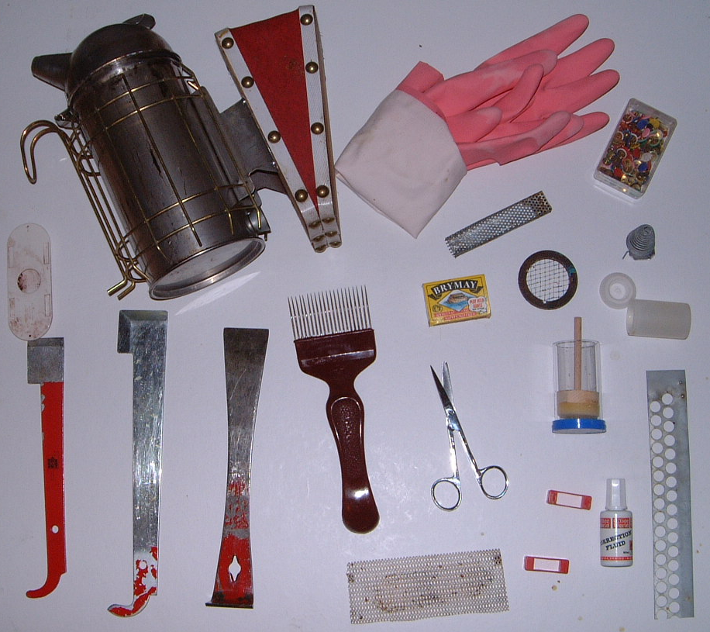
Basic Equipment
Smoker
Gloves
Butler Cage
Drawing Pins
Porter bee
escape
Queen cell cage
2 Queen marking cages
Matches
Scissors
Uncapping
Tool
3 Hive tools
Mouse Guard
Marking Fluid
‘Ends’
Mesh
Session 8: Getting Started

Slide 16
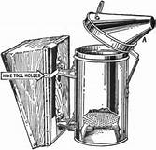
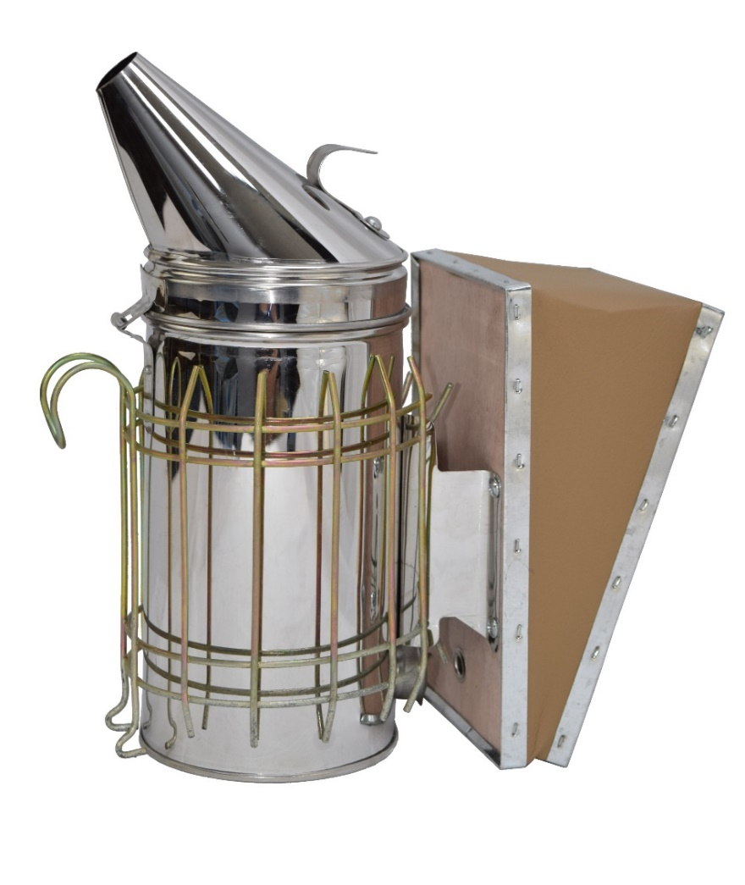
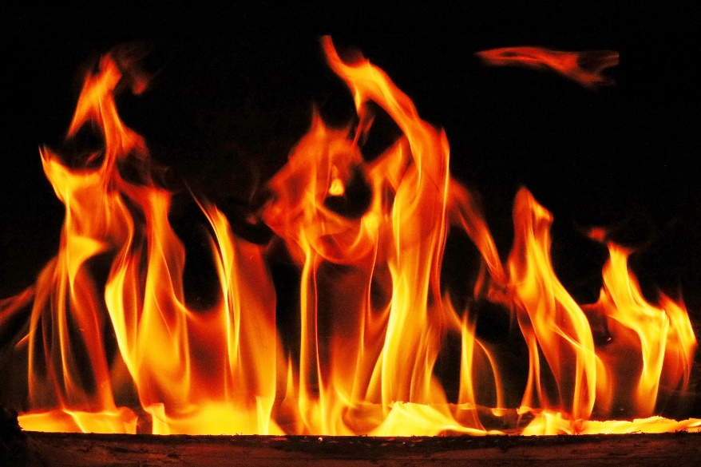
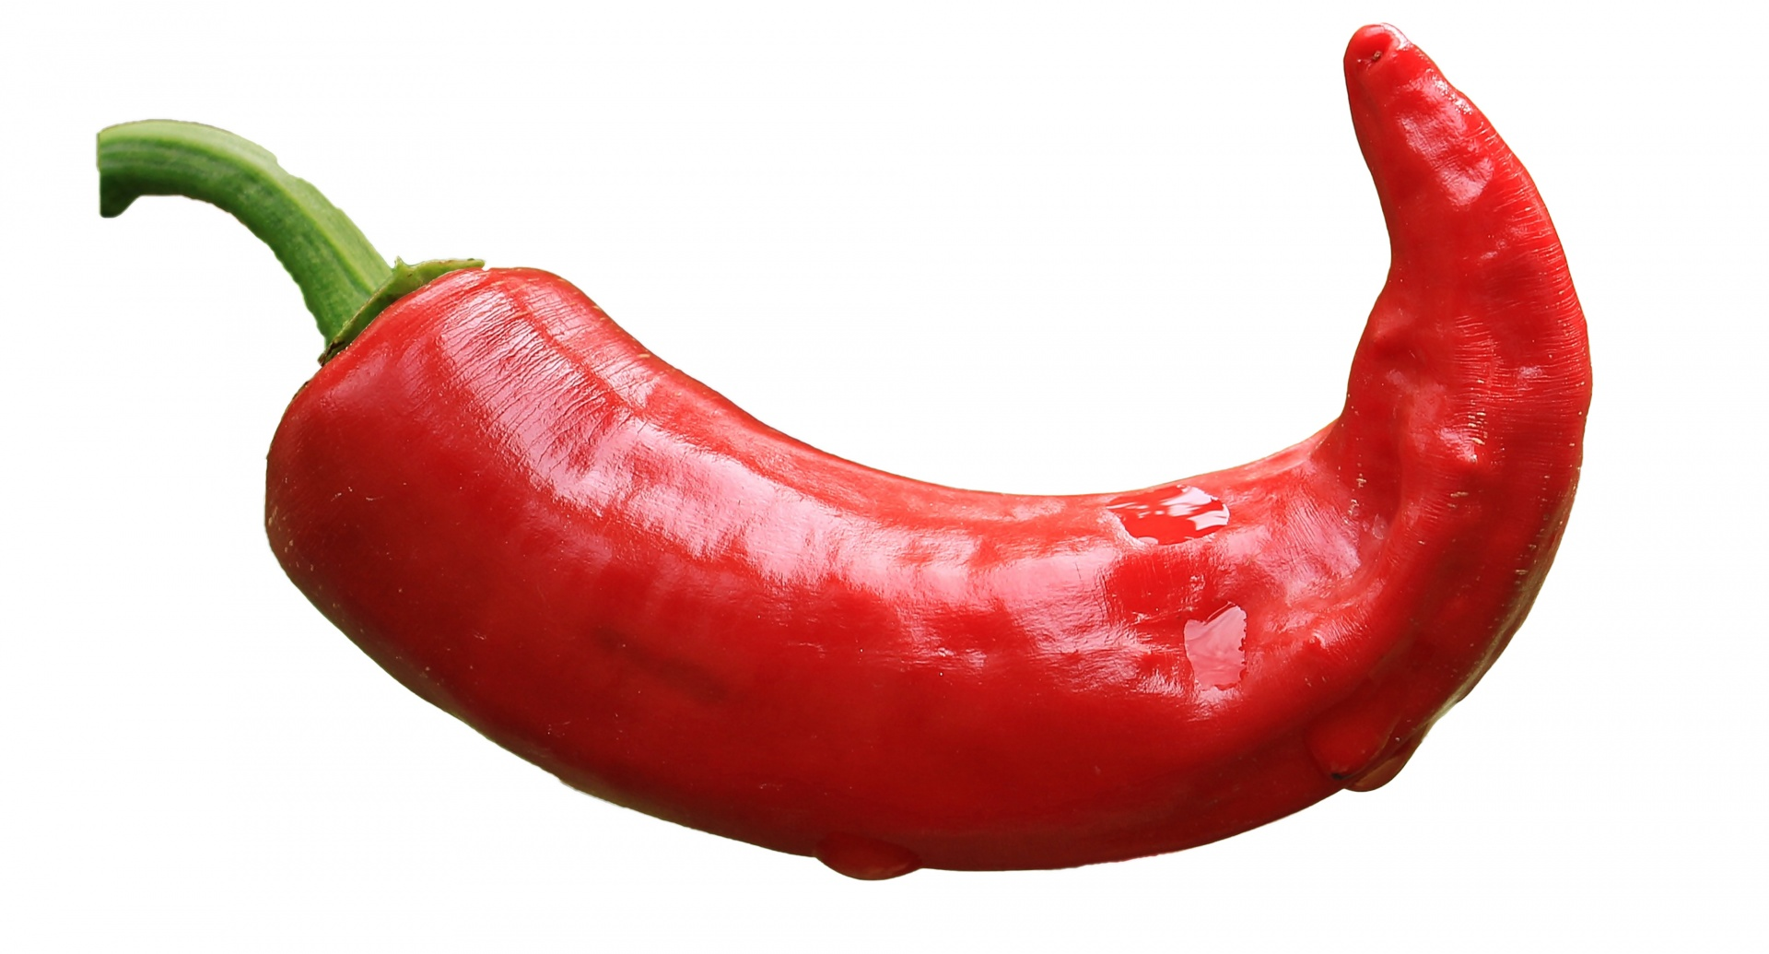
Smoker – This Slide Carries a Health Warning!
Put parcel tape here
Hearth – loose!
An essential Gap
Session 8: Getting Started

Slide 17
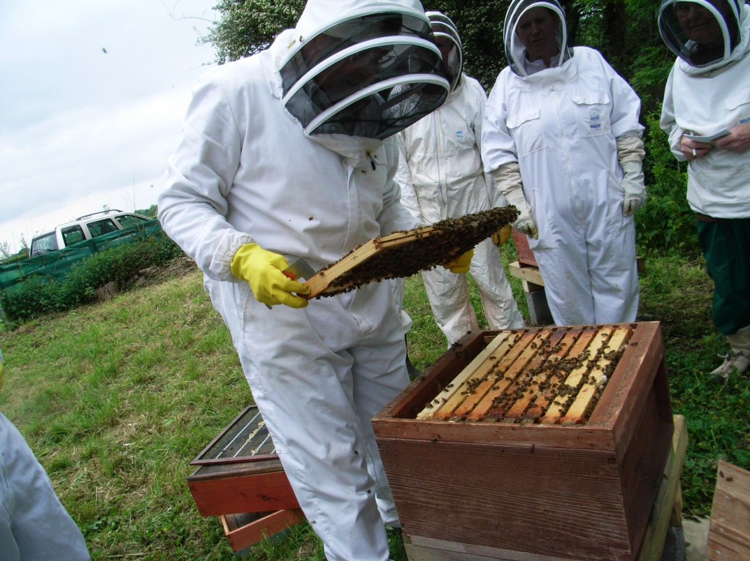
What Next…….
Practice sessions
Place
Date
time
Bring wellies
& washing up gloves
Mentoring??
Session 8: Getting Started

Slide 18
What About Getting Bees?
Sources
Take an experienced beekeeper with you
Talk to other beekeepers
What are the risks?
What are the costs?
What about a swarm?
What about a bait hive?
What about angry bees and viruses?
Session 8: Getting Started

Slide 19
Quick Quiz
What are three signs to consider in relation to anaphylaxis?
  Tingling, Change in breathing, Faster heart beat, rash away from the sting site, sweating, confusion.
What safety preparation might you make if you are going to your hives?
  Phone with you and tell someone where you are and an expected return time
  Know what 3 words for your location
What is an out apiary?
  An apiary away from your place of abode
I have just been stung and have signs of anaphylaxis, what are the what 3 words for this location?
Session 8: Getting Started

Slide 20
Key information
Ludlow and District Beekeepers Association Apiary
Squirrel lane
Ledwyche
Ludlow
Shropshire
SY84JX
https://www.google.com/maps/place/Ledwyche+Brook/@52.3674712,-2.6885753,15z/data=!4m5!3m4!1s0x487069bc98ab1209:0x223cd0316d10c607!8m2!3d52.3754212!4d-2.6781154?coh=164777&entry=tt
What 3 words = swaps.trappings.tester
Session 8: Getting Started

Slide 21
Key information
British Beekeepers Association
National Beekeeping Centre
National Agricultural Centre
Stoneleigh Park
Kenilworth
CV8 2LZ
02476 696679
https://www.bbka.org.uk
National Bee Unit
  FERA
  Sand Hutton
  York, YO4 1LZ
  01904 462510
  https://nationalbeeunit.com
Session 8: Getting Started

Slide 22
Key information
Maisemore Apiaries Ltd
OldRoad
Maisemore
Gloucestershire
GL2 8HT
01452 700289
BJ Sherriff
Carckew Road
Mylor Downs
Falmouth
TR11 5UN
01872 863304
EH Thorne Ltd
Beehive Works
Wragby
Lincoln
LN3 5LA
01673 858555
Other providers are available as well as Amazon and Ebay
See BBKA News
Session 8: Getting Started

Slide 23
Books for Beginners
Practical Beekeeping – Clive De Bruyn
Guide to Bees and Honey- Ted Hooper
The Complete Guide to Beekeeping – Jeremy Evans
Teach Yourself Beekeeping – Adrian & Clare Waring
BBKA News –bimonthly - free for all association members
BeeCraft Beekeeping Magazine – monthly
Session 8: Getting Started

Slide 24
Aims and Objectives
Aim:
To ensure that you are able to consolidate what you have learned, continue to learn and to move on to keeping bees safely and with pleasure.
Objectives:
  To know where to site your hive(s)
  To know what you now need to get started
  To continue your path to further learning about bees
  To understand the risks associated with keeping bees and to mitigate them and take appropriate safety steps
  To have access to appropriate sources of further learning and information
Session 8: Getting Started

Slide 25

Questions?
Notes:
25

