Slide 1

Ludlow & District Beekeepers Association
Session 7 (Chapter 7 of the book)
An Introduction to Beekeeping:
Swarms
Session 7: Swarms
1

Slide 2
Aims and Objectives
Aim:
To enable you to manage the process of swarming and to minimize the adverse impacts on beekeeping, the public
and the colony
Objectives:
  To know the reasons a colony swarms
  To recognize the signs a colony may be preparing to swarm
  To be able to react to the signs of potential swarming
  To know how and why we need to influence swarming
Session 7: Swarms

Slide 3
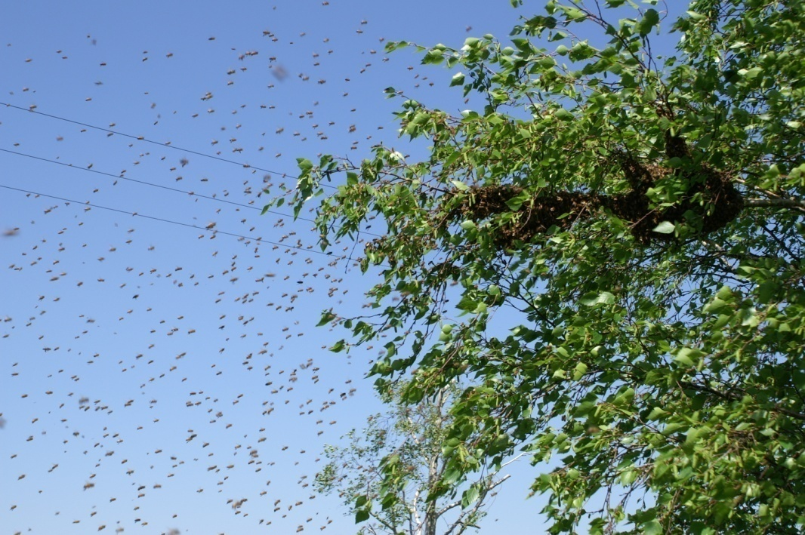
Reasons for Swarming
Natural means of
colony reproduction
Colony too crowded
Unbalanced colony
Queen getting old
Absconding
Session 7: Swarms

Slide 4
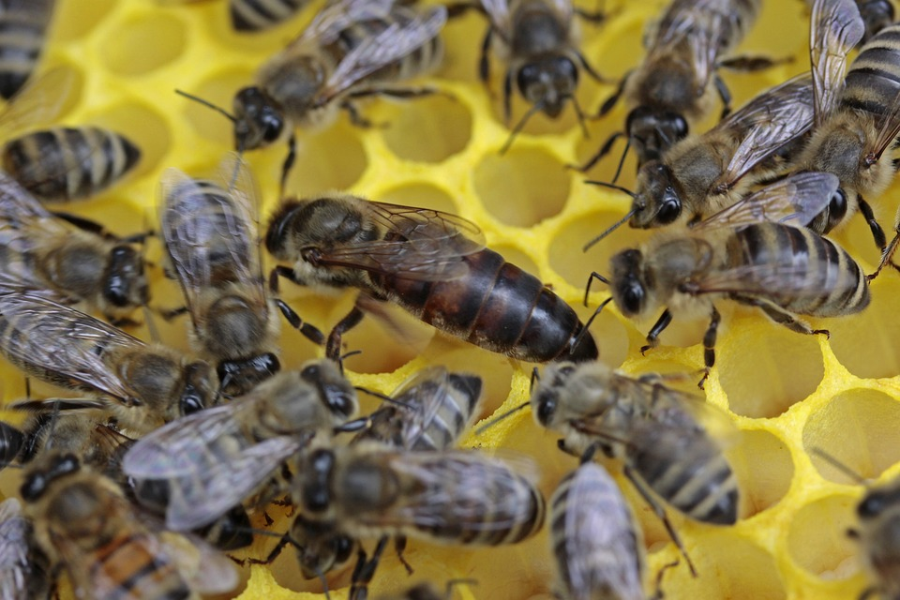
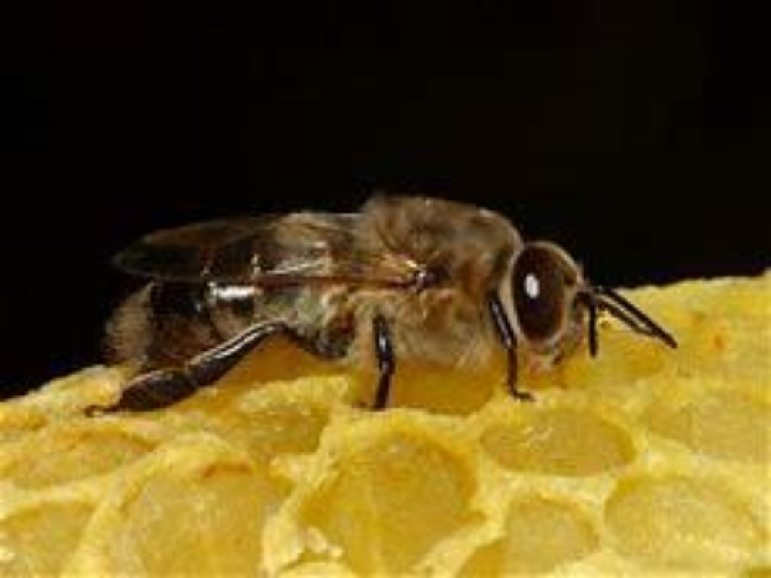
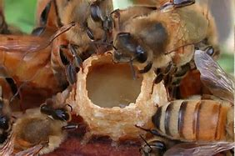
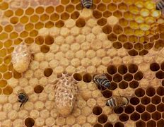
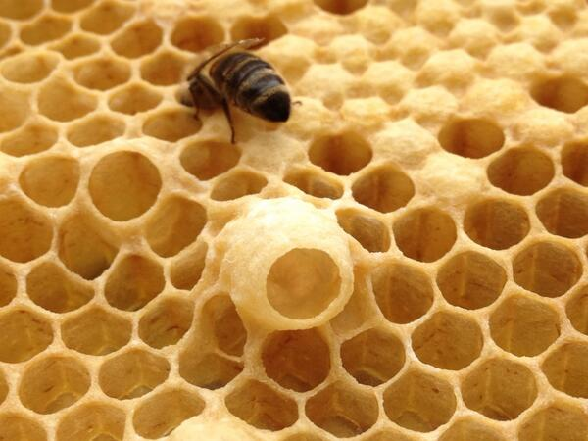
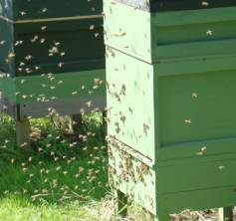
Preparation for Swarming
Drones
Play-cups
Charged
Queen Cell
Capped
Queen cells
Preparing the
Old Queen
Departure
Session 7: Swarms
Notes:
Speaker Notes
No Colony would ever consider Swarming if there were no Drones for the Princess to mate with. No worries for the Beekeeper!
After the Drones appear then the next stage is ‘Play cups.’ These are small acorn shaped cups hanging from the frame. The Bees are getting the Idea!
Now full sized Queen cells are built into which the Queen lays a fertile egg. As soon as this hatches the nurse bees feed the larva with the famous Royal Jelly. This switches her from a fertilised but inert worker into a fully functioning Queen. We are now a week before the actual event.
On day 8 the Queen cell is capped.
During this period the Old Queen will be on lean rations. This will cause her to cease egg laying and to slim down ready for flying.
6) The Prime Swarm Departs

Slide 5
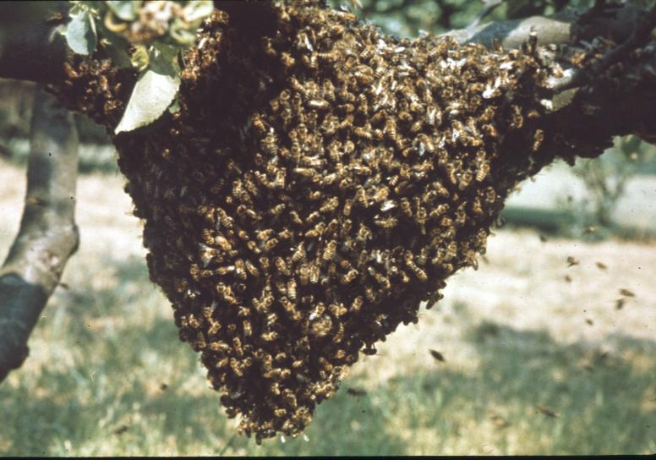
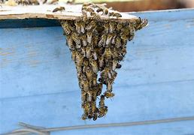
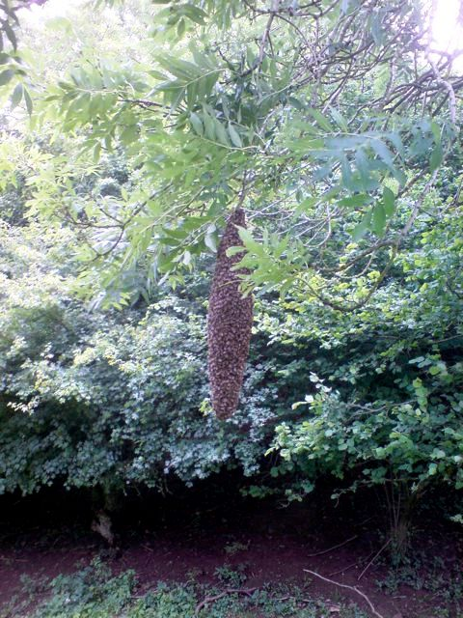
Prime Swarm and Casts
Prime Swarm
– half the workers
Casts – Virgin Queen plus
progressively less workers
Viability of Casts?
Viability of parent colony?
Session 7: Swarms
Notes:
Speakers Notes.
Remember- the Old Queen will take 50% of the workers and a lot of these will be the Young House-builder Bees. These are needed to physically build the new Colony.
Bees Hedge their bets. There are always multiple Queen cells. And these are capped. Normally the First Queen to emerge would eliminate her sisters by stinging them through the side of the cell walls. She is then undisputed Virgin Queen and will proceed to Mating. HOWEVER If the colony was very strong then the Colony may permit a Cast using a Queen from a second cell. This Virgin heads a cast, or second Swarm- and she takes another 50% of the remaining workers. If a third Virgin Queen emerges this process could be repeated until the colony decides to keep one for themselves.
So are these cast viable?. Short answer is no. These Queens are virgins and generally there will be too few workers with them to build the new home.
And this also dooms the Parent colony. They may have hatching brood emerging but now don’t have enough foragers or nurse bees to look after them. They will get chilled.

Slide 6
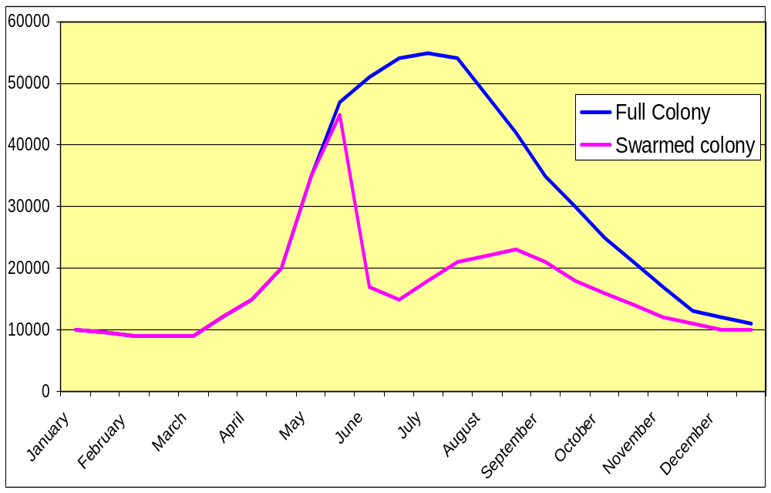
Impact of Swarming
Colony swarms
Foragers lost from parent colony
15,000
Main nectar flow
Session 7: Swarms
Notes:
Speaker Notes:
Another Graph!
The Vertical axis shows the population whilst the Horizontal shows the Beekeeping year.
The Blue line shows the population of the colony without swarming.
The Pink line shows the effect of Swarming on the colony!
And the hashed area is all the lost bees. Half will be young bees but the other half will be foragers. Say 15000 bees. Now 12 bees produce a teaspoon of honey in their lives. Multiplied up that means that you have probably lost 30 to 40 lbs of honey. And this during the Main Nectar Flow!
So as beekeeper what you do is determined by your reasons for Beekeeping.
If it’s Honey production then the swarm is a disaster. Perhaps just remove the Old Queen and let them get on with it. You have removed one leg of the trinity and retained the Foragers- and your Honey Crop. And you have a new young Queen.
If its to Protect and Nurture Bees then Maybe a Split is best for you.
You gain two strong viable colonies with the best chance of survival.

Slide 7
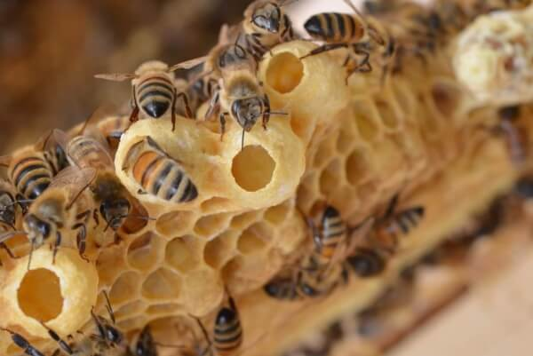
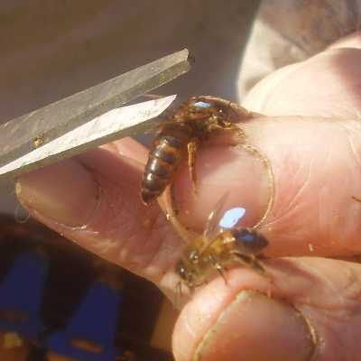
Swarm Prevention
Regular Inspections
- weekly
Young Queens
< 2 years old
Room in brood
space for Queen to lay
Room in super
space for nectar to be
stored
Know what to do when
Queen cells are seen
with eggs or larvae
Mark & maybe clip Queen
Session 7: Swarms

Slide 8
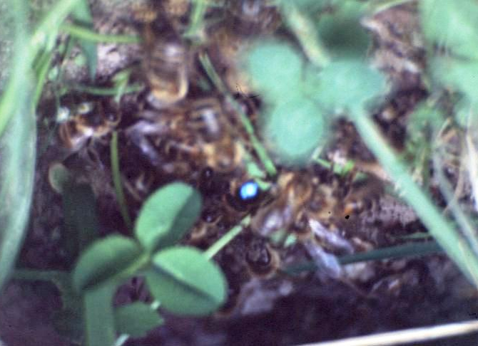
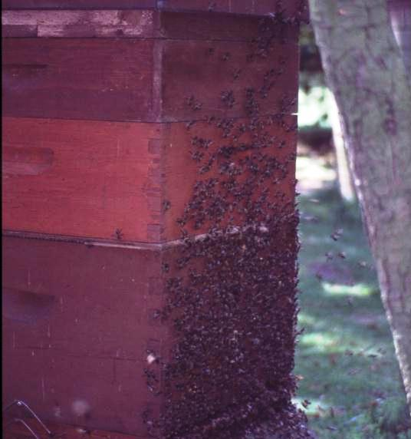
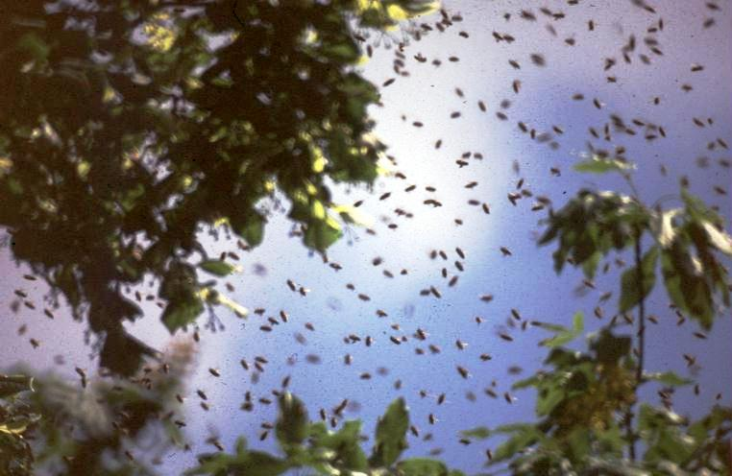
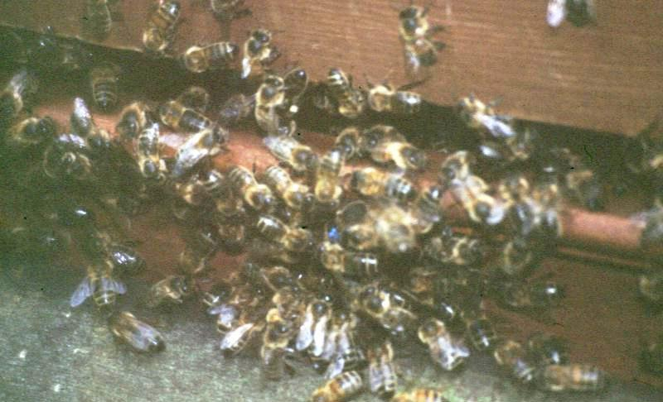
Effect on Swarm of Clipped Queen
Swarm is not lost
Workers return to hive
Queen may return
to hive
The Queen may
not return
What do you do now?
If the Old Queen has
returned then Split!
If she has not returned
then reduce Q. Cells.
Session 7: Swarms

Slide 9
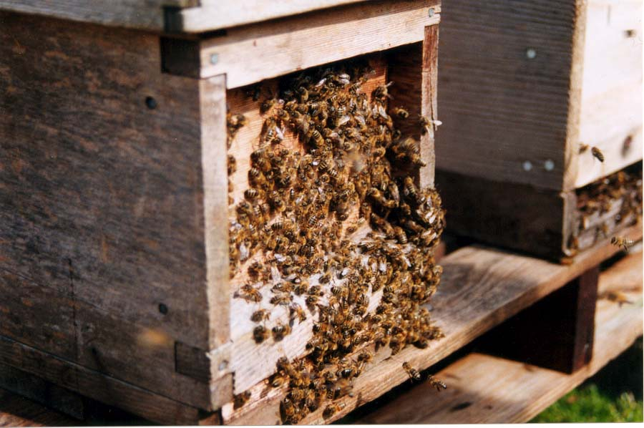
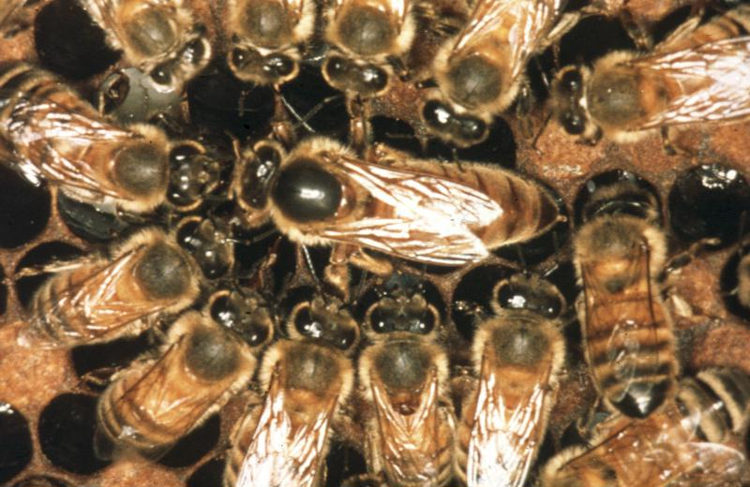
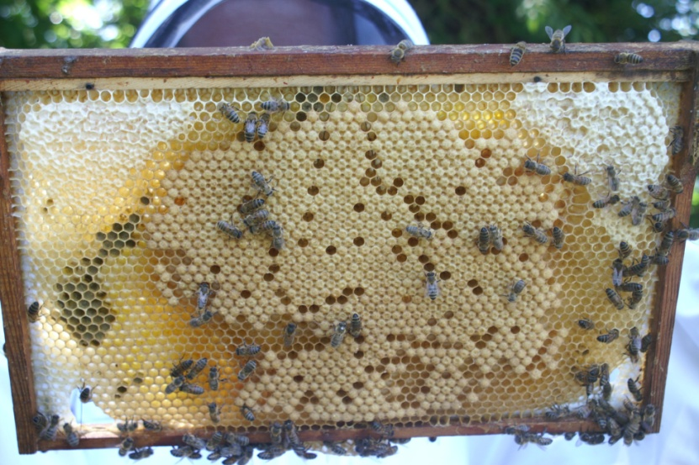
Swarm Control Basic Principles
Colony made up
of 3 parts:
  Queen
  Brood, Nurses
  Flying bees
Session 7: Swarms

Slide 10
Swarm Separation
Swarm control involves separating one of the three parts from the other two:
  Queen from Brood and Flying Bees
  Brood from Queen and Flying Bees
  Flying Bees from Queen and Brood
Session 7: Swarms

Slide 11
Artificial Swarm Method – Stage 1 - Day 1
- Examine all frames
- Remove all sealed Q Cells
- Leave 2 open Q Cells containing a grub
Original Stand
Super off
B
A
Q
Flying Bees
New Box ‘B’
- Find the Frame with the Queen in Box A
- Destroy all Queen Cells on this frame
- Move frame with Queen on to Box B
- Fill Box B with drawn and foundation frames
Session 7: Swarms
Notes:
Speaker Notes
Lets just call this a split. Its what we are doing.
But- We must end up with the Old Queen plus Workers plus food in Box B and a Charged Queen cell plus Brood plus Nurse Bees in Box A
1. Remove all Supers. Put them on a crown board on the ground and put another crown board on top of them. This keeps the little beggars out our way.
Now we move the Whole hive onto a new stand just to the Right Hand side of its original position. (Green)
Now we place a new Chamber B on the Left. (Yellow)
Go boldly into chamber A. Find the Queen and move the frame, with her on it, into the centre of new Chamber B. If this frame has any Queen cells on it they must be destroyed.
Fill Chamber B with any frames from A that contain stores or drawn foundation. Fill spaces produced in A with new frames.
6. Any Queen cells on any frames in B are destroyed. Then back on with the QX, Supers, Crown Board and roof. Its boxed off.
7. Now back into A. Examine the frames and remove any capped Queen cells. Reduce the Charged Queen cells to the best 2. Fill any spaces with drawn frames. You can move the Dummy board closer to the brood nest to reduce the space required to heat. Crown board and Roof on. Boxed off!
8. So what have we done? Brood Box A contains 2 Charged Queen cells, Nurse Bees to nurture them, Brood to emerge as workers and finally Food. The bees will now Bring on their new princesses. They think that they have swarmed!
8. In Brood Box B however we have a Queen with very little brood but plenty of workers. She thinks that she has swarmed! Everyone is Happy!

Slide 12
Artificial Swarm Method – Stage 2 - Day 7
Queen Cells now sealed
Original Stand
Super
Feeder
Q
Qc
Qc
A
B
New Box ‘B’
Move BOX A to other side of BOX B
- Examine all frames
- Remove all Q Cells
Session 7: Swarms
Notes:
Speaker Notes
We now Examine the Old Colony B. First off we Remove any Queen cells that we may have missed last week. The strength of this colony will have been enhance by foragers from returning to the original site from box A.
Examine the new colony A. Hopefully the Queen cells will now be capped. If necessary feed this colony.
So Why swop the brood boxes around again? Its to gain more foragers! Bees that have emerged and become foragers in A will be fooled into entering B thus strengthening it. If both colonies have plenty of food you can miss this stage.

Slide 13
Artificial Swarm Method – Stage 3 - Day 14
Old Queen should be laying well
First VQ to emerge attempts to kills other VQ.
Super
Feeder
After a further week check for Q Cells
Do not open
For 3 weeks
Q
A
B
Flying Bees from both Boxes A & B
Strengthen foraging force
Virgin Q flies out to mate
Session 7: Swarms
Notes:
Speaker Notes:
End of the second week!
In the New colony B the first Virgin Queen has emerged and will attempt to kill her sister by stinging her through the cell wall. We now leave her to Mature, Fly and to meet the boys.
Check the Old Colony A once again for more Queen - destroy them if found. The Old Queen Should have come into lay.
Be prepared to feed either colony if short on stores.

Slide 14
Stage 4 Day 35+
Now you can at last check Colony A. With luck it will have a viable Queen who has started to lay. Continue feeding if necessary
Check the Old Queen in Colony B. How is this colony doing?
What are we going to do next?
  Keep two colonies?
  Merge later in the season, keeping the new Queen?
  Sell one and help finance the Bees?
Session 7: Swarms
Notes:
Speakers notes.
We should now have two colonies. The old Queen is merrily laying away in Box B whilst the New Queen in A has bee successfully mated, Matured and come into lay. Job done!
So What now.
We could keep two colonies,
We could merge them together later in the season, keeping our New Queen.
Yes, sell the old one and use the cash to buy new equipment.

Slide 15
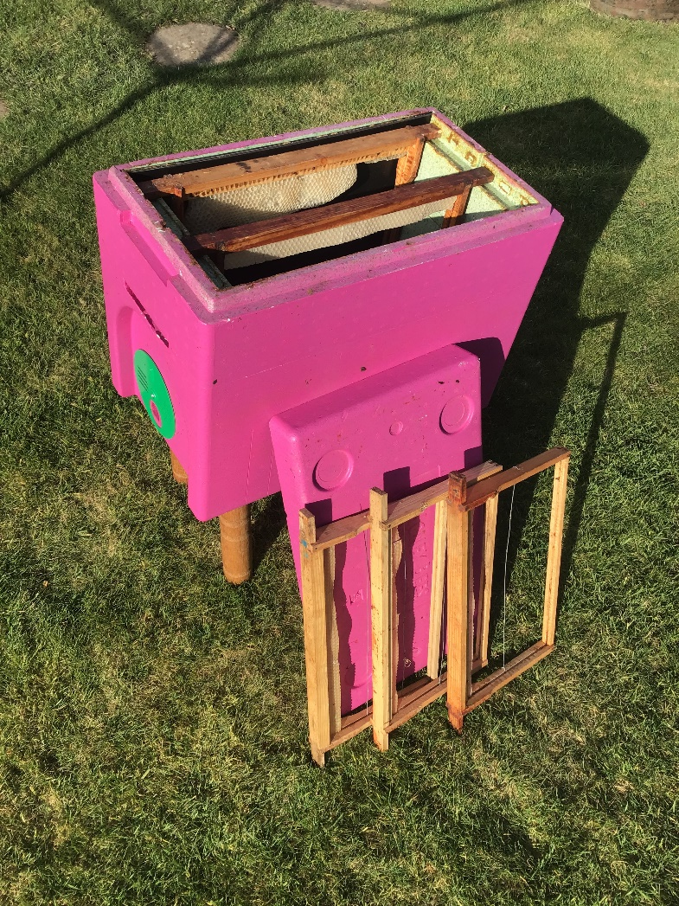
Bait Hive
Session 7: Swarms
Notes:
Speakers Notes
This is just a 6 frame Nucbox used as a Bait Hive. It contains 1 frame with old pulled foundation for it’s welcoming smell and 5 frames with just ½ “ of wax at the top. The Scout bees will measure the volume and hopefully declare it suitable. It’s lots easier than chasing Swarms! The ½” of wax makes certain that they pull the frames out in the right place.

Slide 16
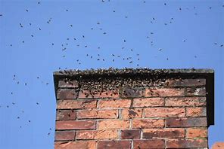
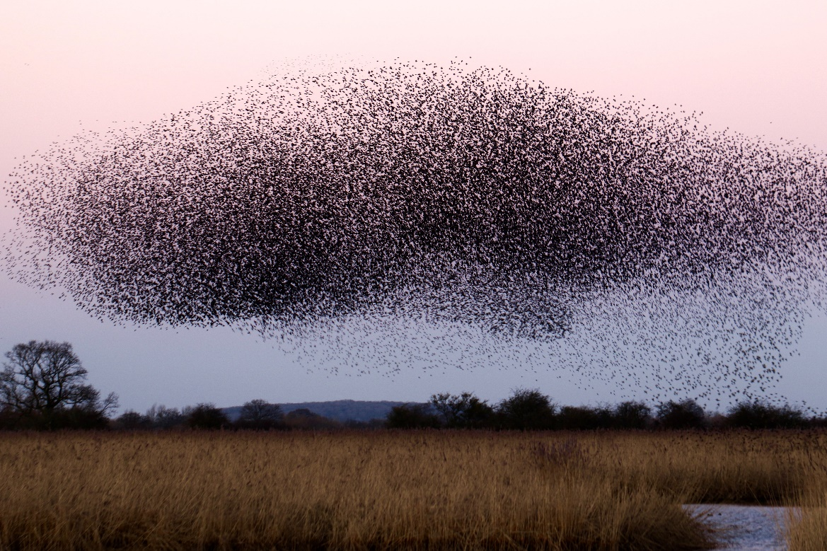
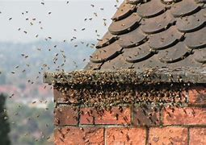
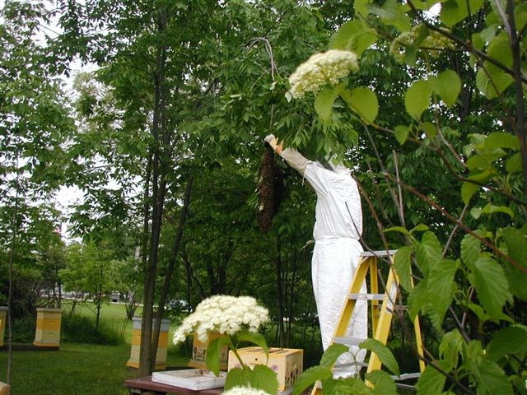
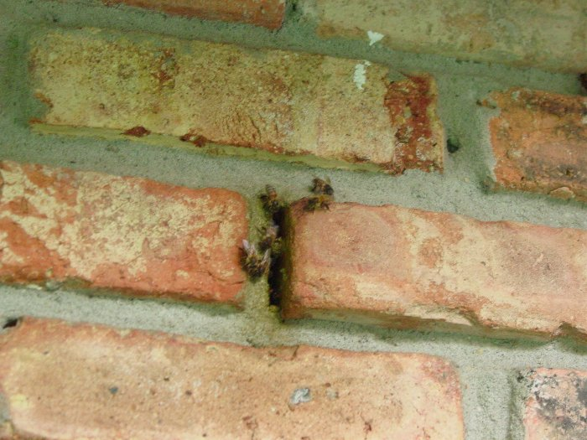
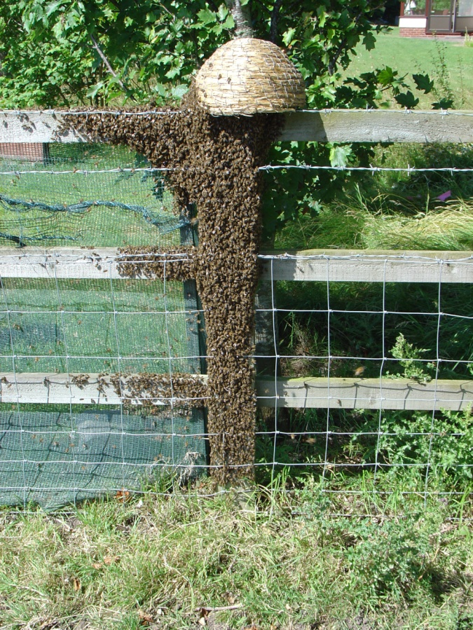
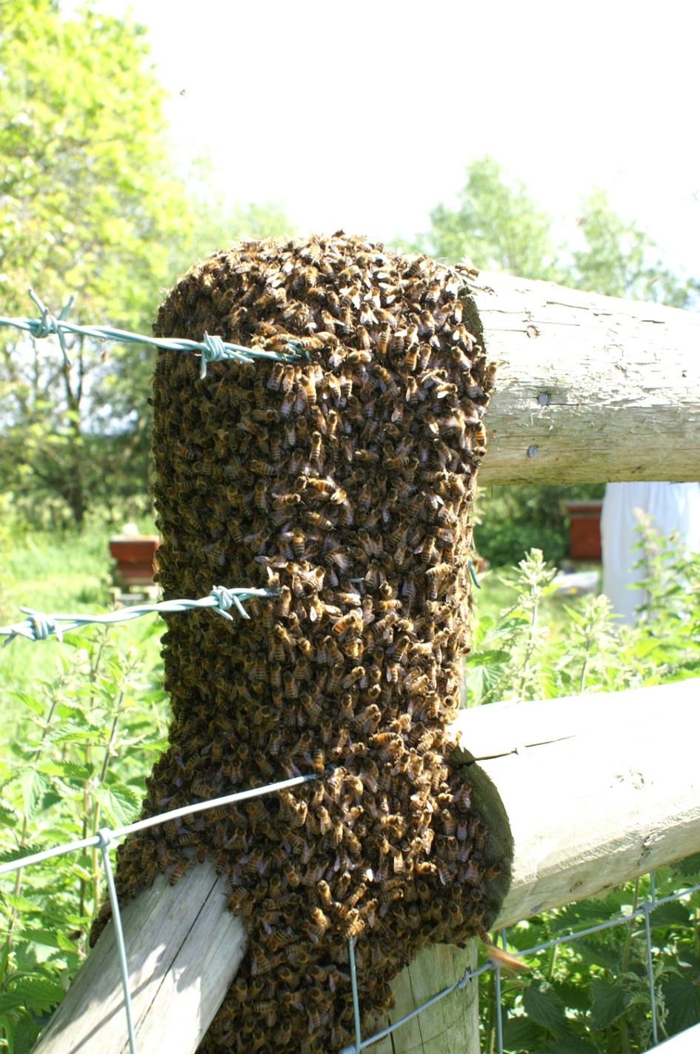
Swarm Collection Locations
Rest nearby
  Trees, hedges,
  posts etc.
Scout bees look
for home
Collective agreement
Fly off
Popular sites
  Chimneys
  Roof spaces
  Walls etc.
Session 7: Swarms
Notes:
Speakers notes:
Oooops- we lost them! Now comes the rite of passage for new Beeks.
Swarms come in two types. The friendly ones that land 5 foot off the ground on a bare branch- and the Swineish ones who test the Beekeepers metal.
The first type are the ones who didn’t do their homework. They land nearby while they wonder what to do.
Now the scouts go out looking for a suitable home., coming back and informing the cluster of their discoveries by performing a modified Waggle Dance.
Finally the swarm picks the most enthusiastic dance, form an agreement-
Scout bees then lead the swarm to a new location - And off they go.
Bees pick sites for themselves, not for us. And some can really annoy the Neighbours!
a) Chimneys. Immediately they are in light your smoker and put it in the grate. Smoke them out befor the build collateral in the form of wax or eggs.
b) Roof spaces. If you can soke them out from underneath then OK. You are not insured for Building work!!!!!
c) Now you’re in it.

Slide 17
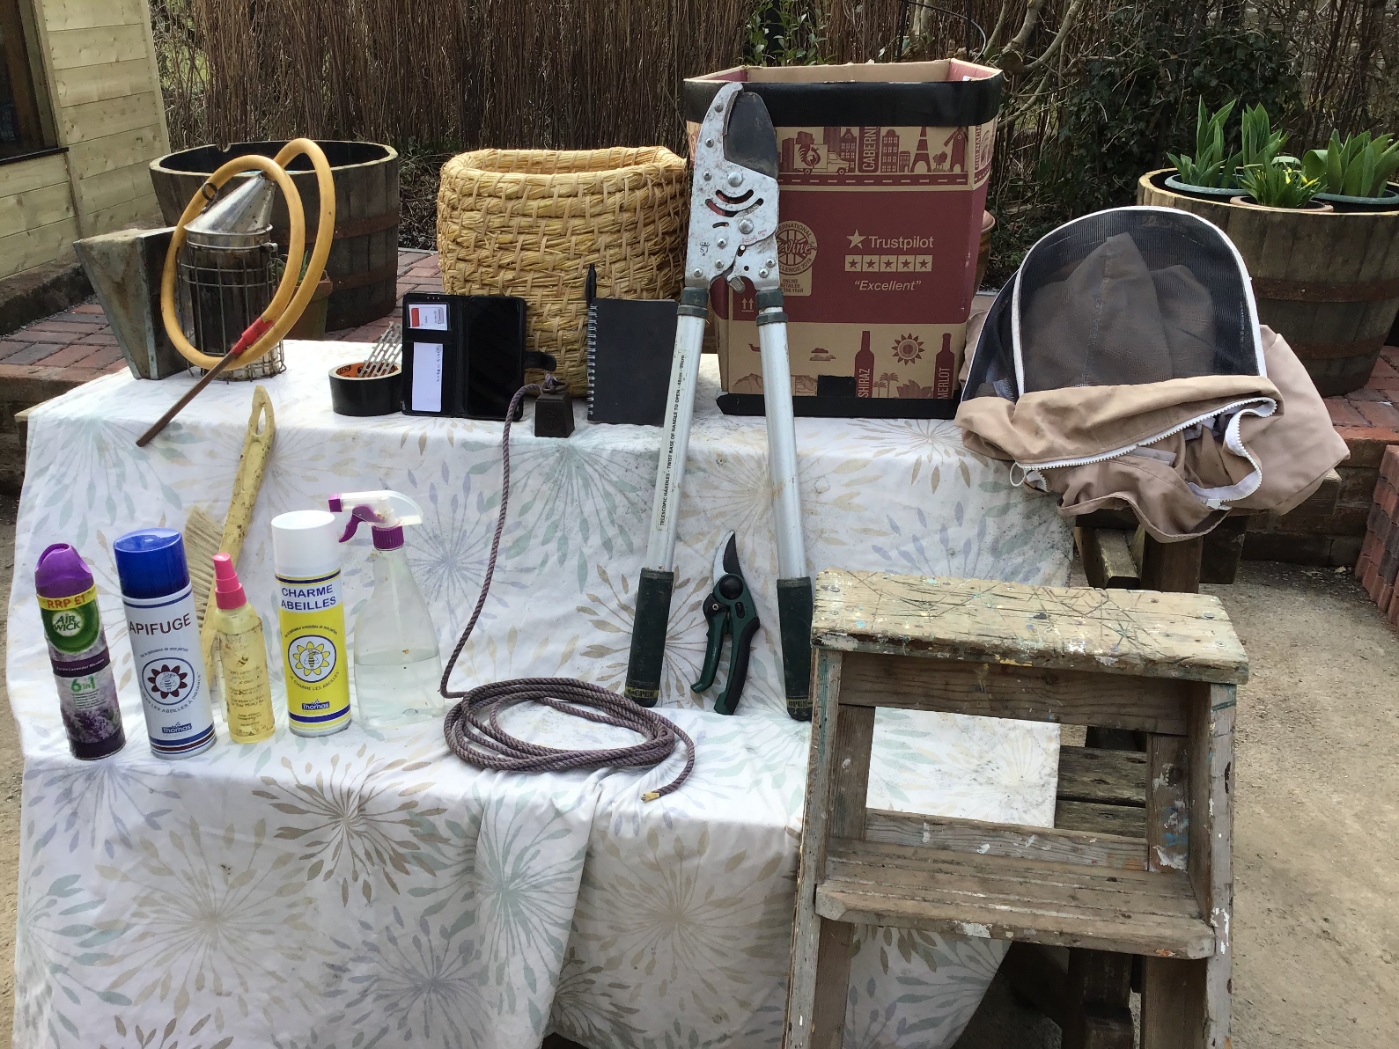
A Swarm Collection Kit
Session 7: Swarms

Slide 18
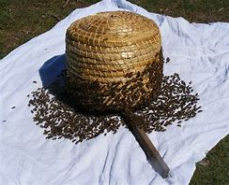

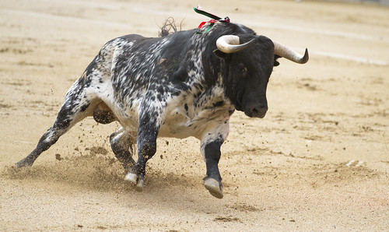

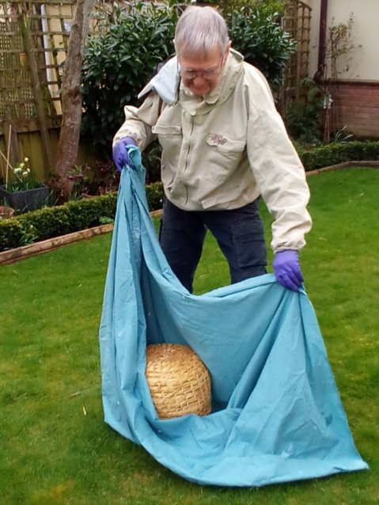
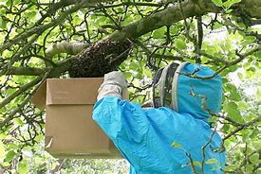
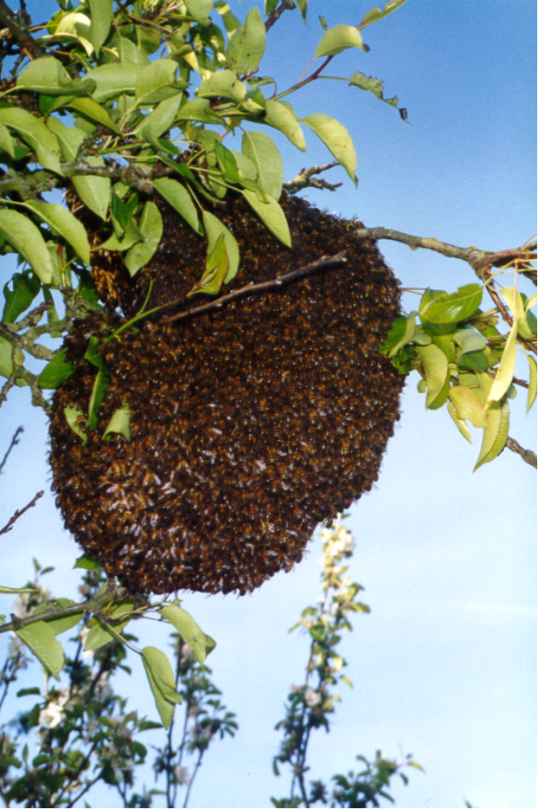
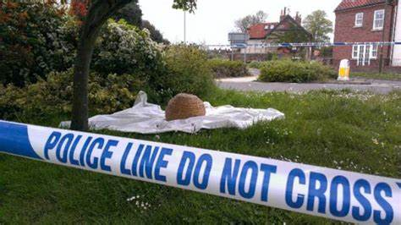
Swarm Collection
Have your Kit ready!
Insurance.
Obtain permission from
the landowner
Ensure the public are kept
away from the swarm
Drop the swarm into the box
Invert the box on the cloth.
Retrieve the queen and
the rest will follow
Wait for all the bees to
join the queen
Take away and
re-hive the swarm
Session 7: Swarms

Slide 19
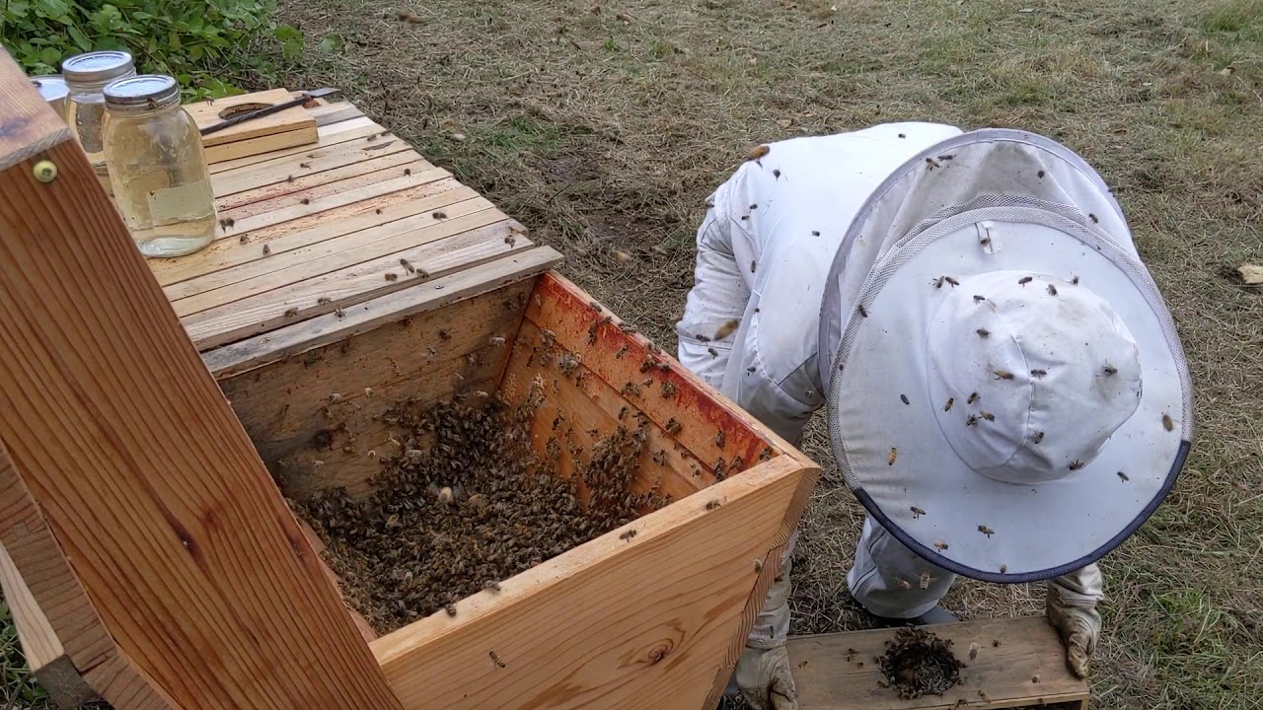
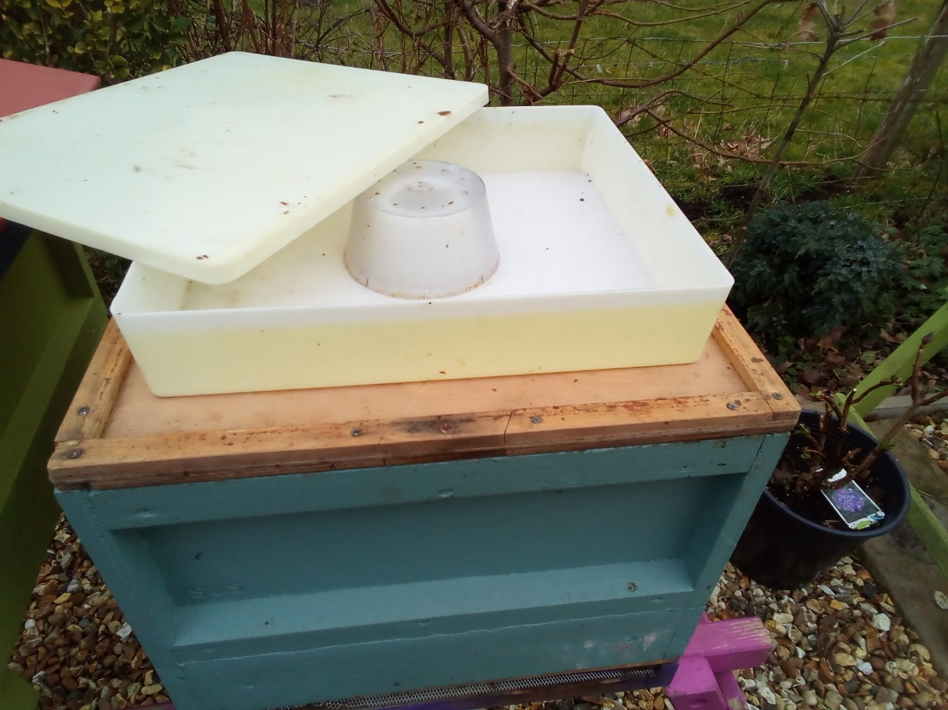
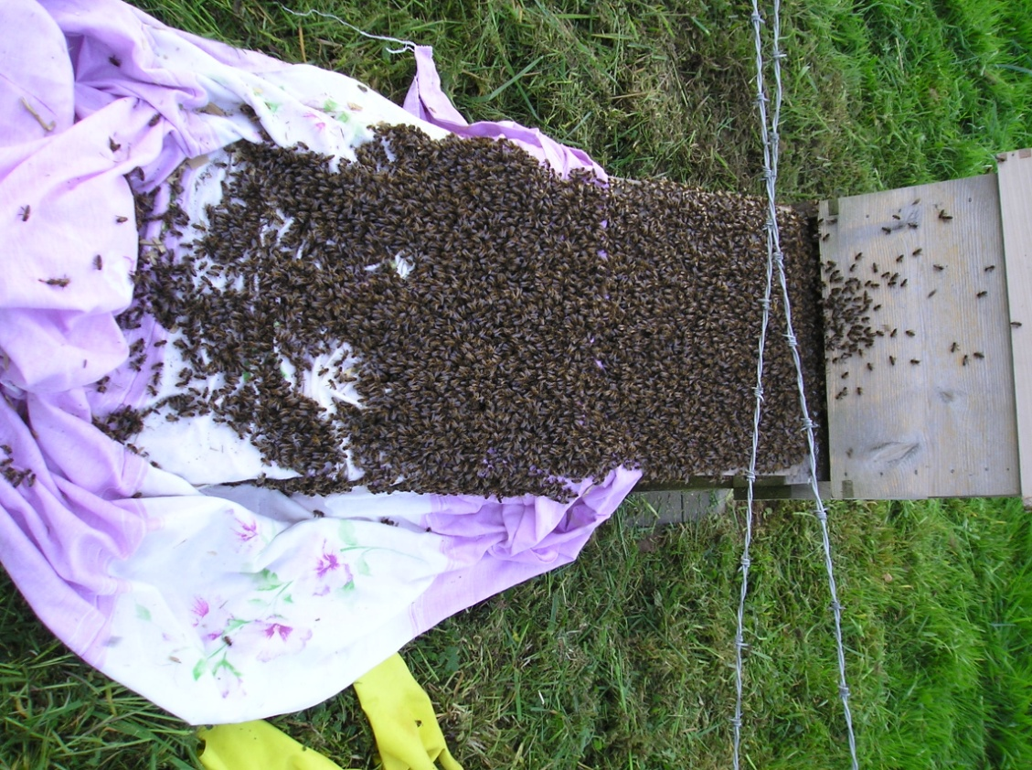
Hiving a Swarm
Walking the Bees
Directly into a box
Feed after 2 days
Check for disease
Session 7: Swarms

Slide 20
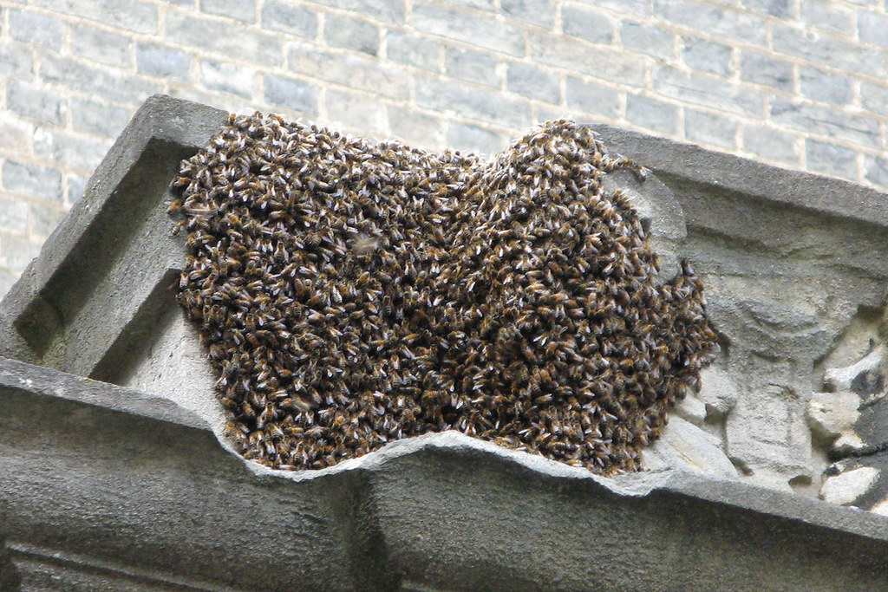
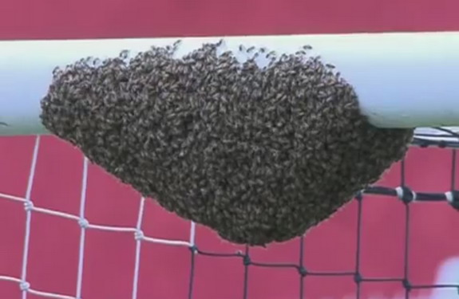
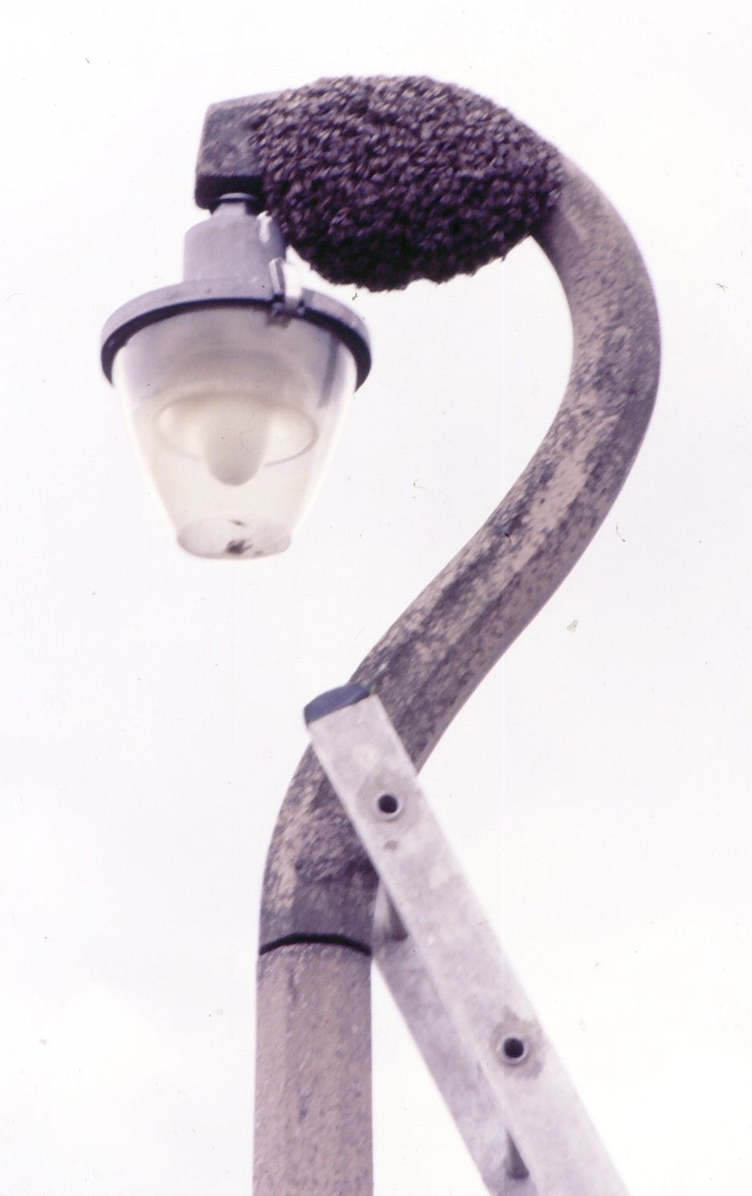
Difficult Locations
Session 7: Swarms

Slide 21
Quick Quiz
What is the best time to hive a swarm?
What are swarm scout bees looking for?
Evening. They will wake up in a new hotel.
A dry cavity with enough space for the colony to expand into.
Session 7: Swarms

Slide 22
Quick Quiz
What are the implications and opportunities of a swarm with a clipped queen ?
The swarm will gather outside the hive and go back home?
You may get a cast with a virgin queen?
You can perform a split if there is more than one queen cell?
Session 7: Swarms

Slide 23
Quick Quiz
As a new beekeeper what are the pros and cons of accepting a swarm?
Do you know where it has come from?
Could it be diseased?
What could be the implications on your existing hives?
It saves time and money?
Session 7: Swarms

Slide 24
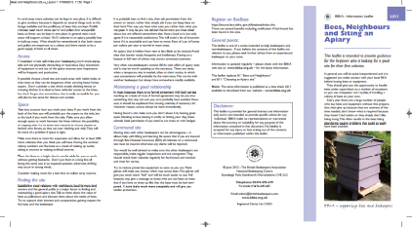
Next Session
Read the following sections of your book for the next session
  Chapter 10 – Getting Started
  Read Chapter 9 – pages 180-189 on extraction
  We are going to be learning about setting up an apiary and associated issues
  Pre read handout about ‘bees and neighbours’ on the catch-up page
Date of next session: 29/3/23 at 7.00pm – 9pm at Ashford Carbonel Hall
Session 7: Swarms

Slide 25

Questions?
Notes:
25

