Slide 1

Ludlow & District Beekeepers Association
Session 6 (Book chapter 9)
An Introduction to Beekeeping:
Plants and Hive Products
Session 6: Plants and Hive Products
1

Slide 2
Aims and Objectives
Aim: To understand the relationship between bees, plants and the production and sale of honey
Objectives:
  To identify the needs of bees for the collection of nectar and pollen
  To know how bees communicate with each other
  To recognise the relationship between plants, bees and the economy
  To describe the legal requirements for the production and sale of honey
Session 6: Plants and Hive Products

Slide 3
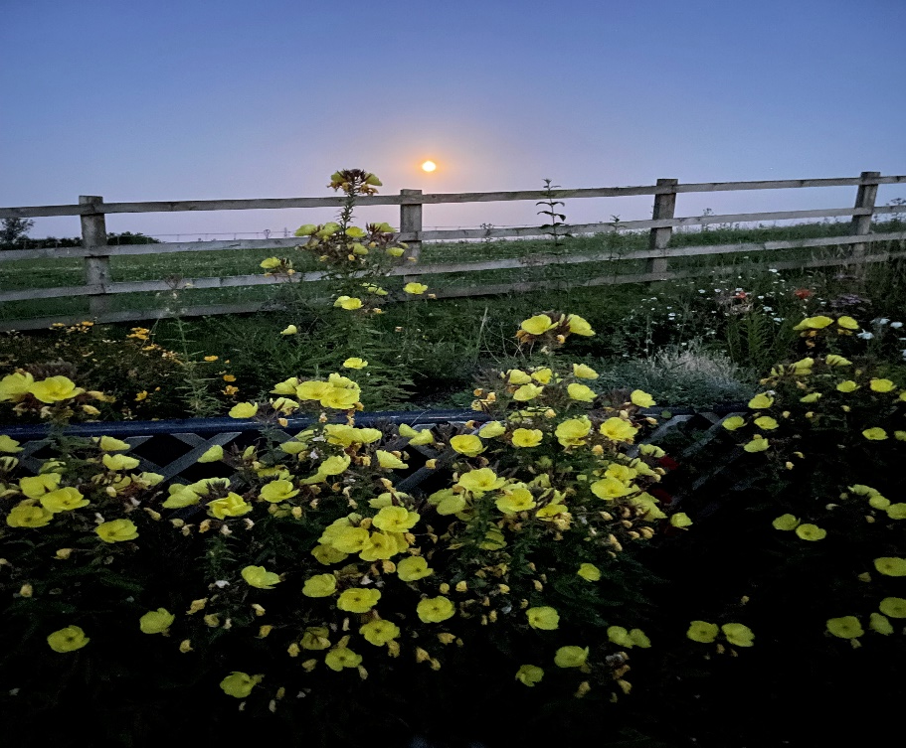
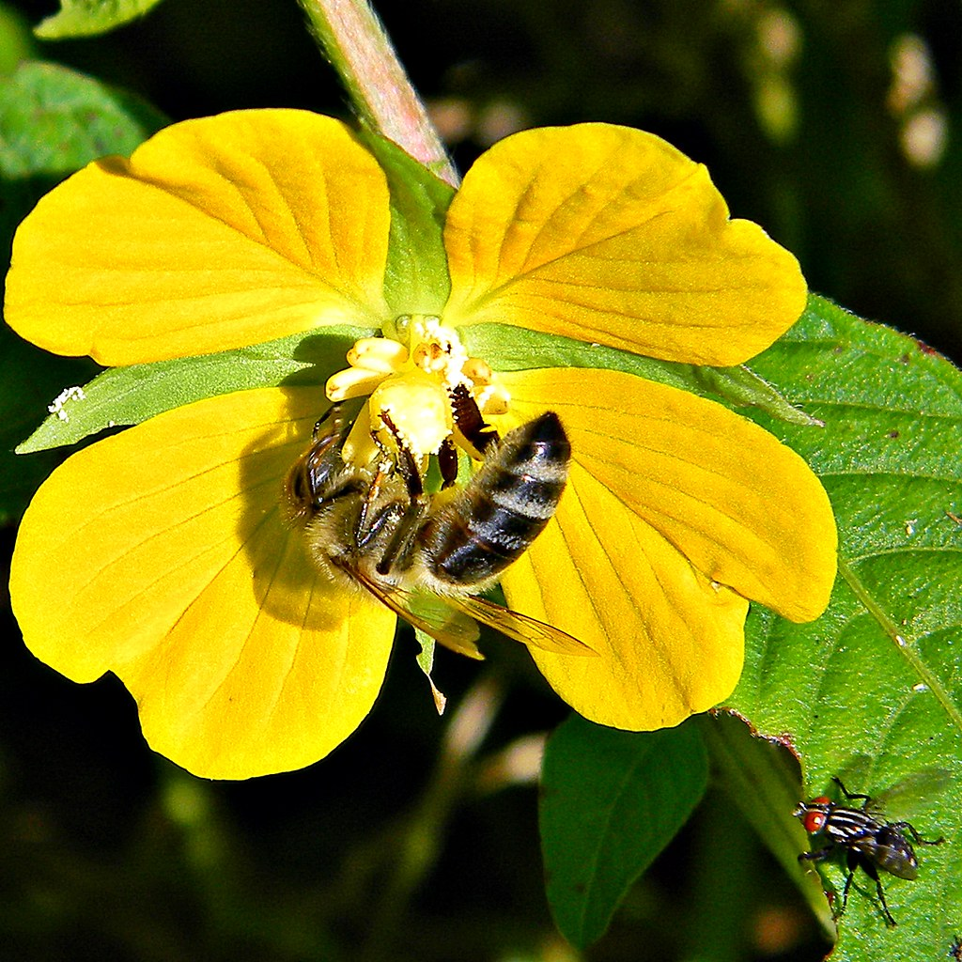
Plants, Bees and Pollination
One of the oldest inter-species relationships on Earth
For the plant: Pollination and survival without having to move
For the bees: Food and survival
Plants have many strategies to
attract pollinators
(e.g. evening primrose)
– it’s their reason for flowering
Plants only produce nectar prior to setting seed
Honey bees are the ‘heavy lifters’ of pollination because:
  There are many of them
  They can navigate accurately
  They can communicate
  They require a lot of forage
Session 6: Plants and Hive Products
This Photo by Unknown Author is licensed under CC BY

Slide 4
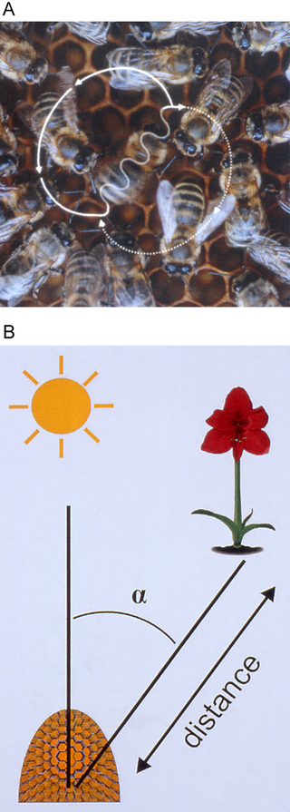
Communication
  Waggle dance (Karl von Frisch)
  Scouts source nectar and return
  with a sample
  The dance is done on the
  vertical face of comb, in the dark
  Run around in a figure of
  eight then across the centre in a
  straight line waggling
  Angle of straight path to
  the vertical indicates direction
  of the food source relative to the sun
  Rate of dance, duration of buzz,
  number of figures of
  eight indicate distance of food source
  Agitation acts as a recruiter
Session 6: Plants and Hive Products
J. Tautz and M. Kleinhenz, Beegroup Würzburg

Slide 5
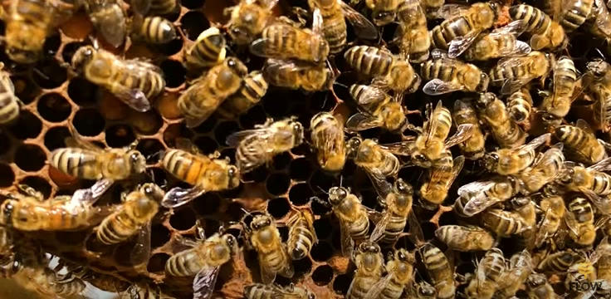
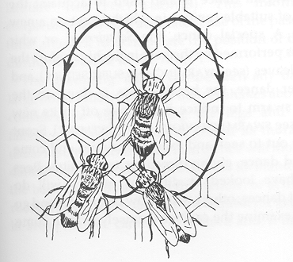
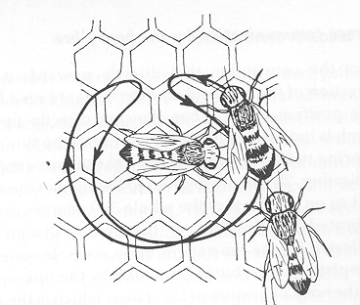
Bee Dances
Round Dance –
(General location)
food nearby
Session 6: Plants and Hive Products

Slide 6
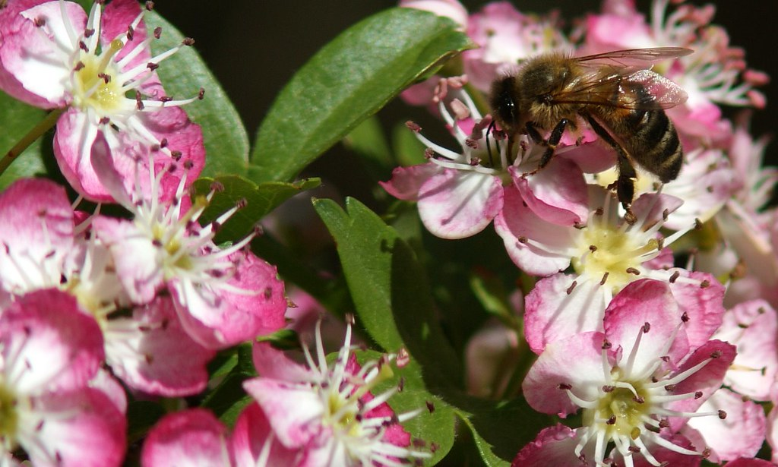
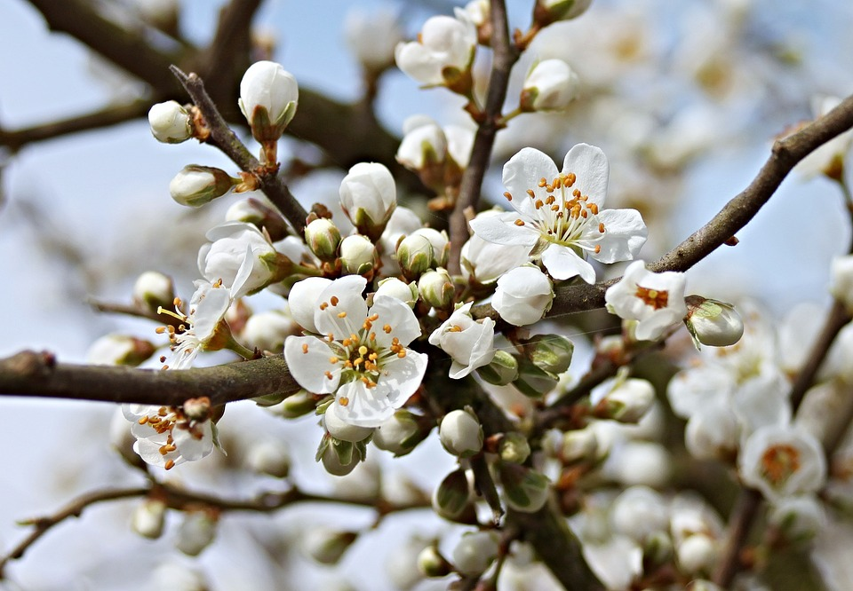
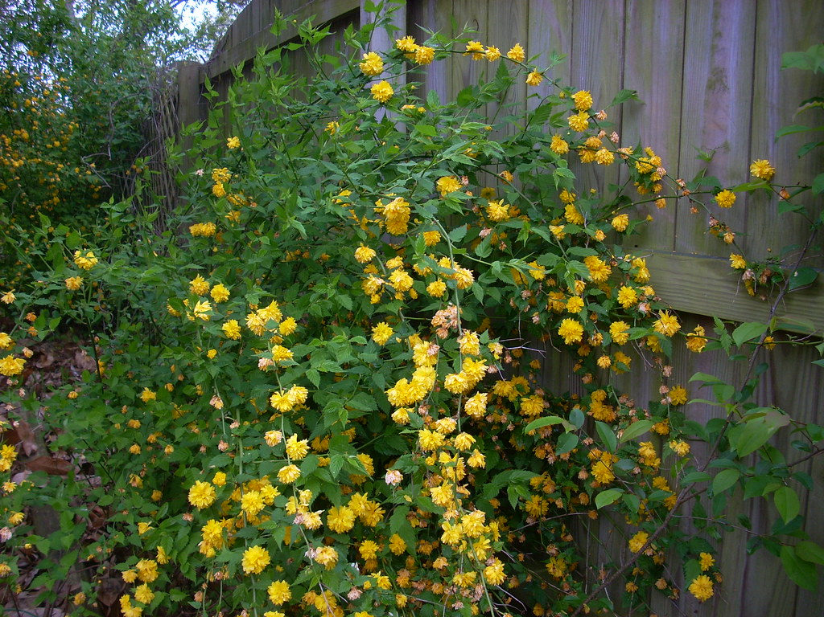
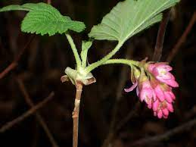
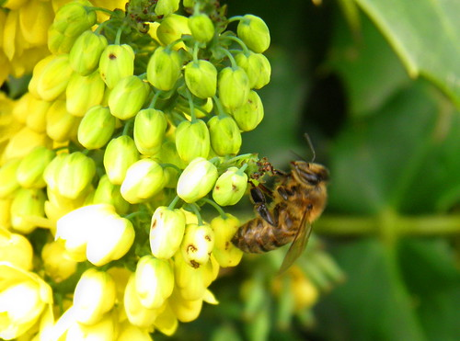
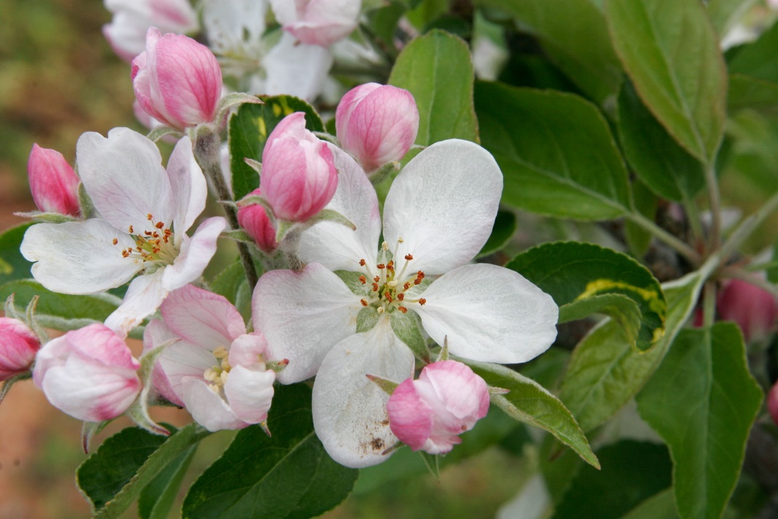
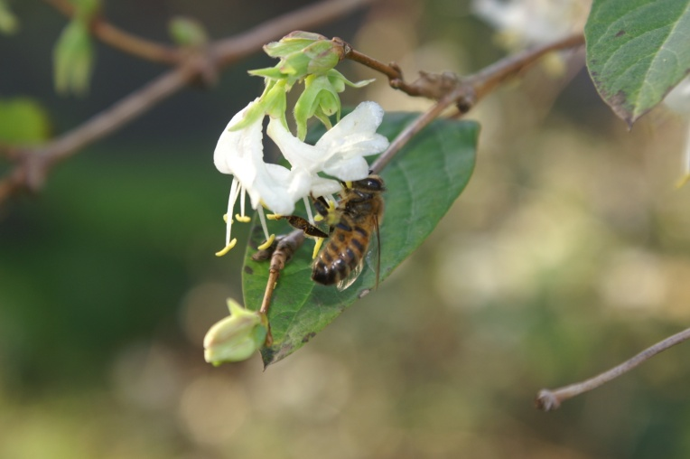
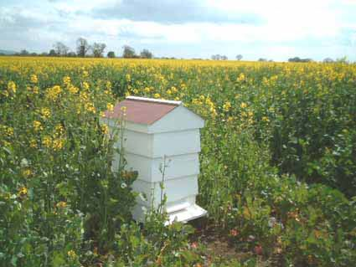
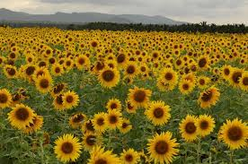
Some Plants Pollinated by Honey Bees
OSR +10%
Beans
Top fruit
Soft fruit
Sunflowers
Blackthorn
Hawthorn
Mahonia
Kerria
Almond
Session 6: Plants and Hive Products

Slide 7
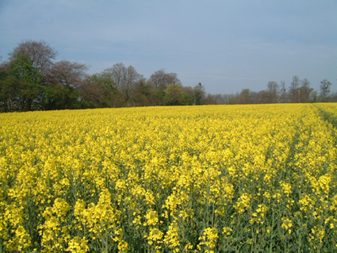
Hard Work
Bee flight
  0.5 mg honey per Km
Bees carry nectar, pollen, water and propolis
  approx. 40 mg
  ~30,000 trips per pound
  of honey
  Trip: approx 30 mins
Phenomenal rate of collection
Session 6: Plants and Hive Products

Slide 8
Forage Chart – Major Honey Plants
July | August | Sept / October
Bell Heather | Bell Heather | Ling
Blackberry | Blackberry | Mustard
Limes | Ling
White Clover | Mustard
Willowherb | Red Clover
OSR | Willowherb
Borage
Feb / March | April | May | June
 | Plumb | Apple | Blackberry
 | Damson | Dandelion
 | Cherry | Hawthorn
 | Pear | Sycamore
 | OSR | OSR
Session 6: Plants and Hive Products

Slide 9
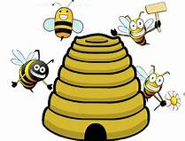
In and Out of the Hive
Honey
Pollen
Water
Propolis
Bees
Wax
Venom
Royal Jelly
Nectar
Pollen
Water
Propolis
Session 6: Plants and Hive Products

Slide 10
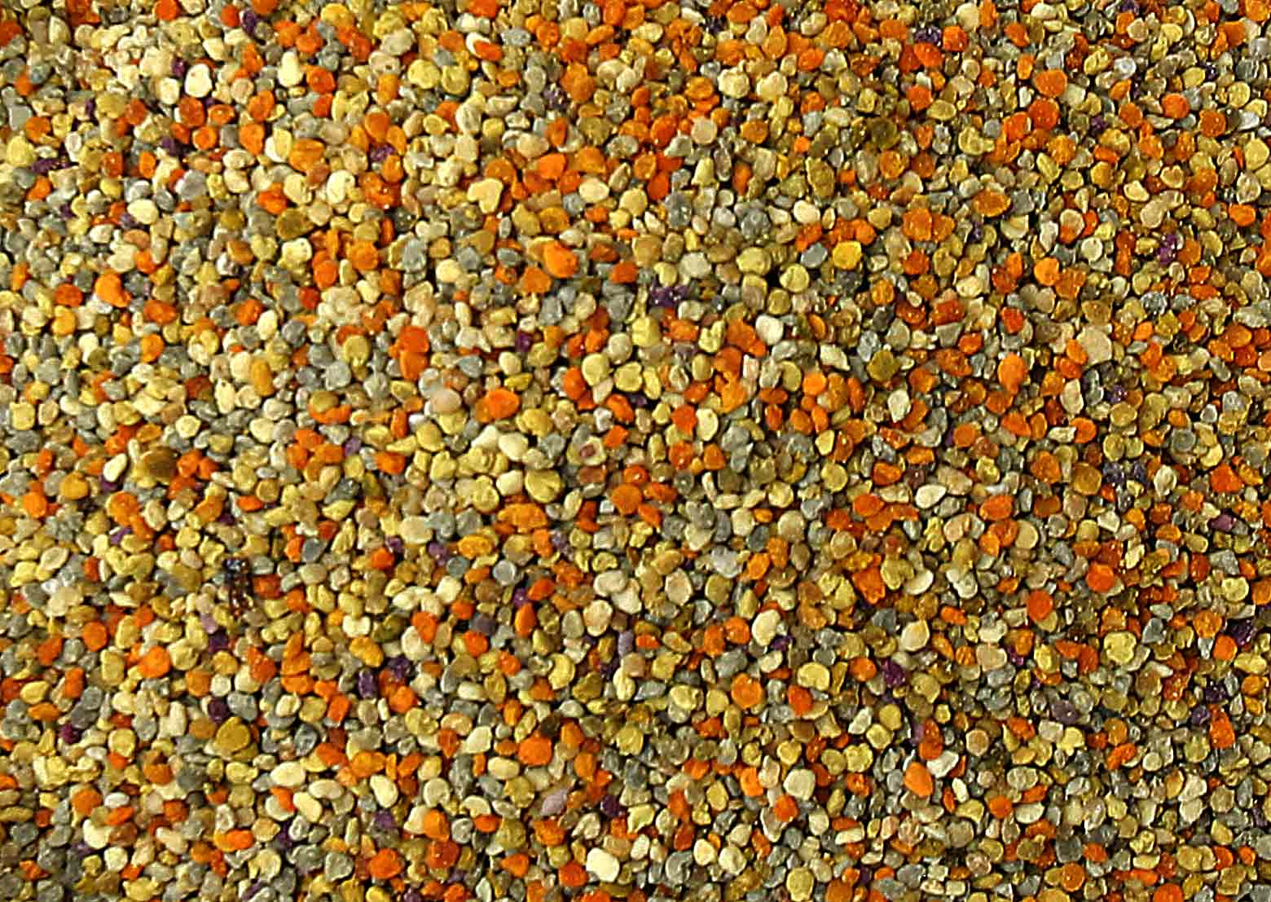
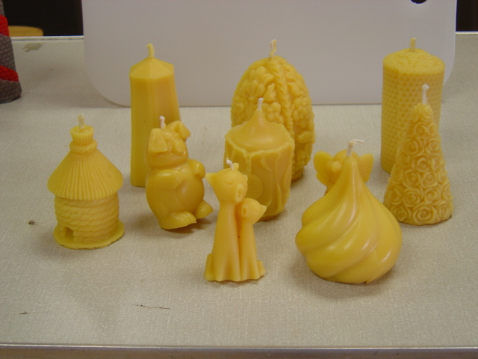
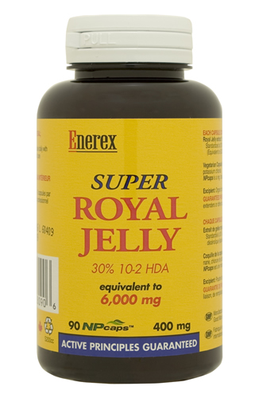
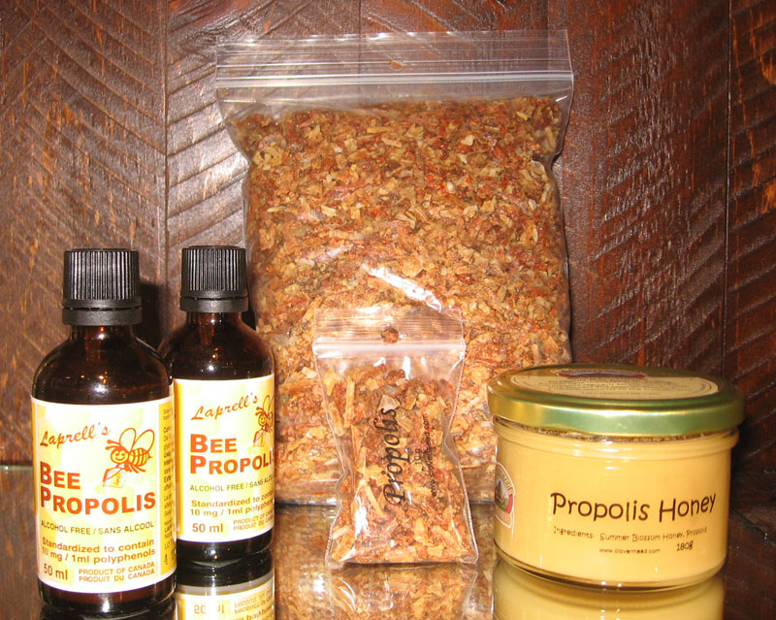
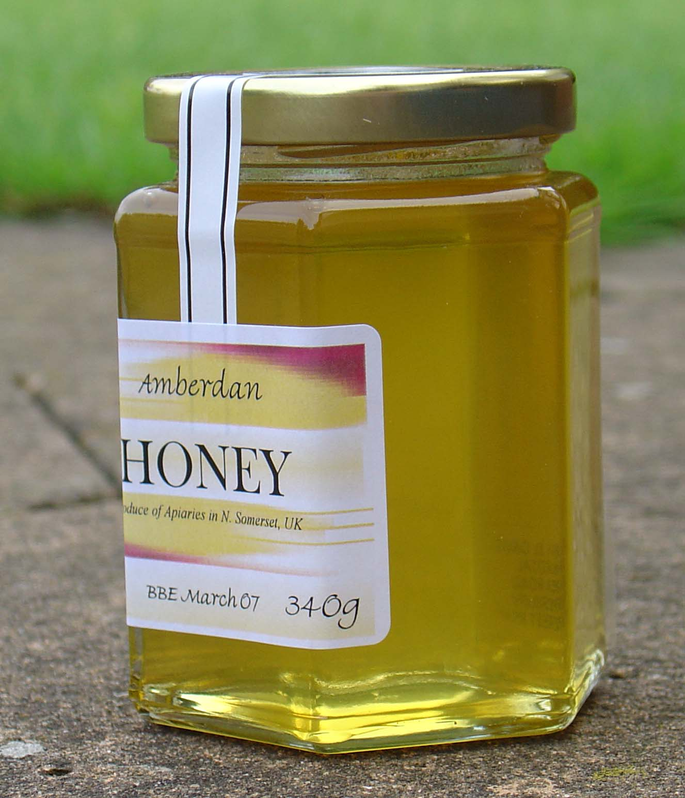
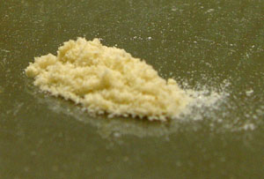
Products of the Hive
Honey
Wax
Propolis
Pollen
Venom
Royal Jelly
Session 6: Plants and Hive Products

Slide 11
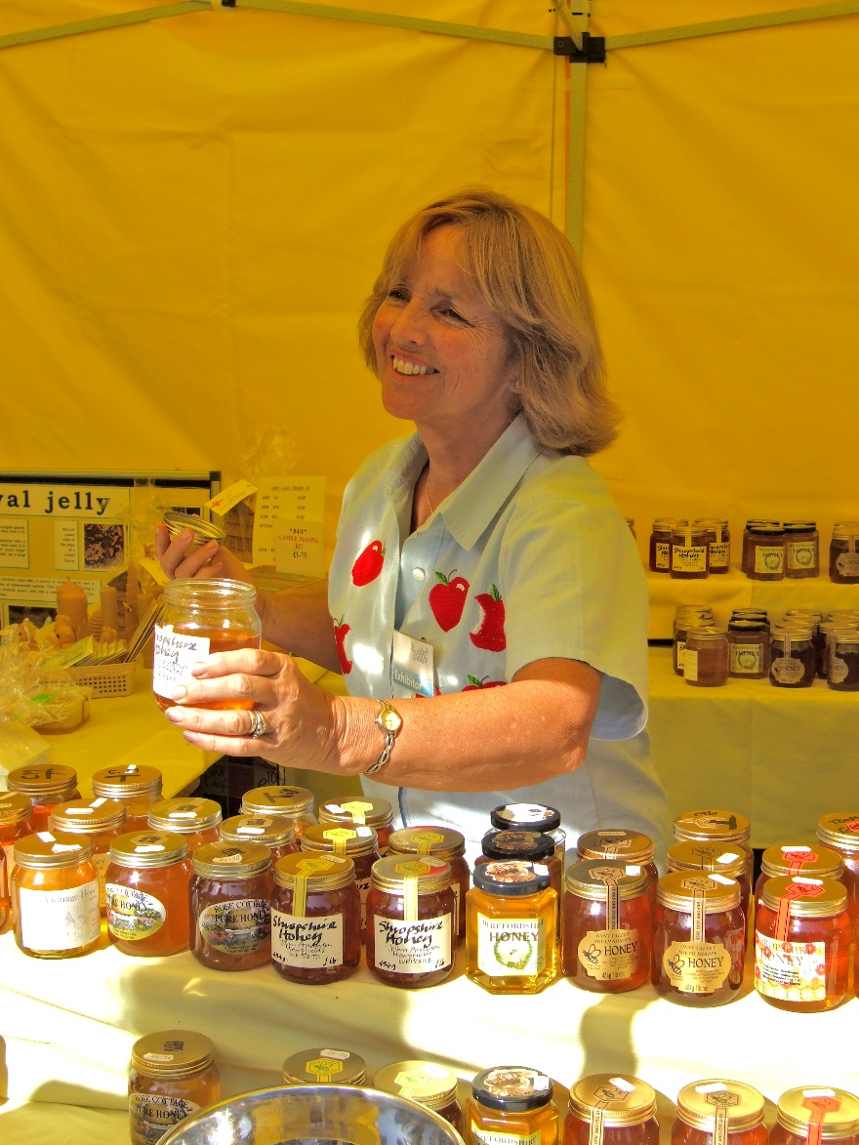
Selling Honey
Preparation
Sales
Regulations
Session 6: Plants and Hive Products

Slide 12
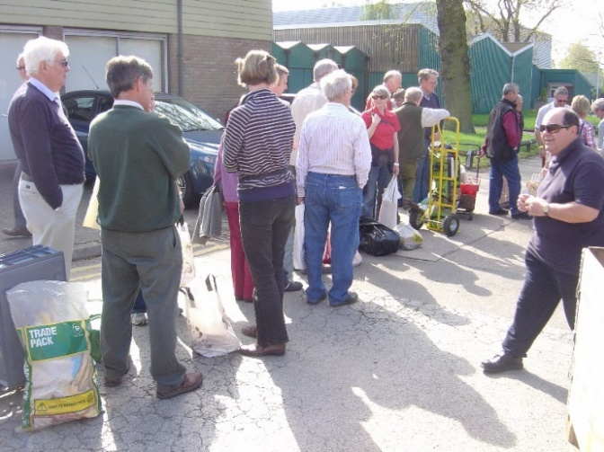
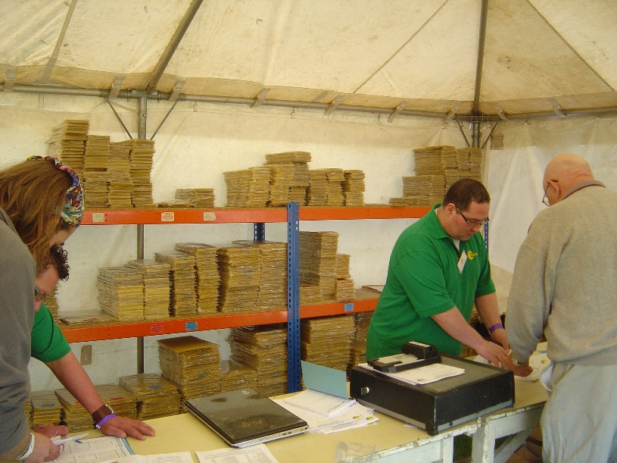
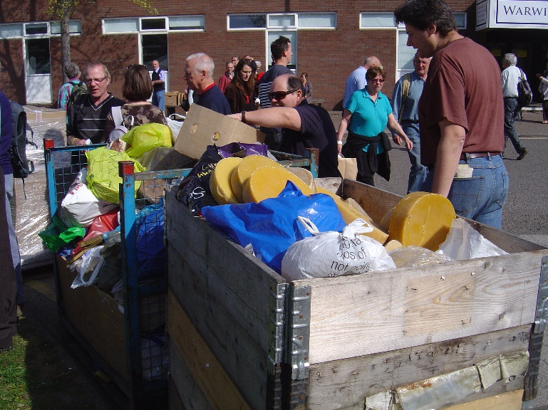
A Special Word About Wax
Bees make wax from
honey
It takes the same amount of
foraging to make 1kg of wax
as 8kg of honey,
- so we need to look after it….
Session 6: Plants and Hive Products

Slide 13
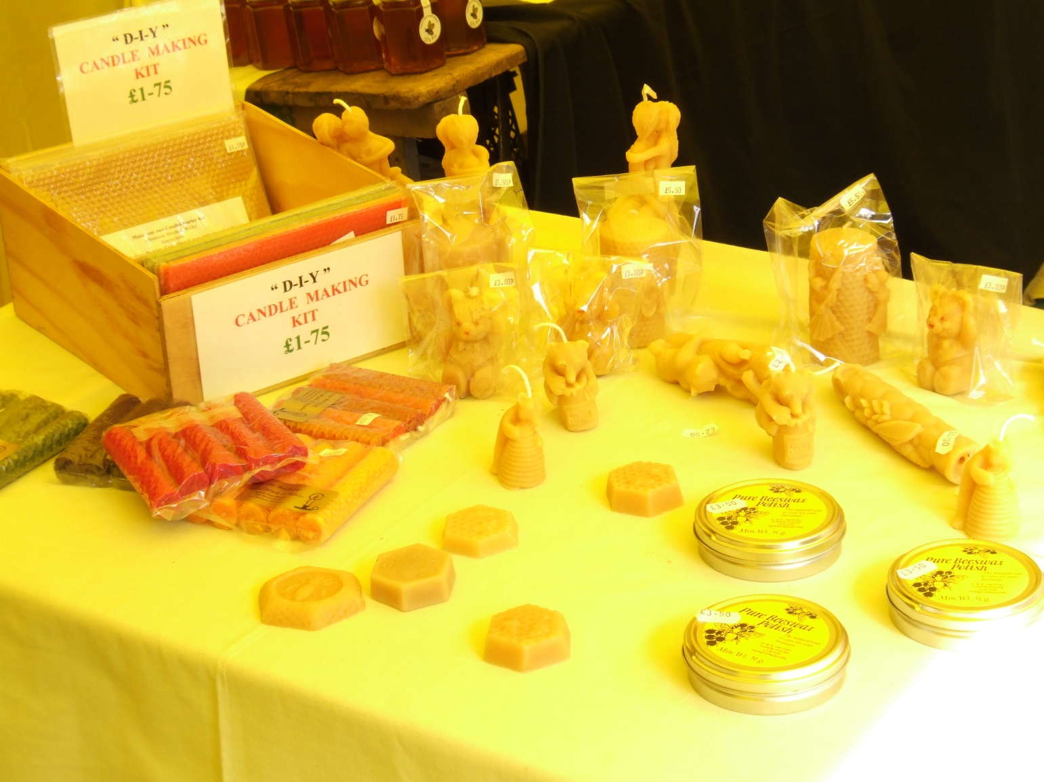
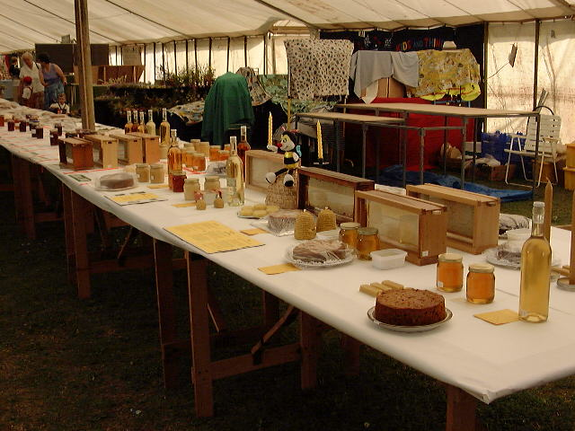
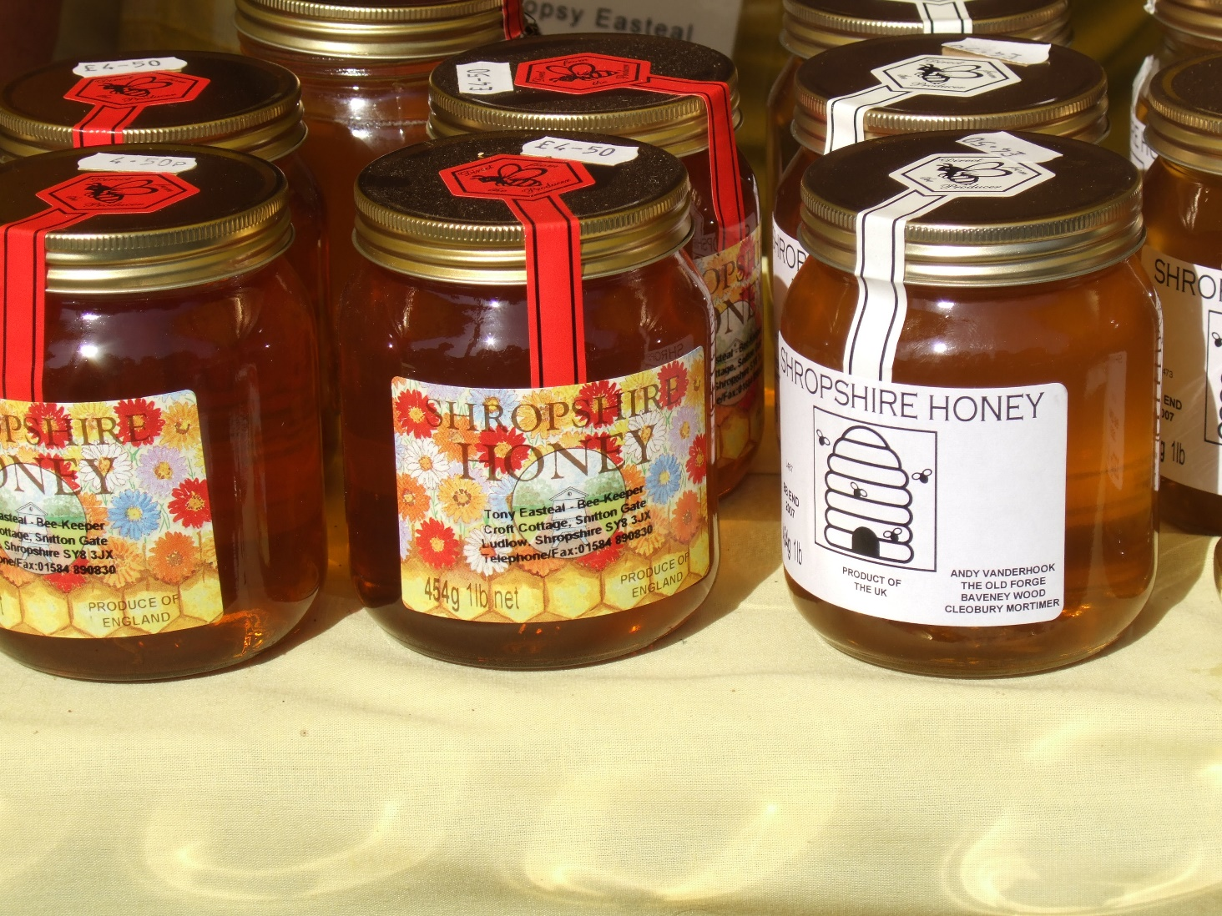
Honey Bee Products
Session 6: Plants and Hive Products

Slide 14
What is Honey?
Sugars: Glucose 31%, Fructose 38%, Water 18%, Average pH 3.91
Minerals: Traces
Plant Substances: Tiny amounts of aromatic compounds which give honey much of its fine aroma and varying taste
Antibiotic qualities: Acidity, Hygroscopic, Hydrogen Peroxide
Fermentation: Honey will ferment if water content is over 20% due to inherent yeasts
Session 6: Plants and Hive Products

Slide 15
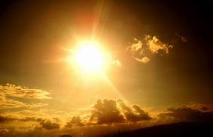
The Honey Cycle
CO2
H2O
NECTAR:
80% water
20% sucrose
Photo-
synthesis
Bee adds invertase
(an enzyme)
H2O
HONEY:
40% Fructose
38% Glucose
20% water
Bee uses honey for energy:
For flight
For warmth
For making wax
Session 6: Plants and Hive Products

Slide 16
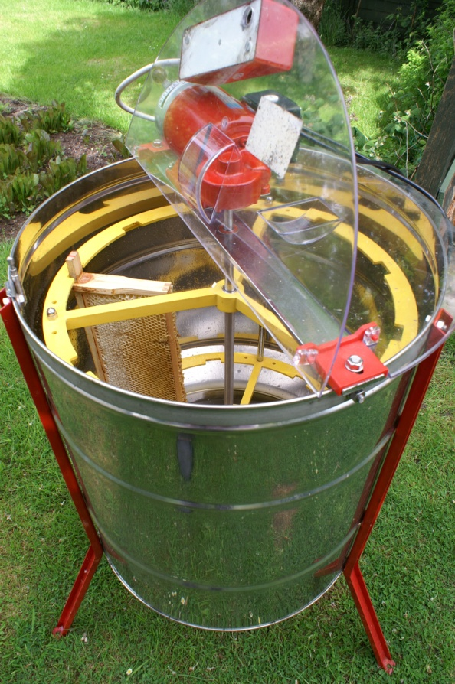
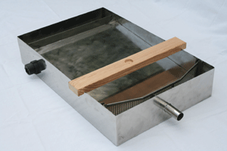
Extraction and Storage
Uncapping
Extractors
Filters
Storage
Session 6: Plants and Hive Products

Slide 17
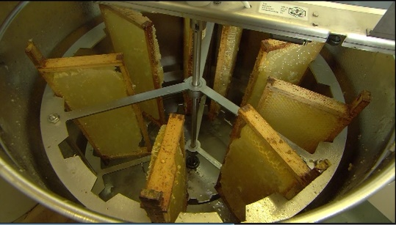
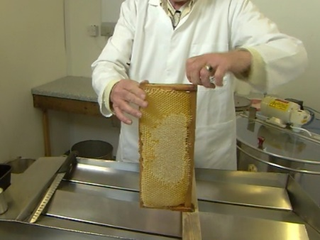
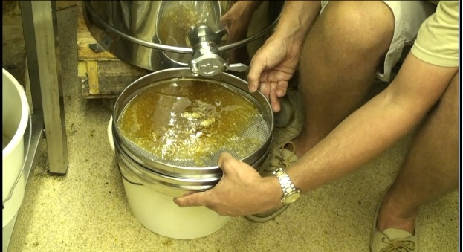
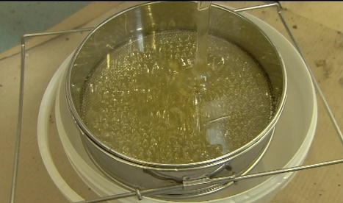
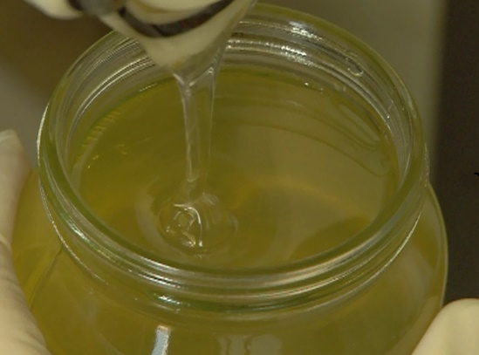
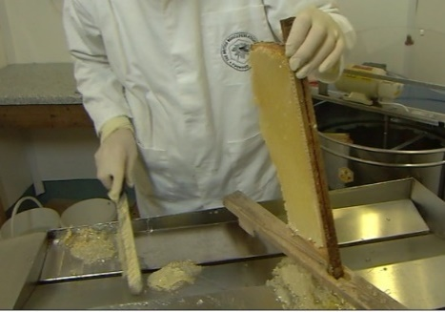
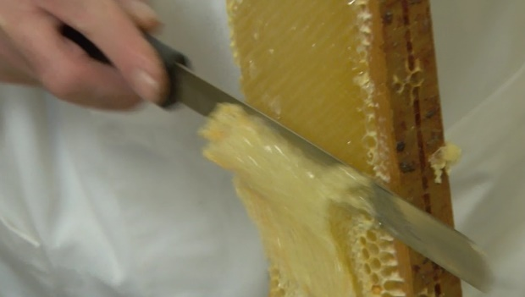
Extraction
Session 6: Plants and Hive Products

Slide 18
Legislation
It’s all about consumer protection
Honey is sold by ‘net weight’
If sold (or raffled) must be labelled according to the UK Honey Regulations (2015, as amended..)
  What honey is
  How it is described on labels
Trading Standards require:
  Contents & WEIGHT as described, including plant & geographic origin (may have changed after Brexit)
  Safe to consume
  Quantity as labelled
  Origin etc. stated – easily tested
  Lot numbers to ensure traceability if sold to public
Session 6: Plants and Hive Products

Slide 19

Legal Labelling
Session 6: Plants and Hive Products

Slide 20
Quick Quiz
Name the scientist credited in the discovery of the Waggle Dance?
Bonus point if you get the year he was awarded the Nobel prize…
Carl Von Frisch
1973
Session 6: Plants and Hive Products

Slide 21
Quick Quiz
Name the two major sugars present in honey.
Glucose and Fructose?
Session 6: Plants and Hive Products

Slide 22
Quick Quiz
What is the ideal water content to minimise fermentation in honey?
<20%
Session 6: Plants and Hive Products

Slide 23
Quick Quiz
What do the bees use to navigate?
The Sun
Session 6: Plants and Hive Products

Slide 24
Next Session
Read the following sections of your book for the next session
  Chapter 7 – Swarms and Chapter 6 (Pages 98 to 107)
  We are going to be learning about Swarms and Swarming
Date of next session: 22 March 2023 at 7.00pm – 9pm at Ashford Carbonel Village Hall
Session 6: Plants and Hive Products

Slide 25

Questions?
Notes:
25

