Slide 1
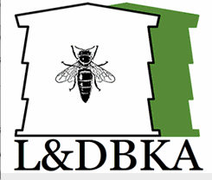
Ludlow & District Beekeepers Association
Session 5 (Chapter 8 of the book)
An Introduction to Beekeeping:
Bee and Colony Health
Session 5: Bee and Colony Health
1

Slide 2
Aims and Objectives
Aim:
To enable you to understand the impact of viruses, pests and diseases on the health of a colony so you are able to take appropriate steps to prevent them, identify them, and respond accordingly
Objectives:
  To recognize when a colony is not healthy
  To know how to manage your hives to prevent the introduction of disease
  To enable you to identify viruses and diseases
  To take appropriate action in response to viruses, pests and diseases
Session 5: Bee and Colony Health

Slide 3
Disease Map
HIVE
VARROA & Small Hive Beetle
ADULT
FUTURE?
BROOD
ACARINE
???
AFB
NOSEMA
EFB
EFB-CONFUSION
SAC BROOD
CHALK BROOD
Session 5: Bee and Colony Health

Slide 4
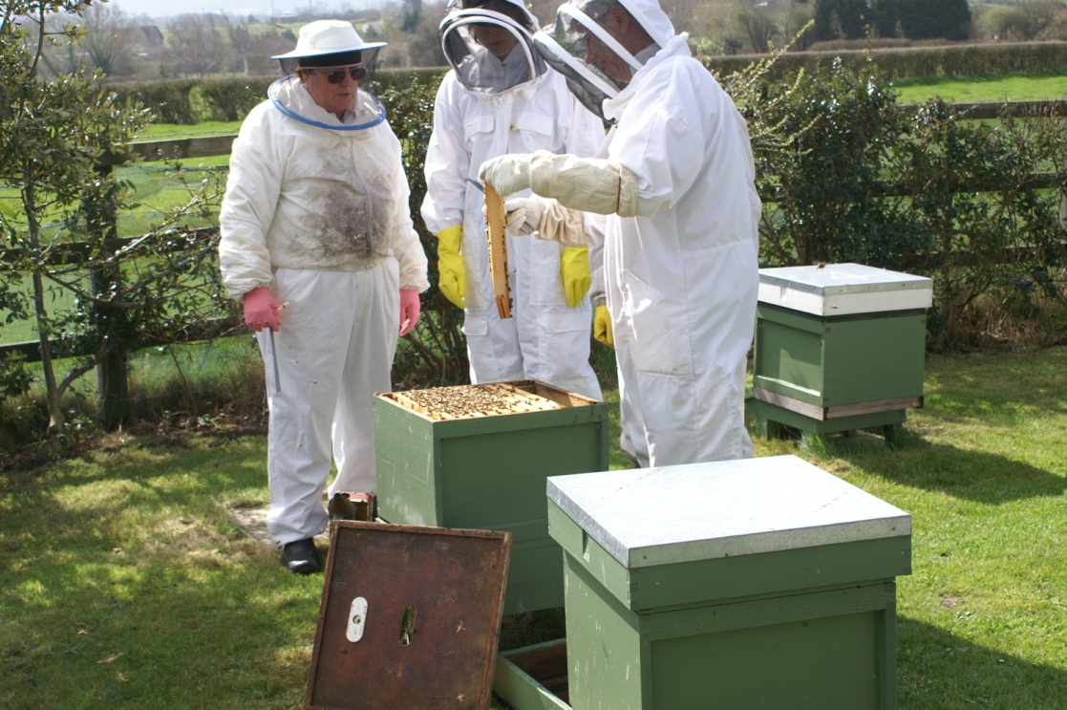
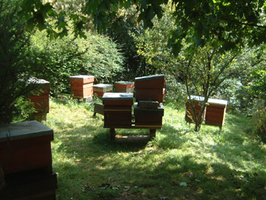
Healthy Bees Start with………..?
Good hygiene
  Clean apiary
  Clean equipment
  Clean bee suit
Secure hive
  Minimise robbing
  Minimise draughts
Gentle handling
  Reduce stress
Apiary site
  Good forage
Session 5: Bee and Colony Health

Slide 5
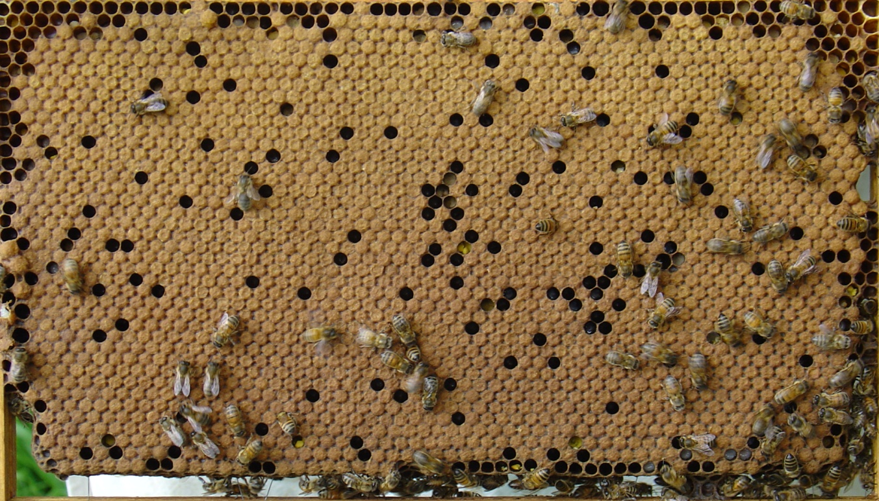
Identifying Healthy Brood
Healthy or Unhealthy?
Why?
Session 5: Bee and Colony Health

Slide 6
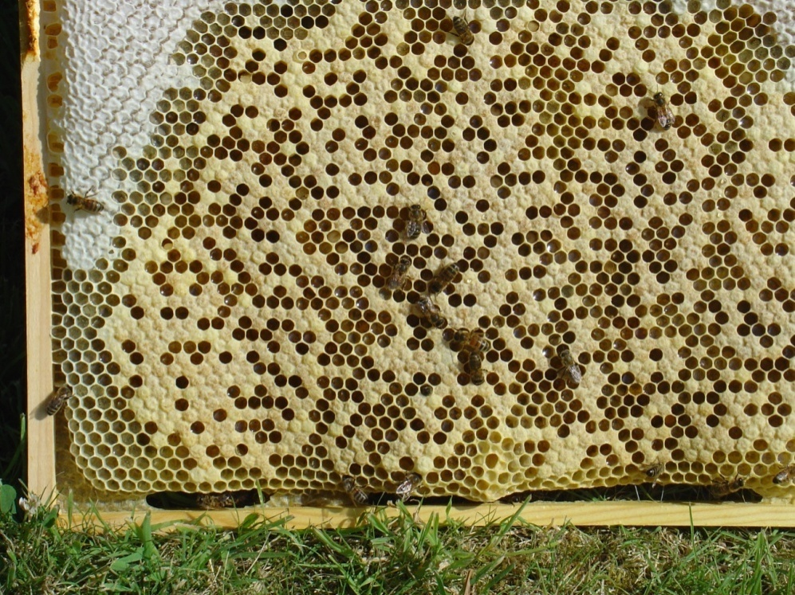
Identifying Healthy Brood
Healthy or unhealthy?
Why?
Session 5: Bee and Colony Health

Slide 7
Identifying Healthy Brood
Session 5: Bee and Colony Health

Slide 8
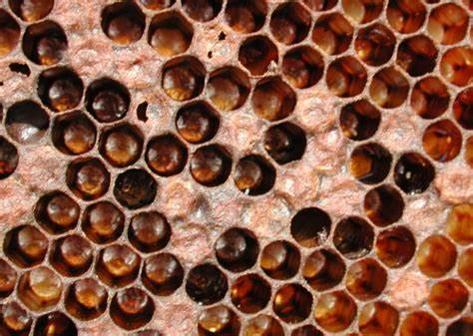
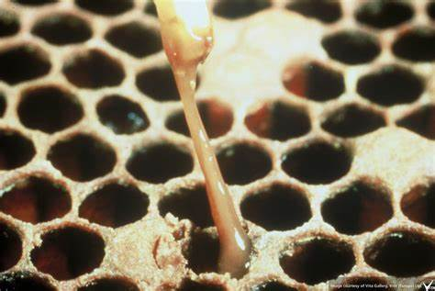
Brood Diseases - AFB
AFB – Notifiable
  Pepper pot look
  Dead larvae in
  sealed cells, turn to a black scale that is impossible to remove
  Ropey contents ‘matchstick test’
  Sunken capping
  Bacteria remain viable for 30 years+
Session 5: Bee and Colony Health

Slide 9
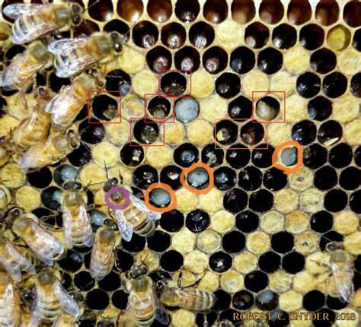
Brood Diseases EFB
EFB – Notifiable
  Dead larvae in open cells
  Uneven brood pattern
  Distorted larva, ‘melted’
  appearance, loss of
  segment definition
  Gut may be yellow
  in colour
  Easily removed from the cell
Chalk Brood - confuser
  White ‘mummies’ in cells
  Mummies on alighting board and floor
Chilled Brood
  Dead larvae near edge of brood
Session 5: Bee and Colony Health

Slide 10
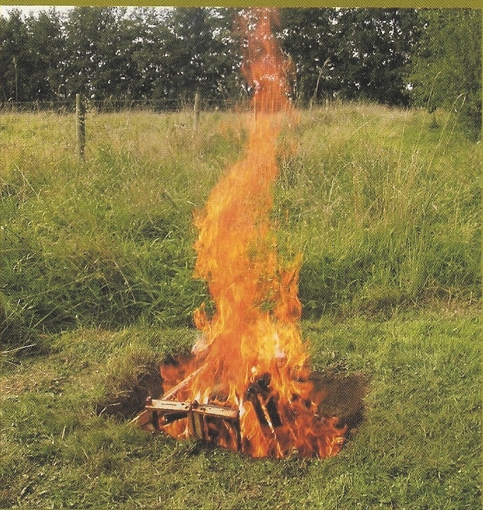
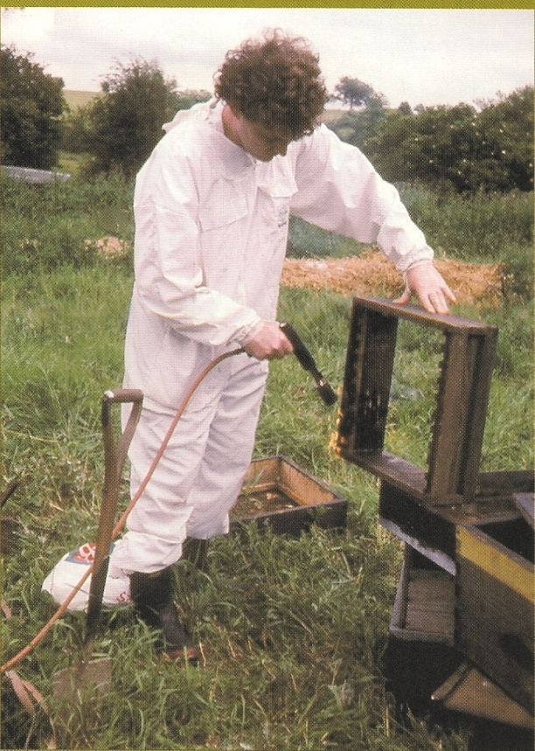
UK Statutory Requirements
Notifiable diseases:
Must inform Bee Inspector –law!
    AFB, EFB, SHB, Tropilaelaps
    Standstill order will be put in place until all clear
    Antibiotics may affect honey
Treatment by authorised person
  Destruction (AFB & EFB)
  Antibiotics (EFB)
  Shook Swarm (EFB)
  Bee Disease Insurance (BDI)
  Importation of bees!
200 total cases p.a.
Session 5: Bee and Colony Health

Slide 11
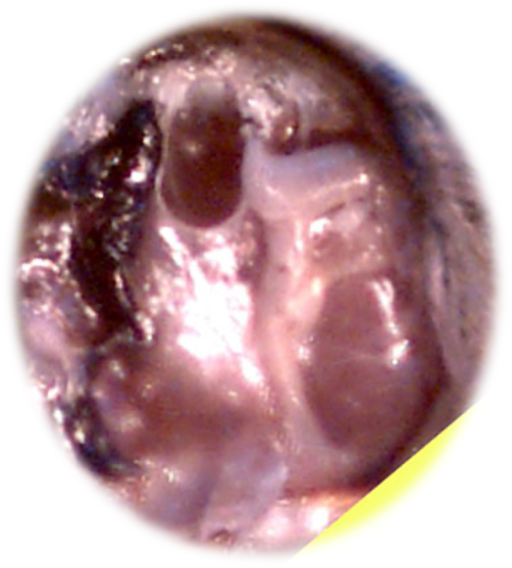
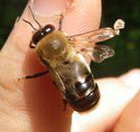
Acarine – Adult Bee
Mite – Acarapis woodii
Infests 1st thoracic trachea
Breeds there
  blocks with debris
Mites move to young bees
Associated with viruses
No treatment
Prevention
  – good bee husbandry;
  strong colonies
Effect: atrophy of flight muscles, bees can’t forage, debilitating
Aorta
Clear Trachea
Infected Trachea
Session 5: Bee and Colony Health

Slide 12
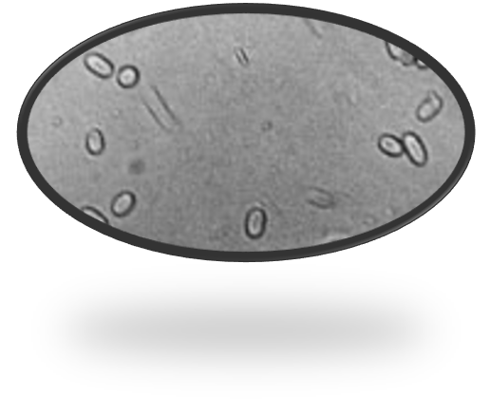
Nosema – Adult Bee
Microsporidian – Nosema spp
Spore forming fungus
Invades gut of adult bees
Associated with dysentery
  Good husbandry
    strong stocks with young queens
    on comb as new as possible – implement a good comb change regime (e.g. Bailey Comb change)
Effect: Damages epithelial cells and
reduces digestion of pollen, therefore less brood food, debilitating
x400+ magnification
Session 5: Bee and Colony Health

Slide 13
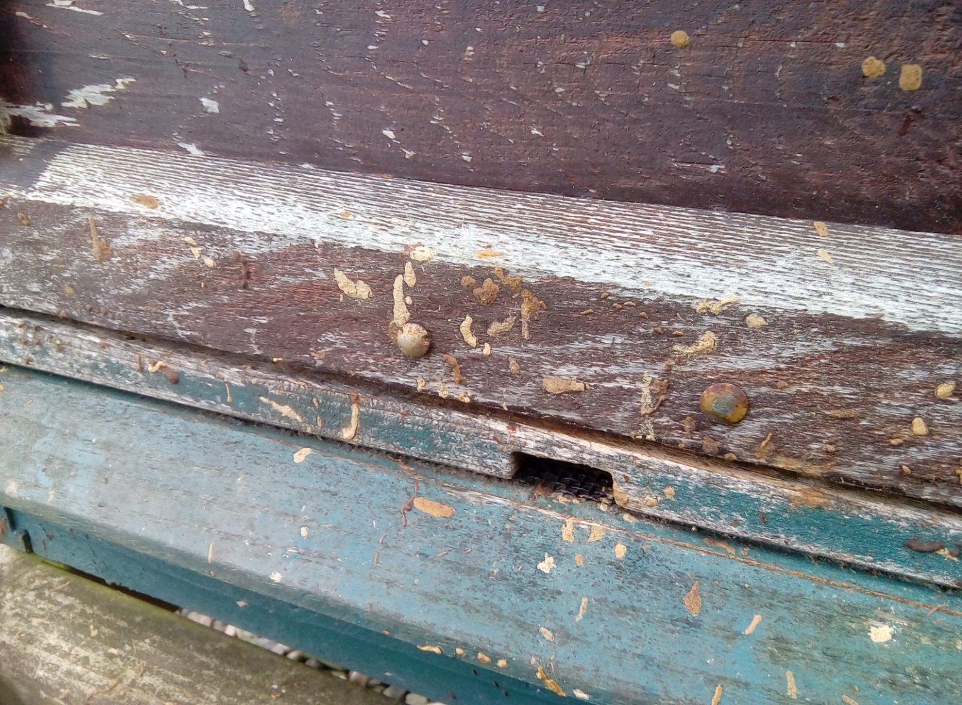
Nosema – Signs
Session 5: Bee and Colony Health

Slide 14
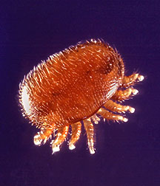
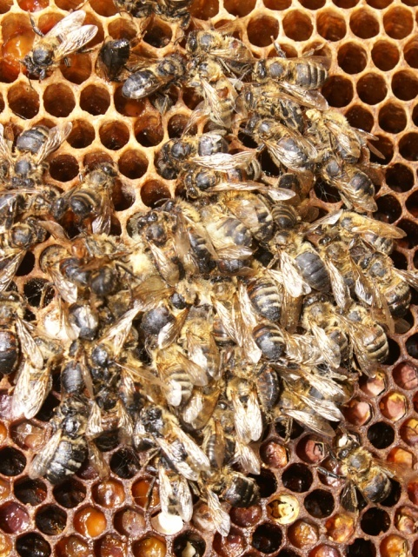
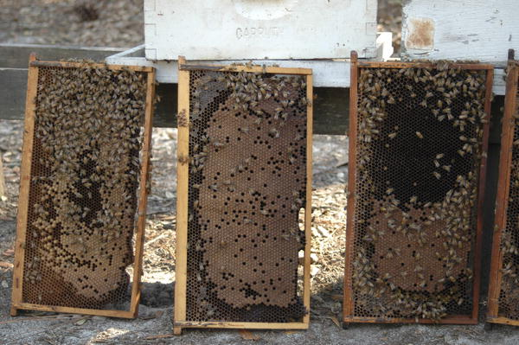
Current Dangers to Honey Bees
Varroa destructor
Introduces Viruses
  Paralysis viruses
  Deformed wing
  Black queen cell
Outcome
  Collapsing colonies
  Marie Celeste
  Colony loss
Asian Hornet
Small Hive Beetle (SHB)
2.6 mm
Session 5: Bee and Colony Health

Slide 15
Asian Hornet
Target bees for food
  Hawking, ‘meat balls’
Report sightings
  Asian Hornet Watch
  iPhone and Android app
Session 5: Bee and Colony Health

Slide 16
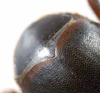
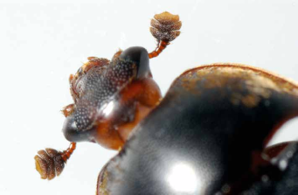
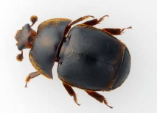
Small Hive Beetle
Shortened wing case
Layered ‘club’ antenna
5 – 7 mm long
Session 5: Bee and Colony Health

Slide 17
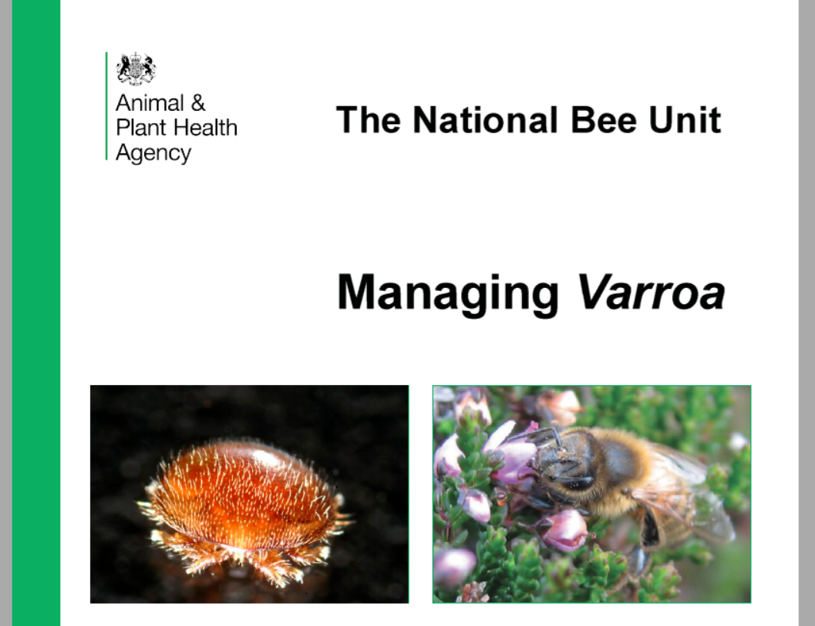
The REAL menace - Read this….
… this is non-negotiable.
All beekeepers must read this.
Causes loss of ~10,000 colonies p.a.
Session 5: Bee and Colony Health

Slide 18
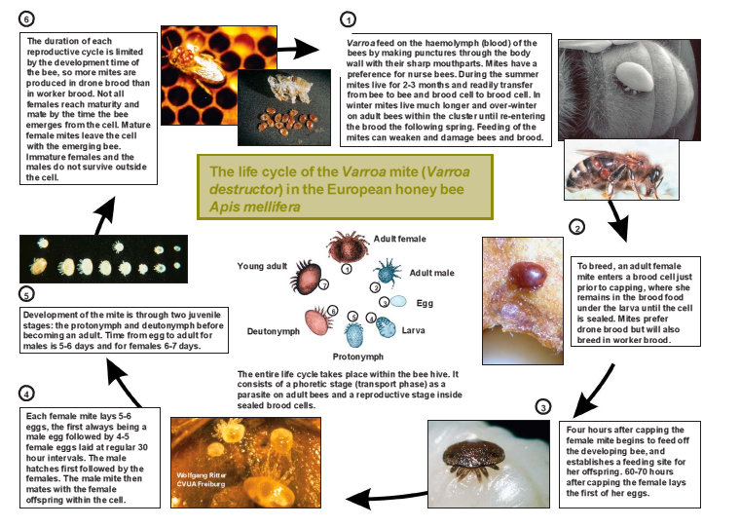
The Life Cycle of the Varroa Mite
Session 5: Bee and Colony Health

Slide 19
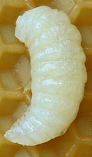
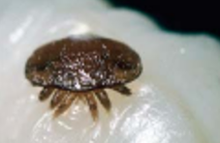
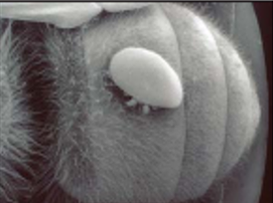
Why so successful…?
Sealed cell
Capping:
Female enters
6 days 150 hrs) –
Mated females emerge with adult bee
Every 30 hrs
4-5 female eggs laid
Male mates with all females and dies
Adult females live 60-90 days in hive
60-70 hrs
Male and first female eggs laid
Session 5: Bee and Colony Health

Slide 20
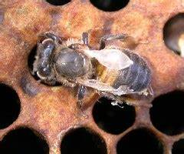
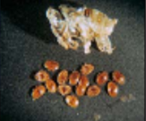
Why so damaging…?
Feeding mites harm larval development, loss of wings, reduction in size
Puncturing the larvae introduces viruses that affect the adult.
Unmanaged varroa WILL kill a colony in 2 years.
Session 5: Bee and Colony Health

Slide 21
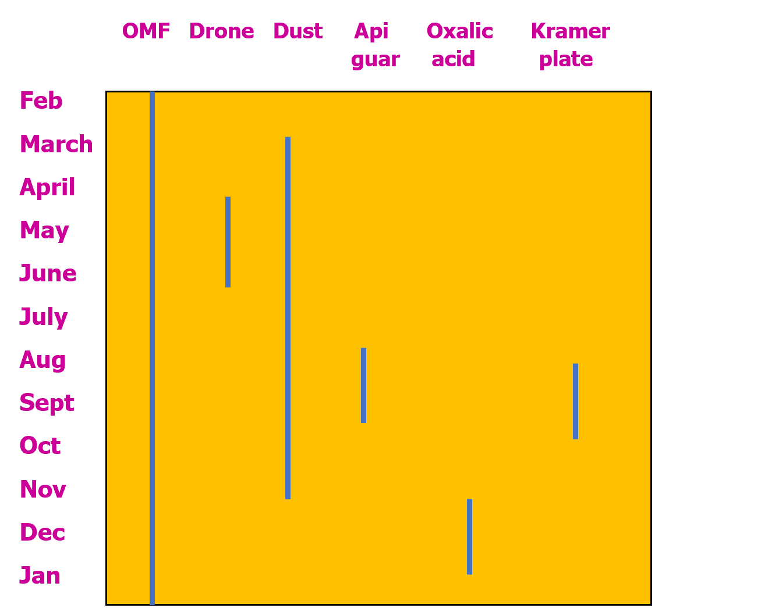
Integrated Bee Health Management
IBHM or IPM
Economic Injury Level
Pyrethroid resistance
Range of methods to
attack mites
Non-medicinal
  Icing sugar dusting
  Open mesh floors
  Queen trapping
  Drone brood
  removal
Session 5: Bee and Colony Health

Slide 22
Monitor Mite Levels
Mite population <1000
Natural mite drop: Varroa tray – average daily mite drop over 7 days or more
  Critical numbers depend on time of year, low in winter and maximum in summer
  Use Bee Base calculator to estimate degree of infestation and if/when you need to treat
Uncap mature drone pupae (pink eye stage)
  ~7% infestation treat as soon as possible
BeeBase - https://secure.fera.defra.gov.uk/beebase/public/BeeDiseases/varroaCalculator.cfm
Session 5: Bee and Colony Health

Slide 23
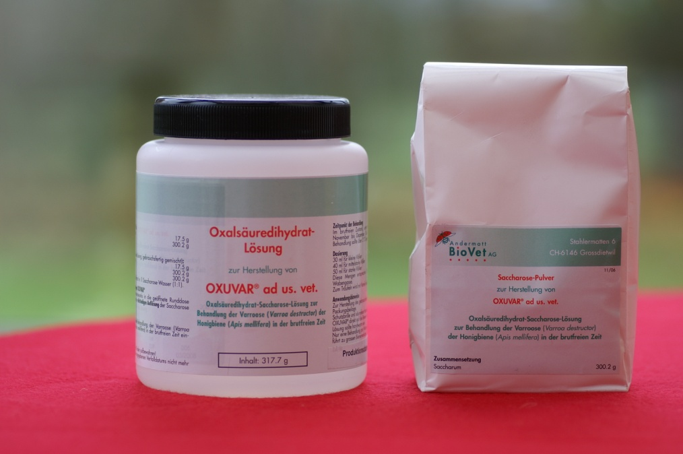
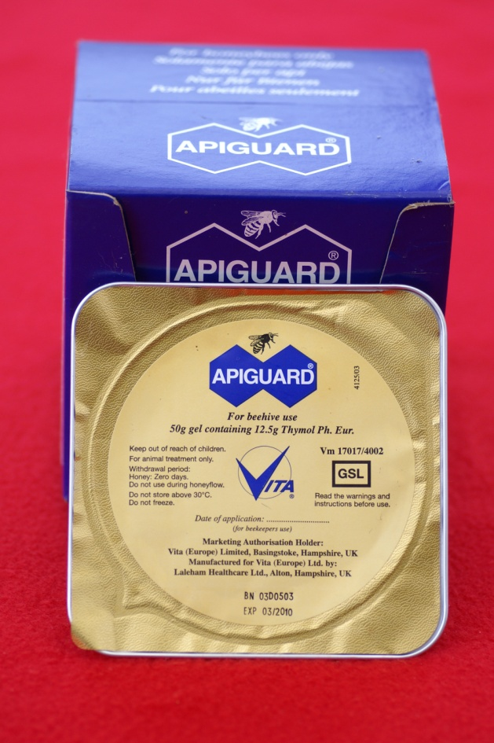
Varroa Treatment
Monitor mite drop
Use the FERA varroa calculator
to find number of mites in
the colony
When excessive treat the
colony (>1000)
Control mite numbers by
removing drone larvae &
dust with icing sugar
Can use Apiguard® &
oxalic acid !
Session 5: Bee and Colony Health

Slide 24
Information is here……
DEFRA leaflets on Varroa, EFB and AFB are downloadable from BeeBase website.
The current links are in the catch-up material
You MUST download and read the varroa leaflet
Session 5: Bee and Colony Health

Slide 25
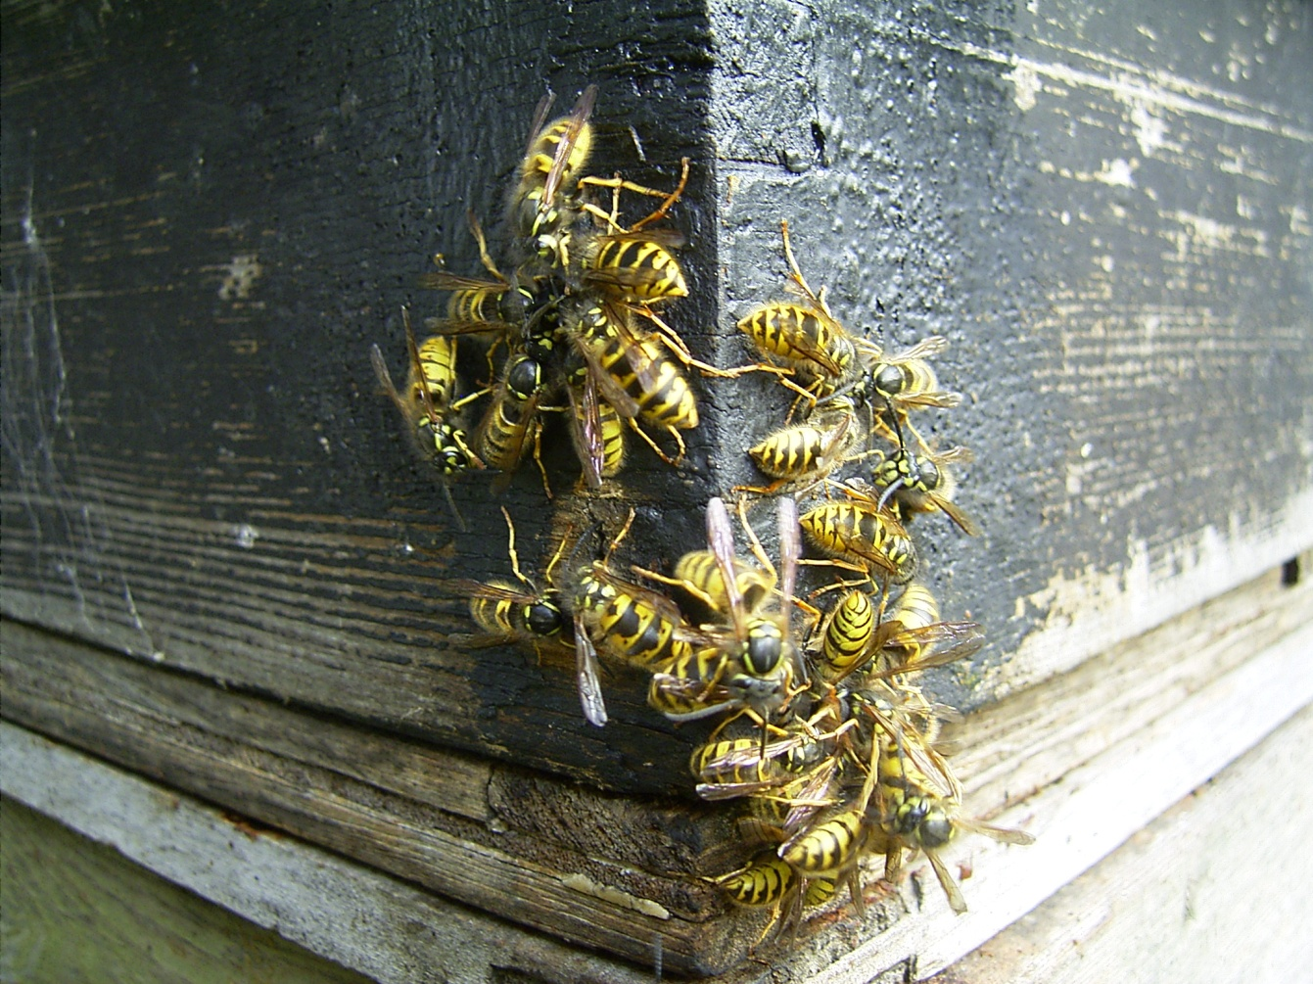
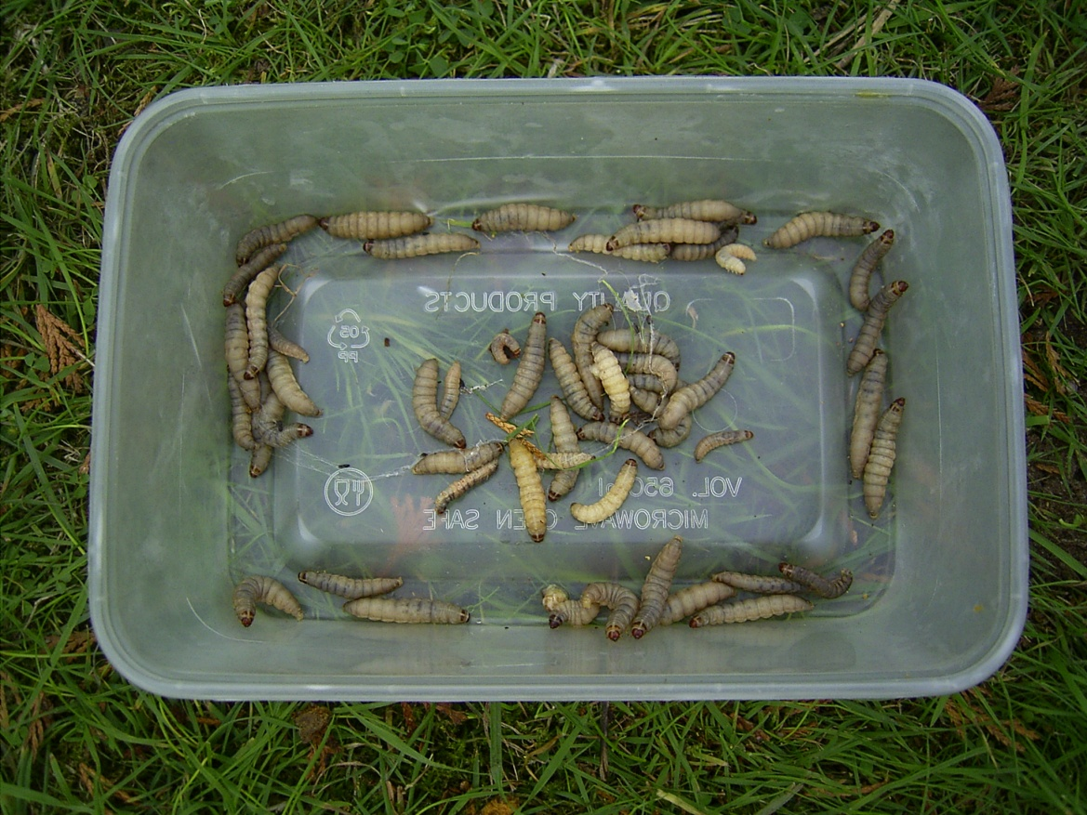
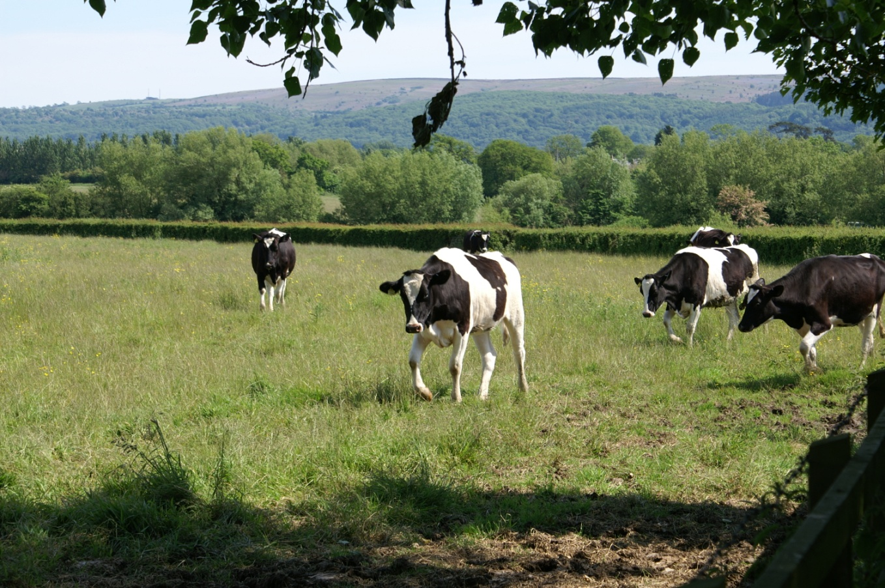
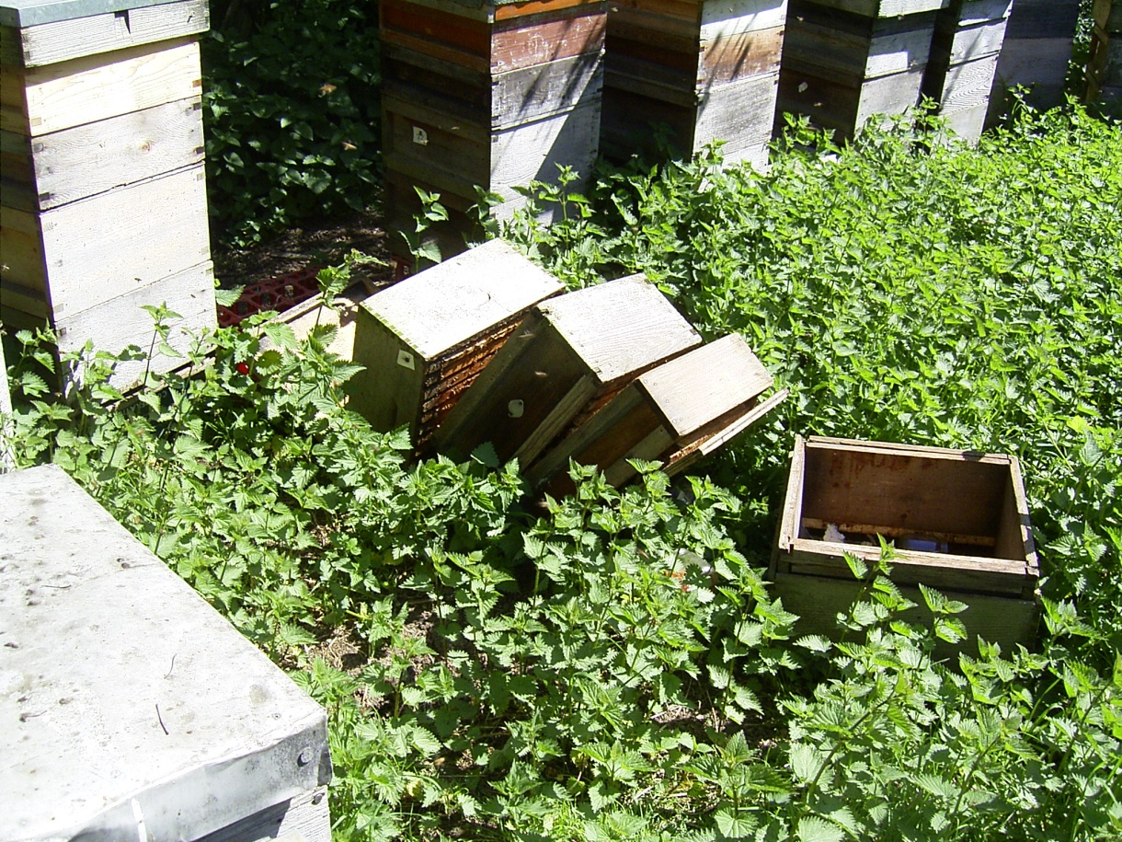
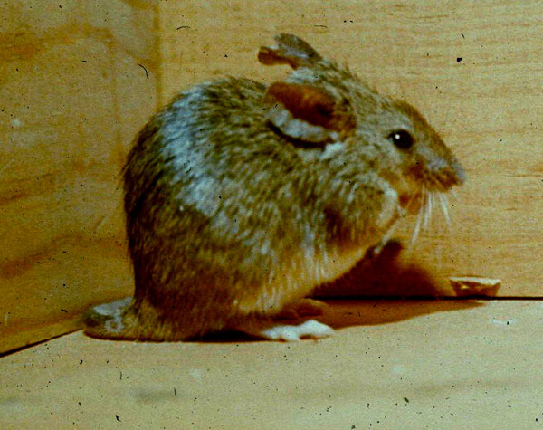
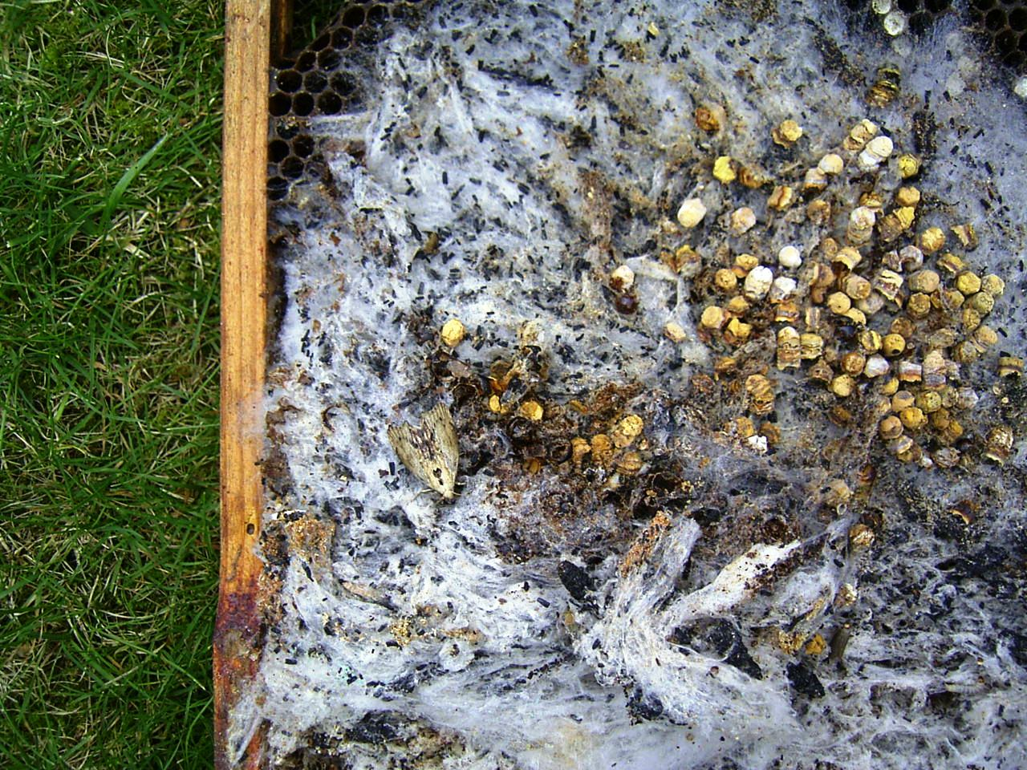
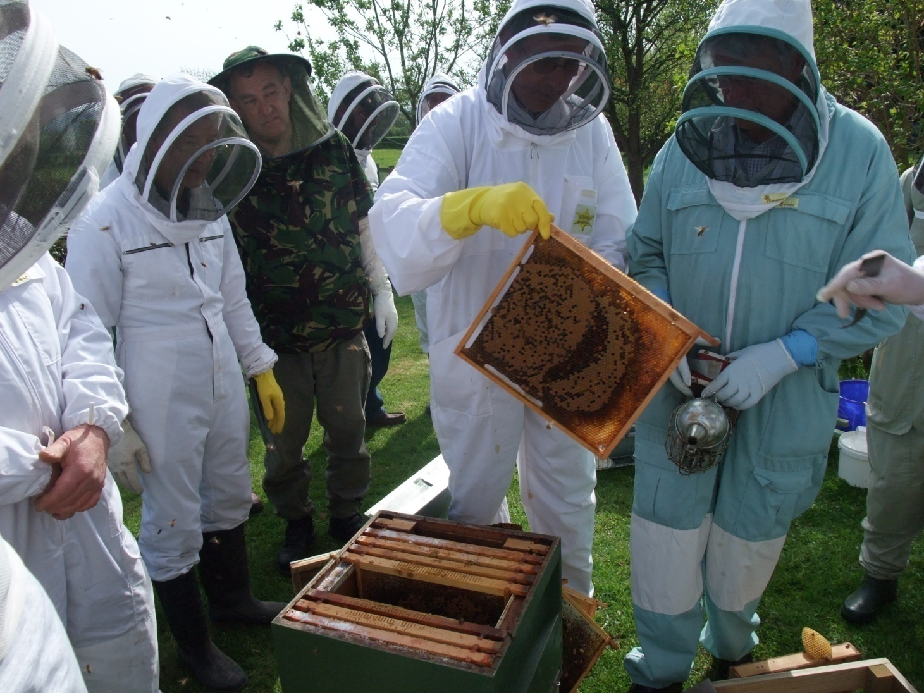
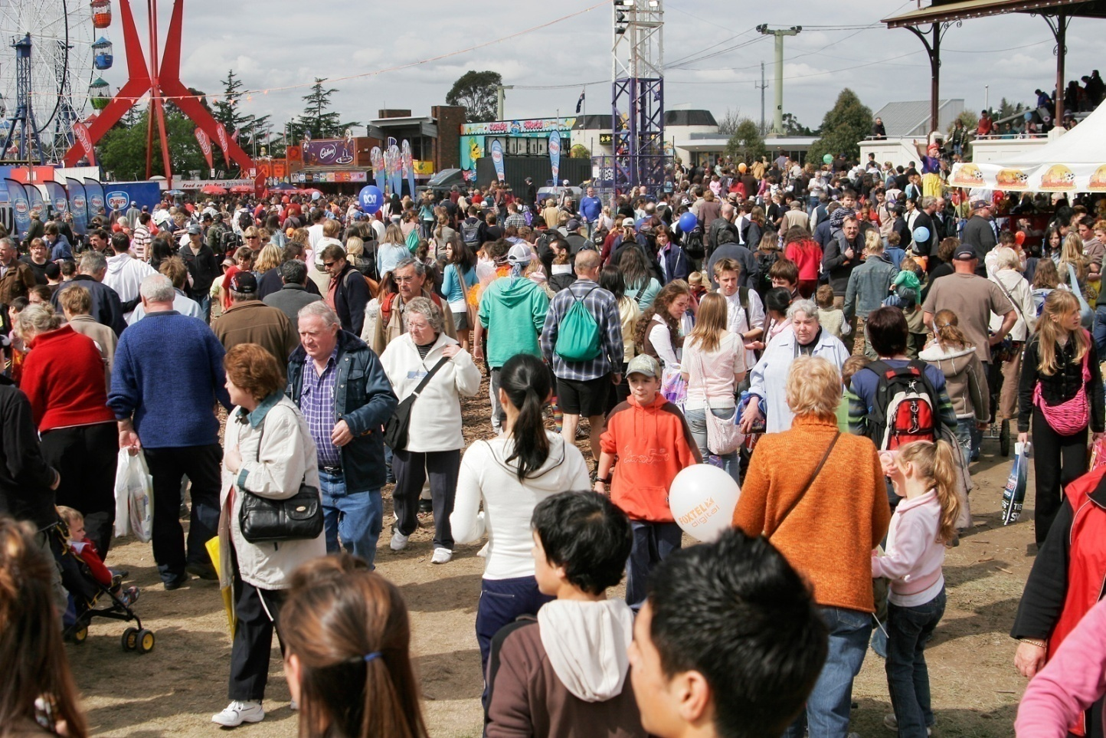
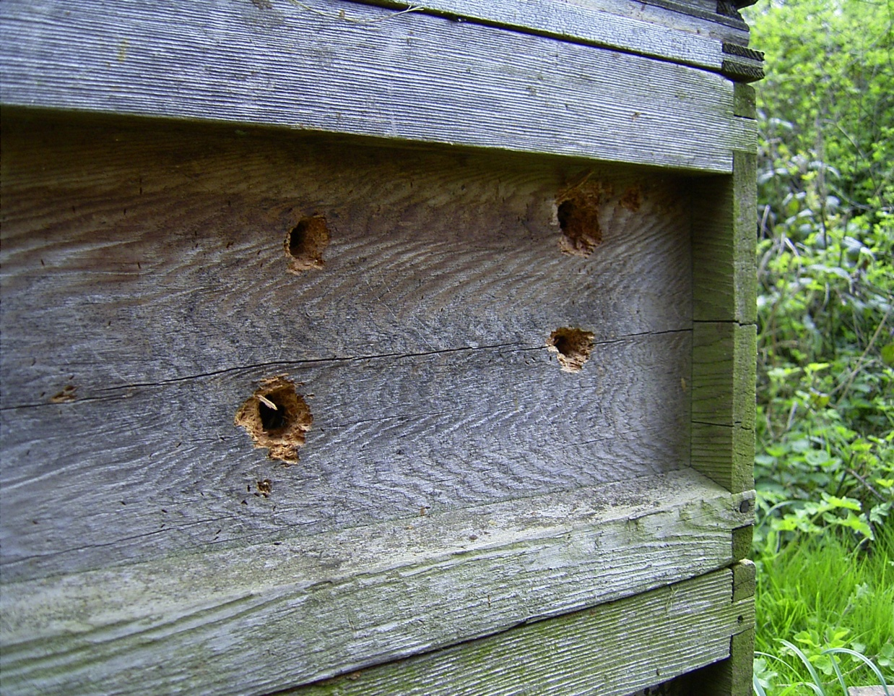
Pests
Wax moth
Mice
Woodpeckers
Badgers
Livestock
Humans
Wasps
BEEKEEPERS
Session 5: Bee and Colony Health

Slide 26
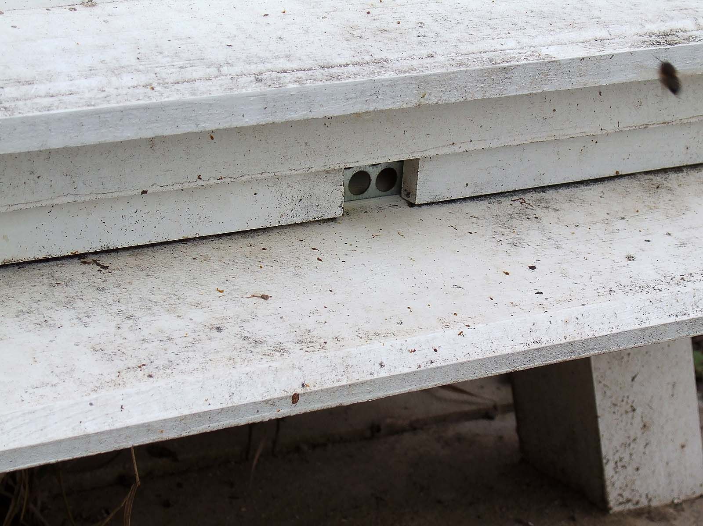
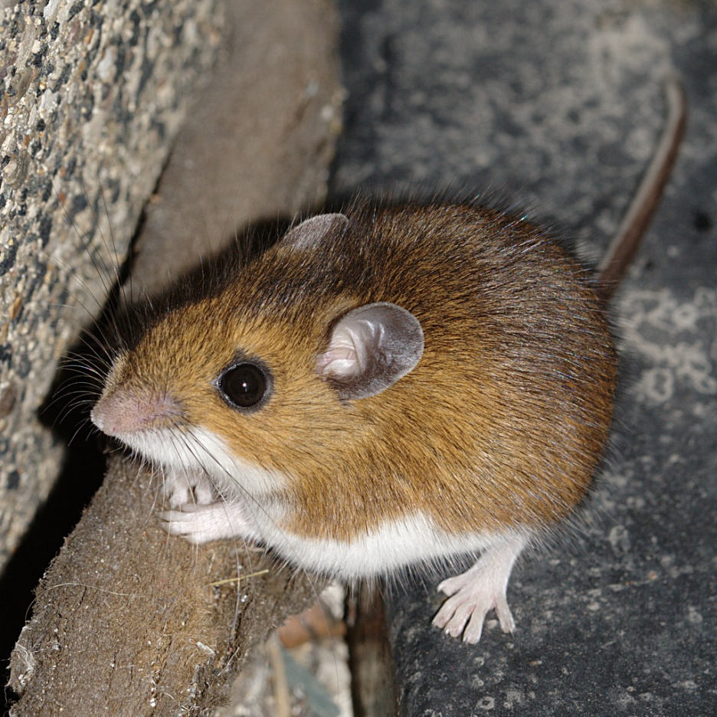
Mice!
Enter hive at
first frost
Make nest in hive
Destroy comb
Disturb bees
Colony reduction or
destruction
Mouse guard before
1st frost
Narrow entrances
(<8mm)
Courtesy of Beige Alert
Session 5: Bee and Colony Health

Slide 27
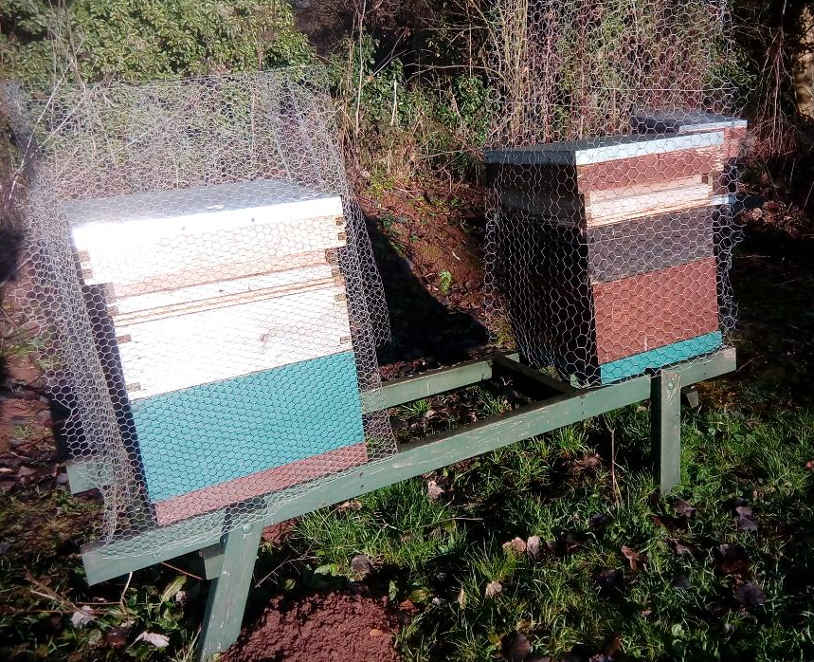
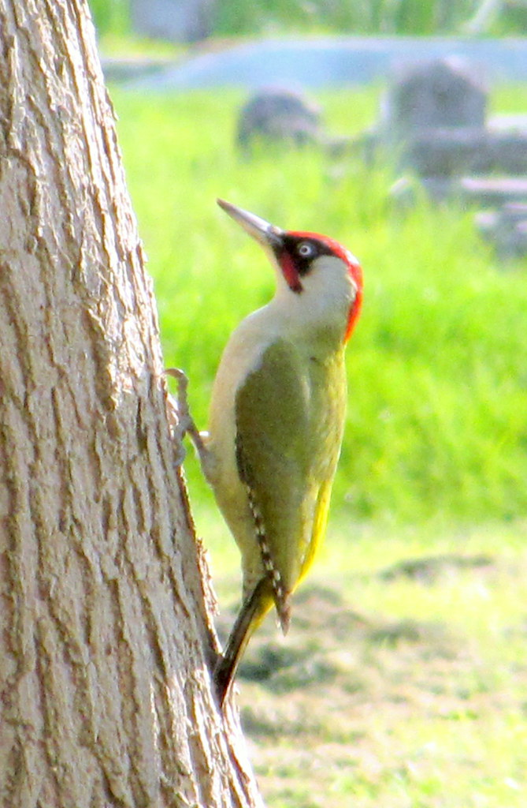
Woodpeckers
Green Woodpecker - Picus viridis
Learn to penetrate hive
- esp. with wood defects
Feed on larva & stores
Cover hive sides with
  chicken wire
  plastic sheet
Session 5: Bee and Colony Health

Slide 28
Quick Quiz
Name two notifiable diseases?
  EFA, AFB, SHB
Name one sign of an unhealthy colony?
  Pepper-pot brood
What must you do when you medicate a hive?
  Keep records
What is an RBI and an SBI?
  Regional and Seasonal Bee inspector
What effects do varroa have on the bee and the colony.
  Bee: small, wing damage, colony: population decline and death
How do you prevent woodpecker damage in the winter
  Mesh or similar over hive.
Session 5: Bee and Colony Health

Slide 29
Next Session
Read the following sections of your book for the next session
  Chapter 8 that covers what we have taught today
  Chapter 9 – Bees plants and honey for the next session
  This session will be about how and why bees and plants work to make honey and about honey as a foodstuff
Date of next session: 15/2/23 at 7.00pm – 9pm on Zoom
Session 5: Bee and Colony Health

Slide 30
Closing thoughts
Practical opportunities to take:
  Plan
  Download leaflets named above
  Have a look around the BeeBase website and the good material there
There is a lot to do but you don’t need to eat an elephant all at once – beekeeping is a long journey…
Session 5: Bee and Colony Health

Slide 31

Questions?
Notes:
31

