Slide 1

Ludlow & District Beekeepers Association
Session 4 (Book chapter 3)
An Introduction to Beekeeping:
The Hive
Session 4: The Hive
1

Slide 2
Aims and Objectives
Aim: To understand the background, purpose and operation of a honeybee hive and how to use a modern hive safely and effectively as a beekeeper
Objectives:
  To know the constituent parts of a hive and their function
  To recognise the genesis of a beehive
  To know how bees adapt the hive to their use
  To be able to manage a hive as a beekeeper
  To review types of hives
  To be able to assemble a frame?
Session 4: The Hive

Slide 3
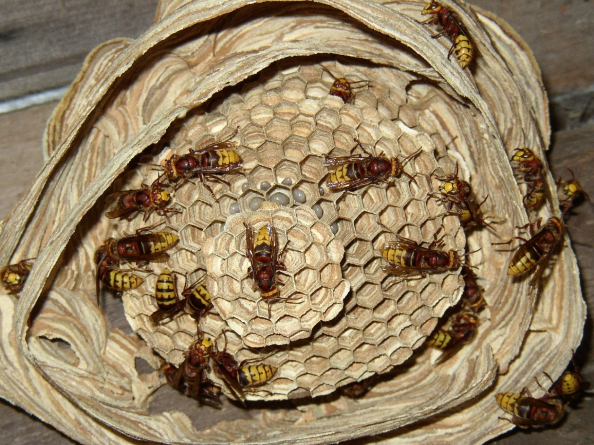
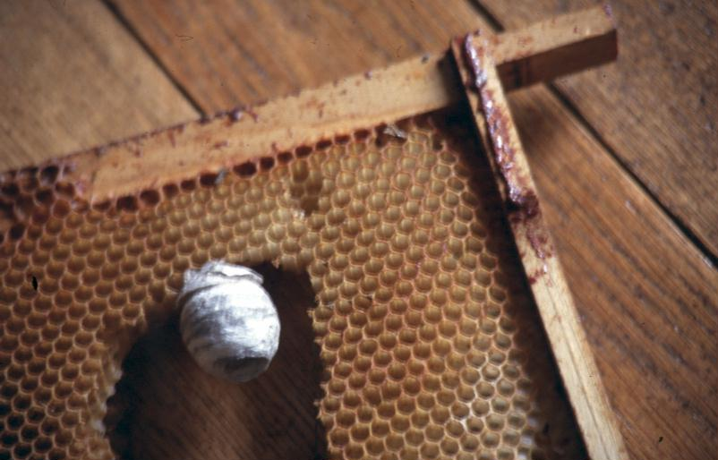
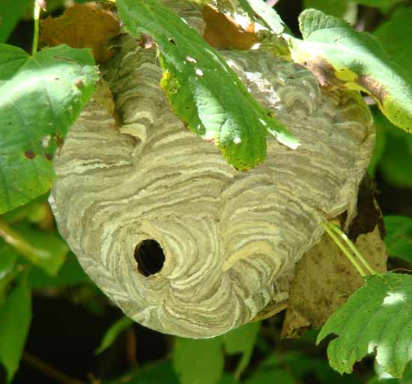
Wasp nests
Session 4: The Hive

Slide 4
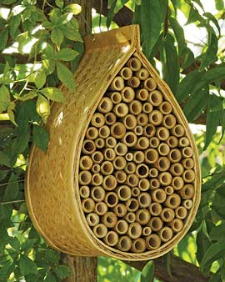
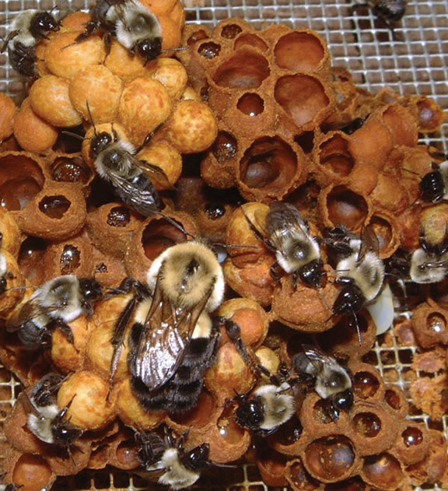
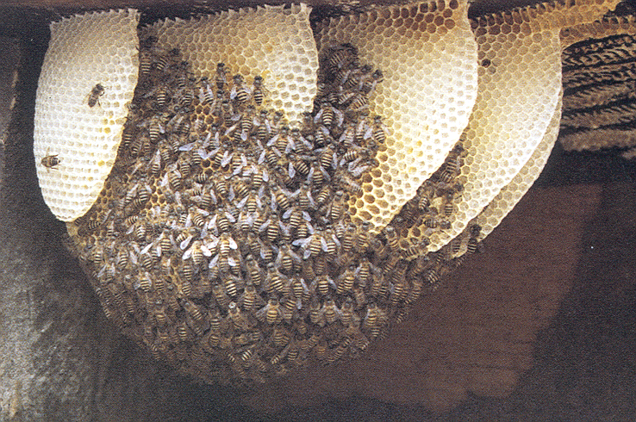
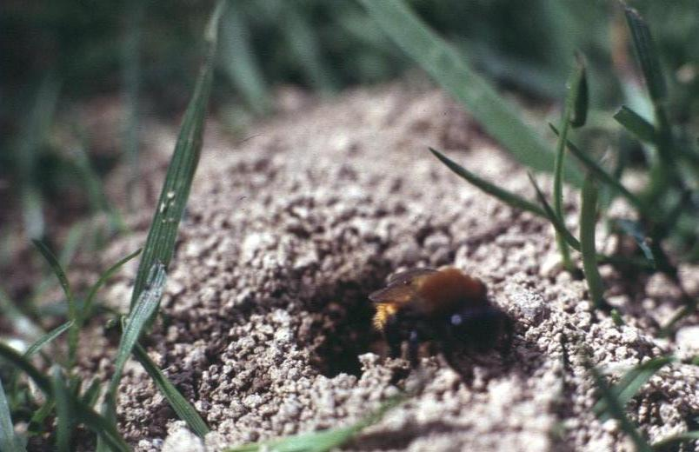
The Bees’ nests
Session 4: The Hive

Slide 5
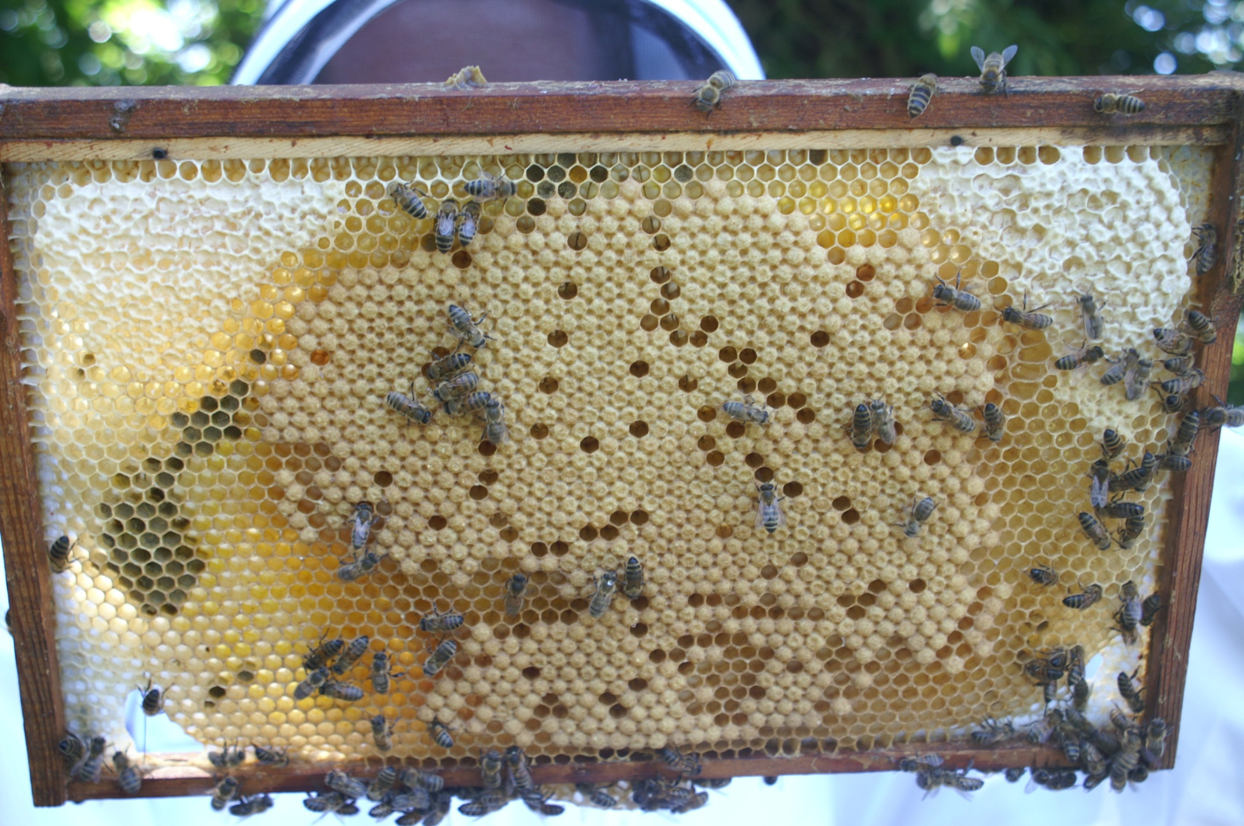
Brood Frame
Eggs
Larvae
Session 4: The Hive

Slide 6
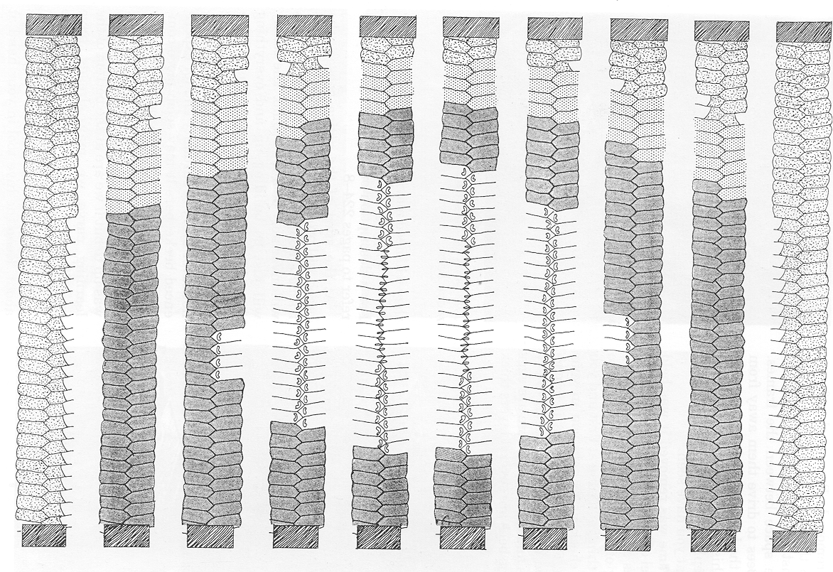
A cross section through the honey bee nest
Session 4: The Hive

Slide 7
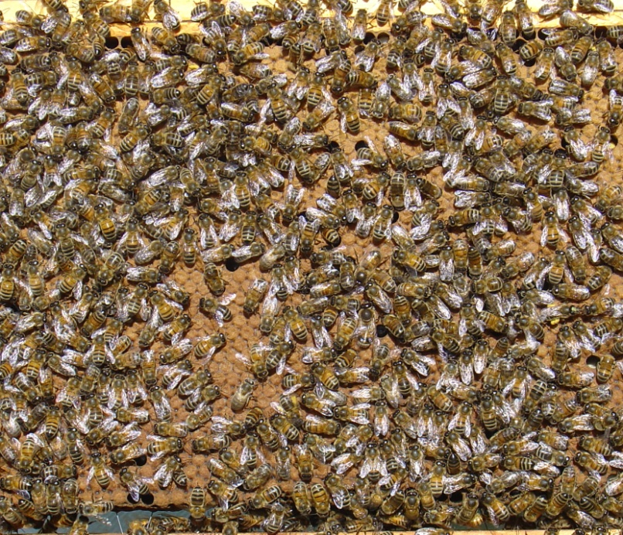
Environment in the Nest
Eggs and larvae
tended by workers
Larvae kept warm (35°C)
Nest temperature
between 34°C - 36°C
Nest workers
maintain temperature
and humidity
Session 4: The Hive

Slide 8
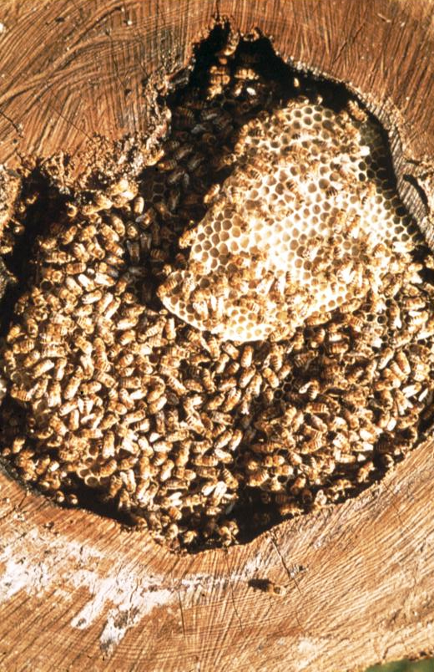
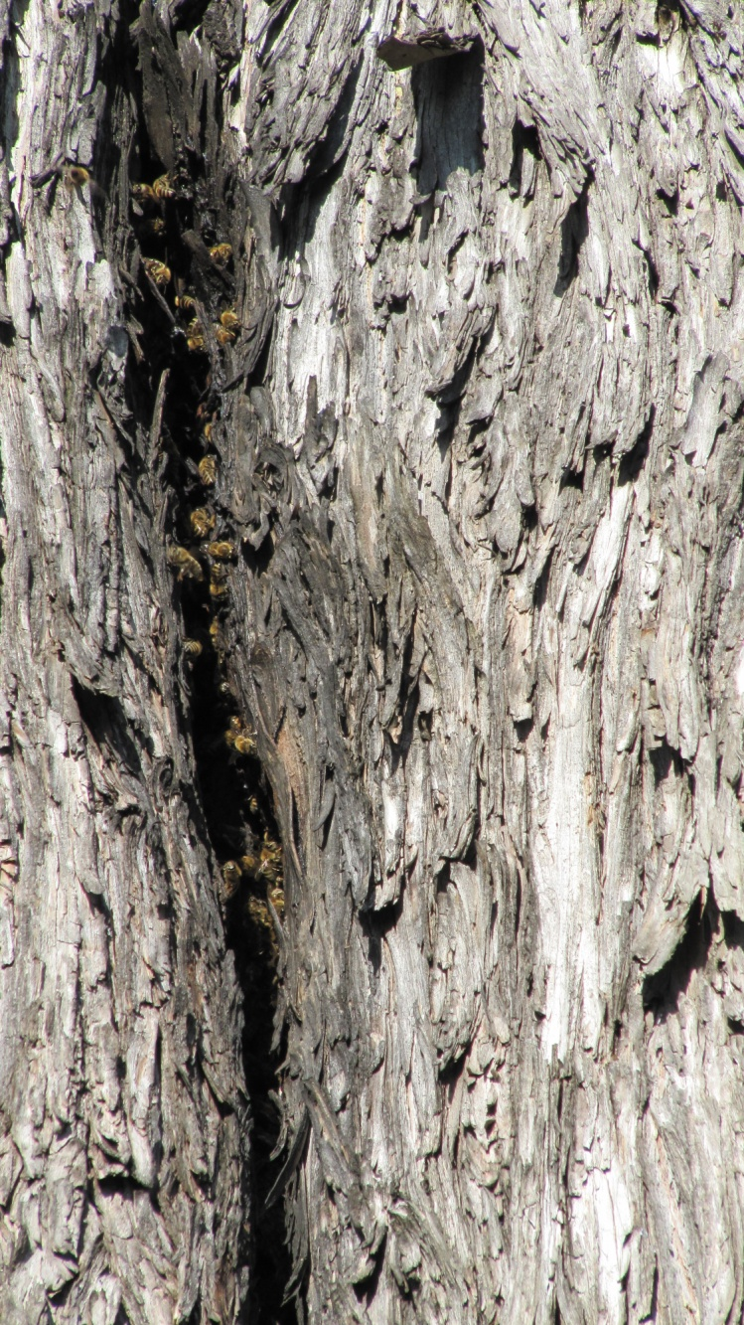
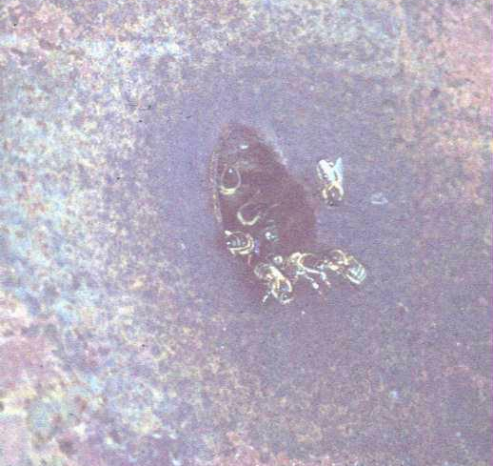
Natural Nests
Hollow trees
Rock cavities
Chimneys
Session 4: The Hive

Slide 9
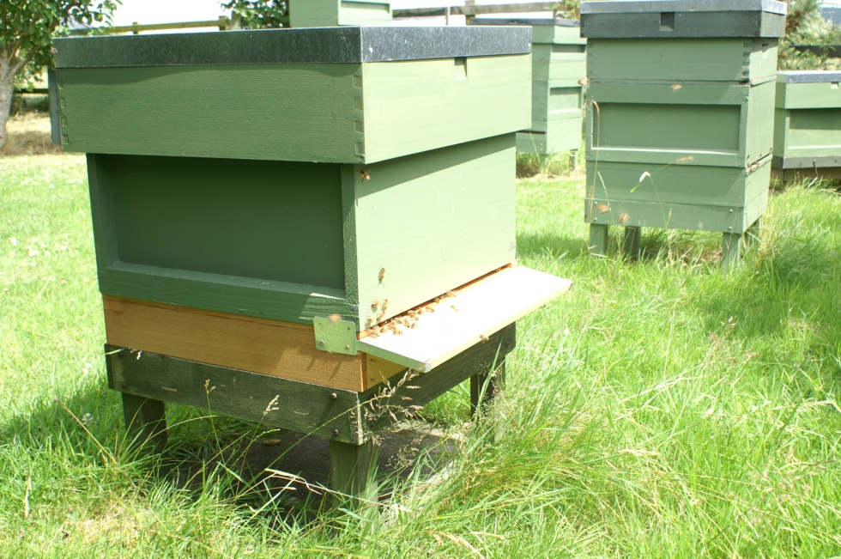
Honey bee requirements
Cavity of right size
Cavity weatherproof
Easily protected
entrance
Space to expand into
Entrance allowing
ventilation
At height away
from predators
Away from other colonies
Session 4: The Hive

Slide 10
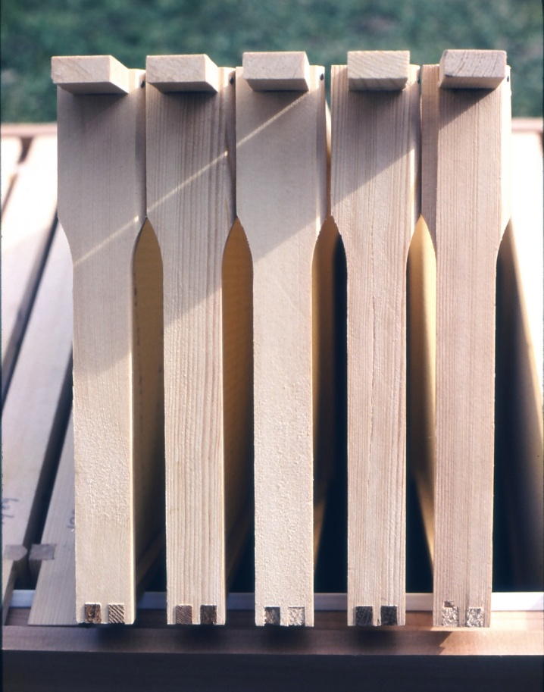
Bee Space – 6-8mm
Is between honeycomb and
sides of cavity
Allows bees to walk
through gaps
Is big enough for bees to
work back to back
Smaller gaps – filled
with propolis
Bigger gaps –
filled with brace comb
Hoffman Frames
Session 4: The Hive

Slide 11
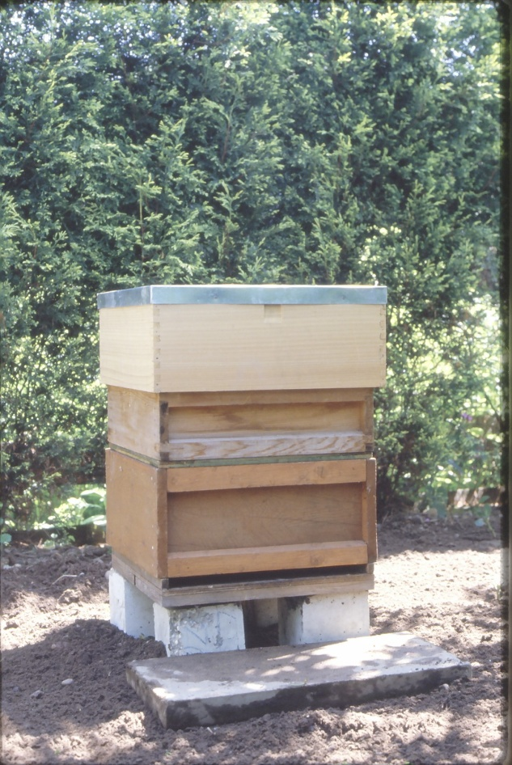
Beekeepers’ Requirements
Suitable container preferably
wood or polystyrene
Removable frames on
which comb may be constructed
Frames suspended in
boxes to maintain bee space
Hives at workable height
Work WITH the bees
rather than destroy their hard work
Session 4: The Hive

Slide 12
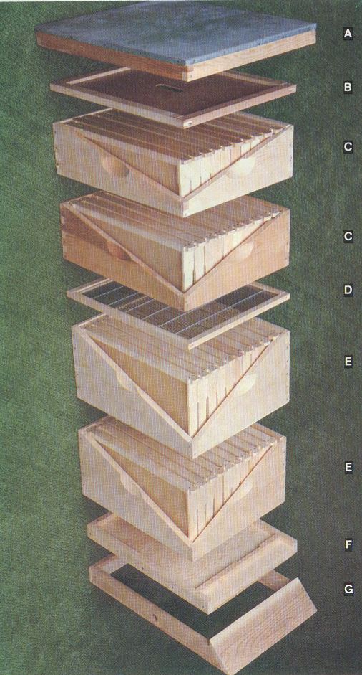
Hive Components
ROOF
CROWN BOARD
SUPER
SUPER
QUEEN EXCLUDER
BROOD CHAMBER 2
BROOD CHAMBER 1
FLOOR
STAND / ALIGHTING BOARD
Session 4: The Hive

Slide 13

Coffee
Session 4: The Hive

Slide 14
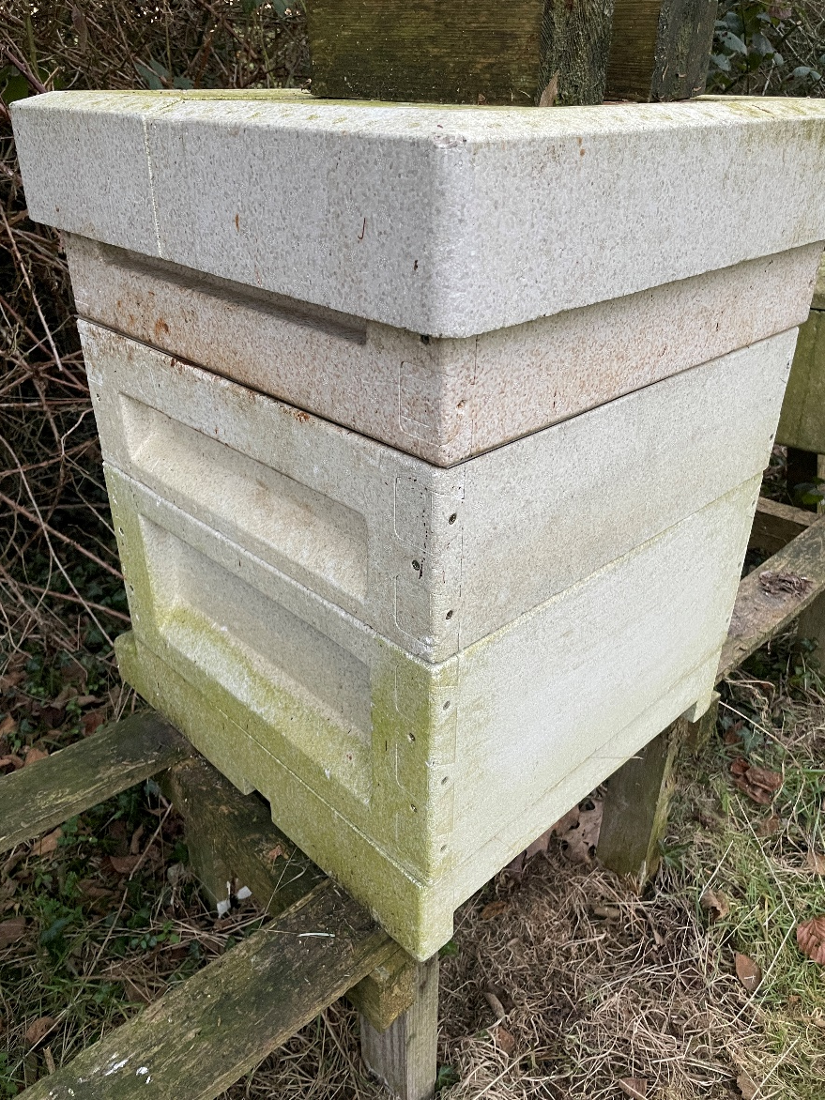
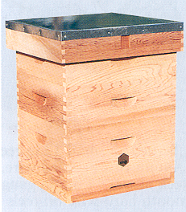
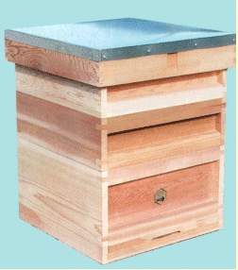
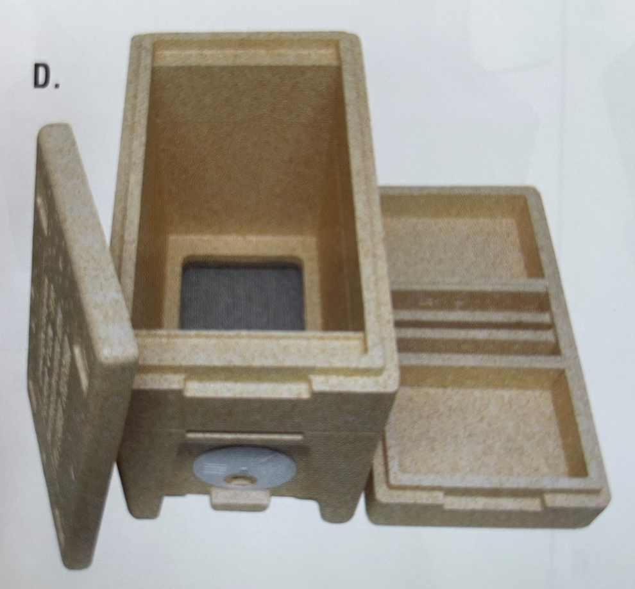
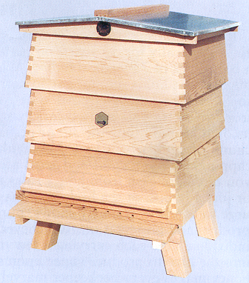
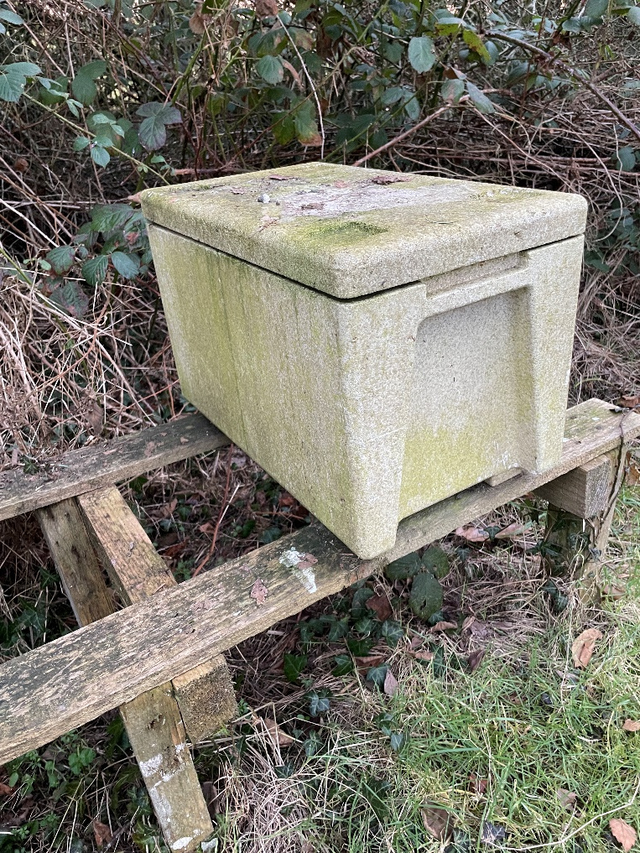
Common Hives in the UK
WBC
Smith
National
Courtesy of Thornes Catalogue
Session 4: The Hive

Slide 15
Optimal Brood Box Capacity
Maximum Queen’s daily rate of egg laying in summer about 2,000 eggs a day
Worker eggs will take 21 days to emerge as adult
Cells required for workers – 21 X 2000 = 42,000
Drone cells = 500
Honey stores = 10,000
Pollen stores = 10,000
Unusable cells, wastage – equivalent to = 9,500
TOTAL = 72,000 Cells
Session 4: The Hive

Slide 16
Hive Capacities
WBC - 10 Frames – 52,000
Smith - 11 Frames – 57,100
BS National Brood - 11 Frames – 57,100
BS Shallow - 11 Frames – 35,750
BS Deep 14 X 12 - 11 Frames – 78,550
Langstroth - 10 Frames – 72,250
Commercial - 11 Frames – 74,250
Modified Dadant - 11 Frames – 93,700
Session 4: The Hive

Slide 17
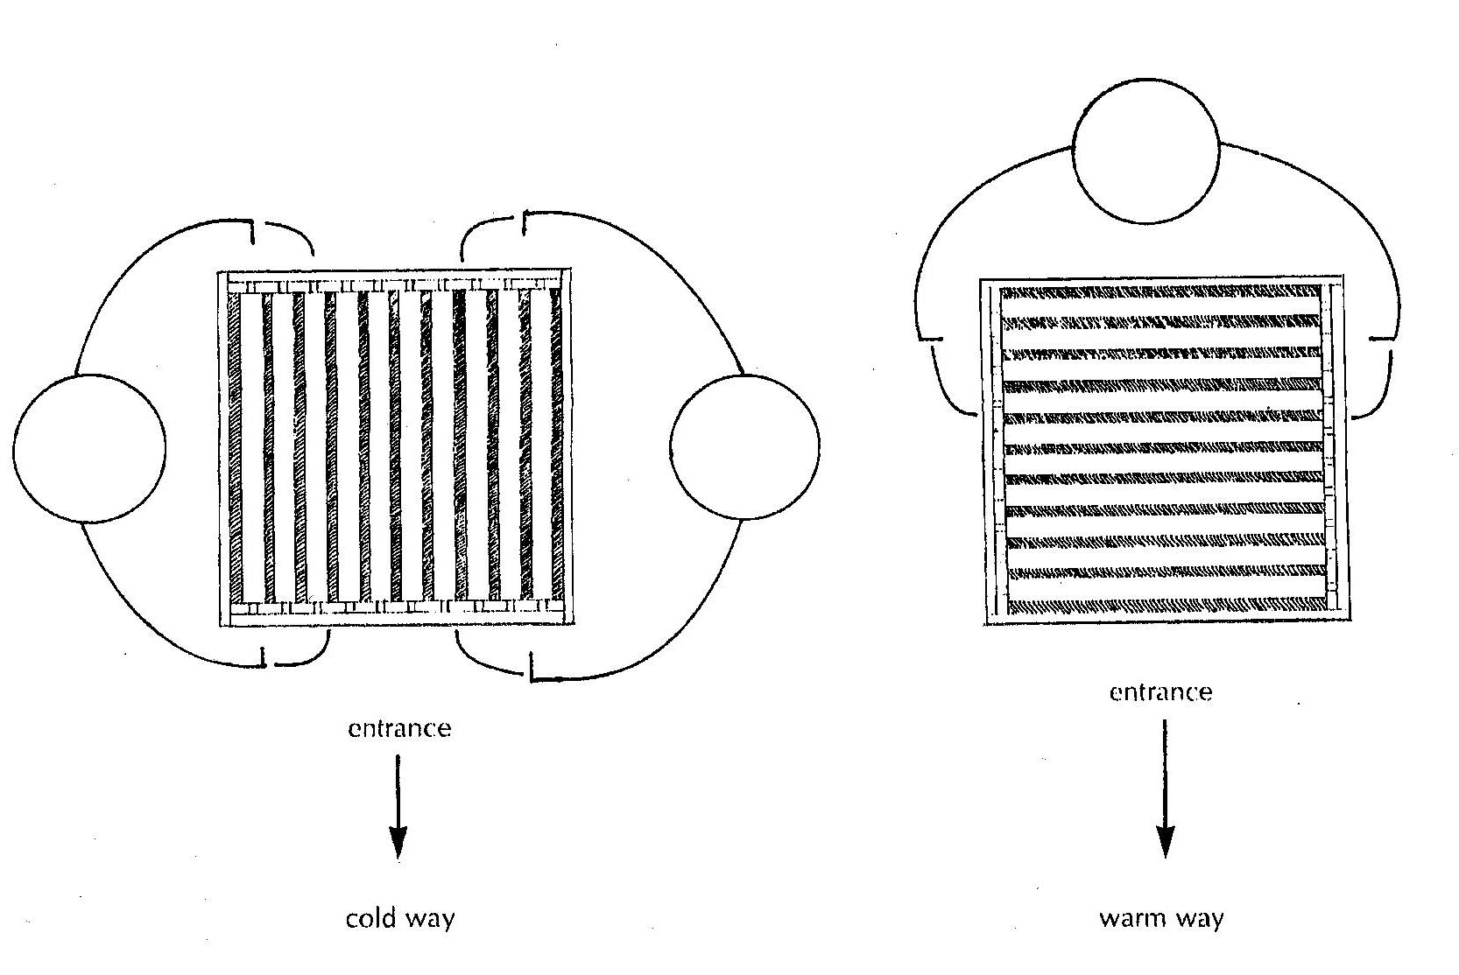
Brood Frames – Warm Way or the Cold Way
Session 4: The Hive

Slide 18
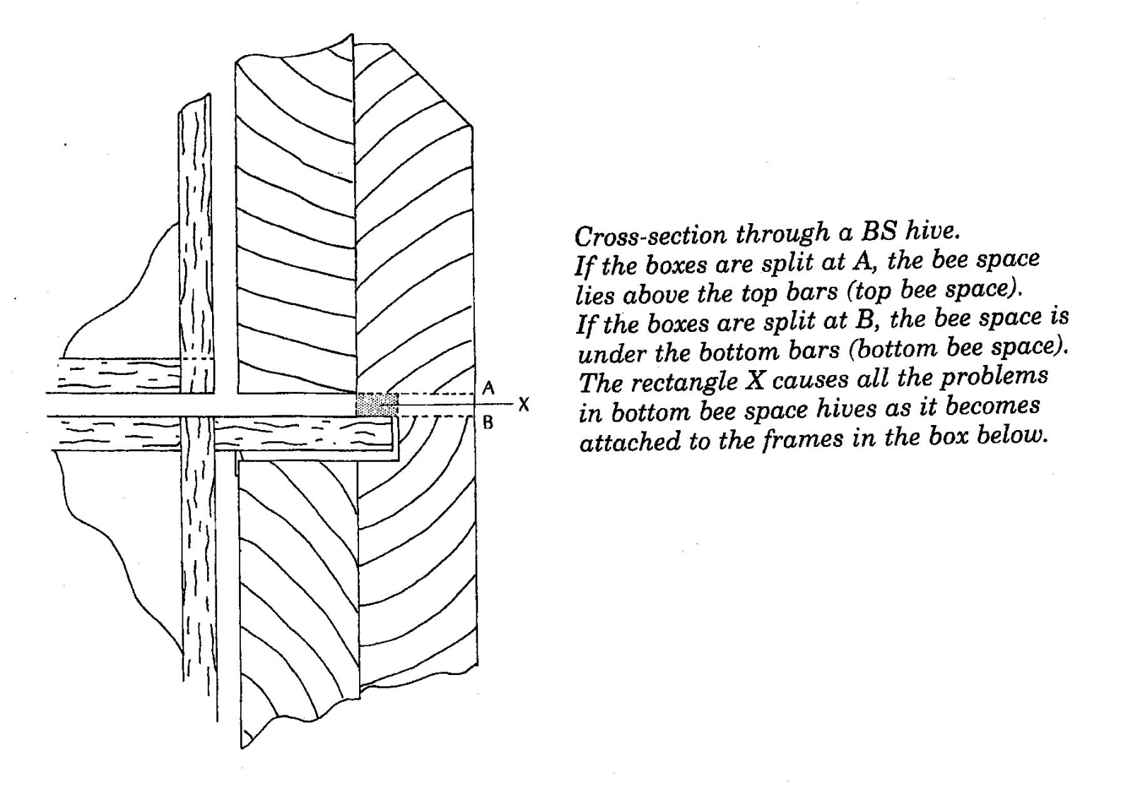
Top Bee Space or Bottom Bee Space?
of Courtesy of Kata De Bruyn Bruyn
Courtesy of de Bruyn
Session 4: The Hive

Slide 19
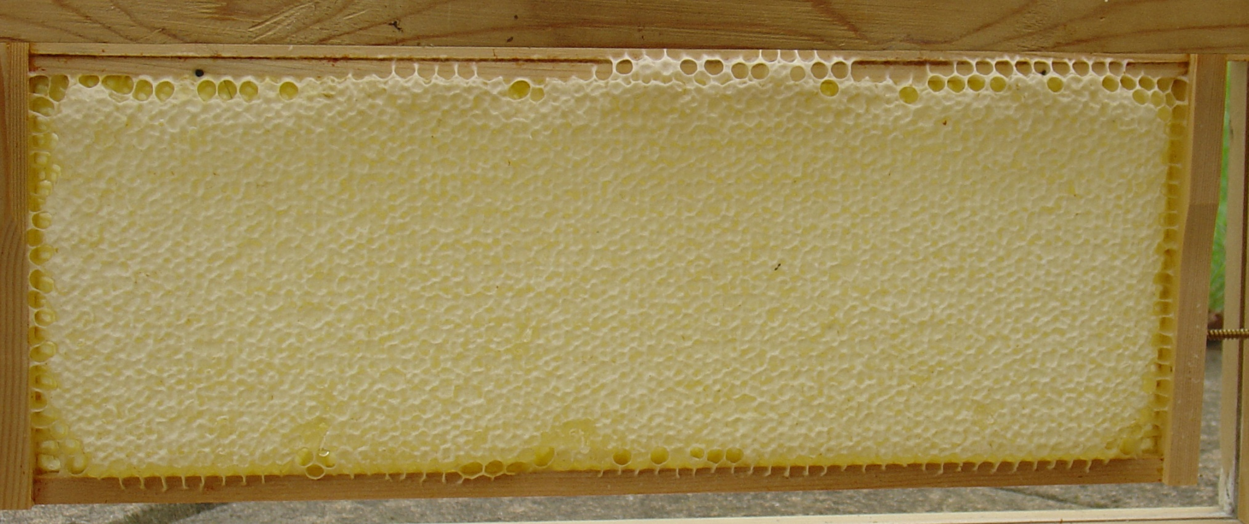
Supers
Designed to be stacked one on another
Shallower than brood box
Storage space above the brood body
Honey stored can be increased by using different frames or changing frame spacing
After extraction empty frames can be returned to be cleaned
Session 4: The Hive

Slide 20
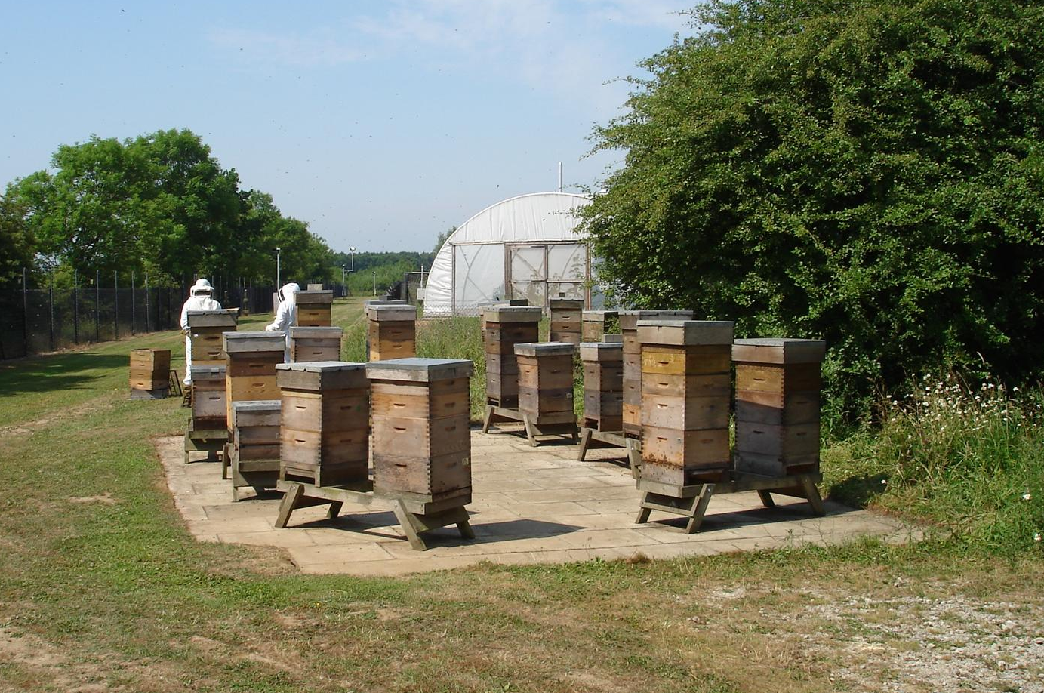
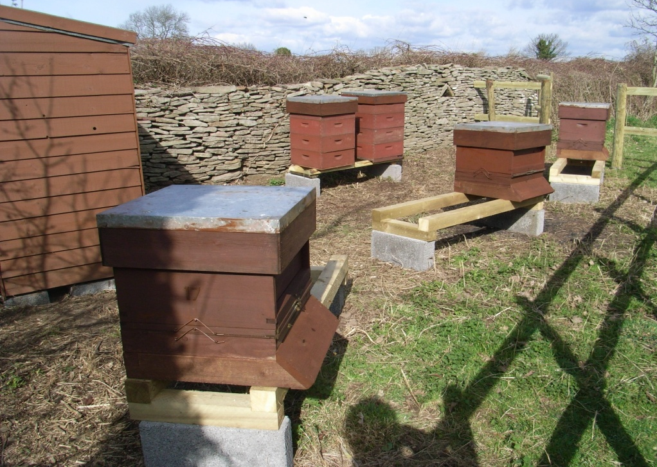
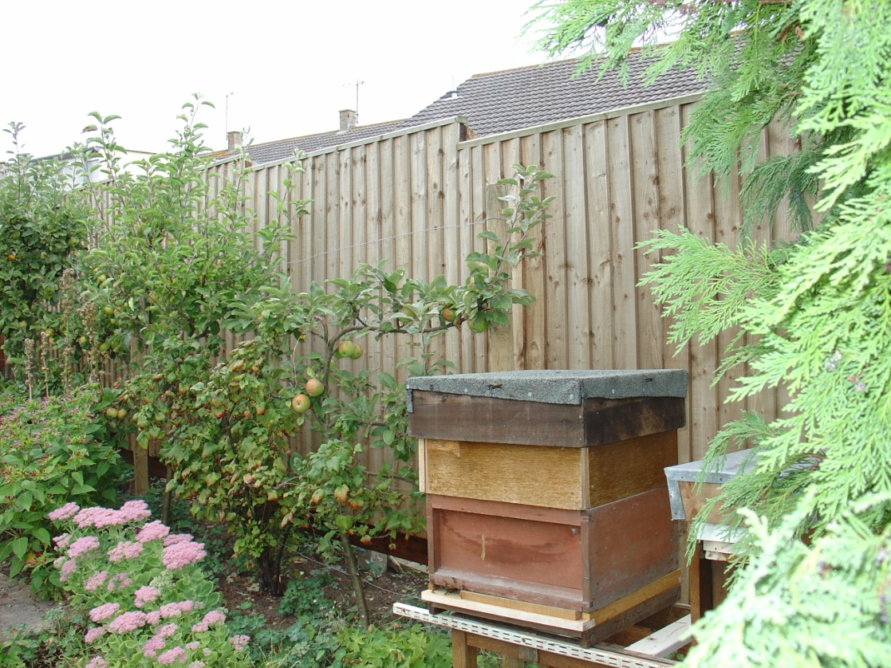
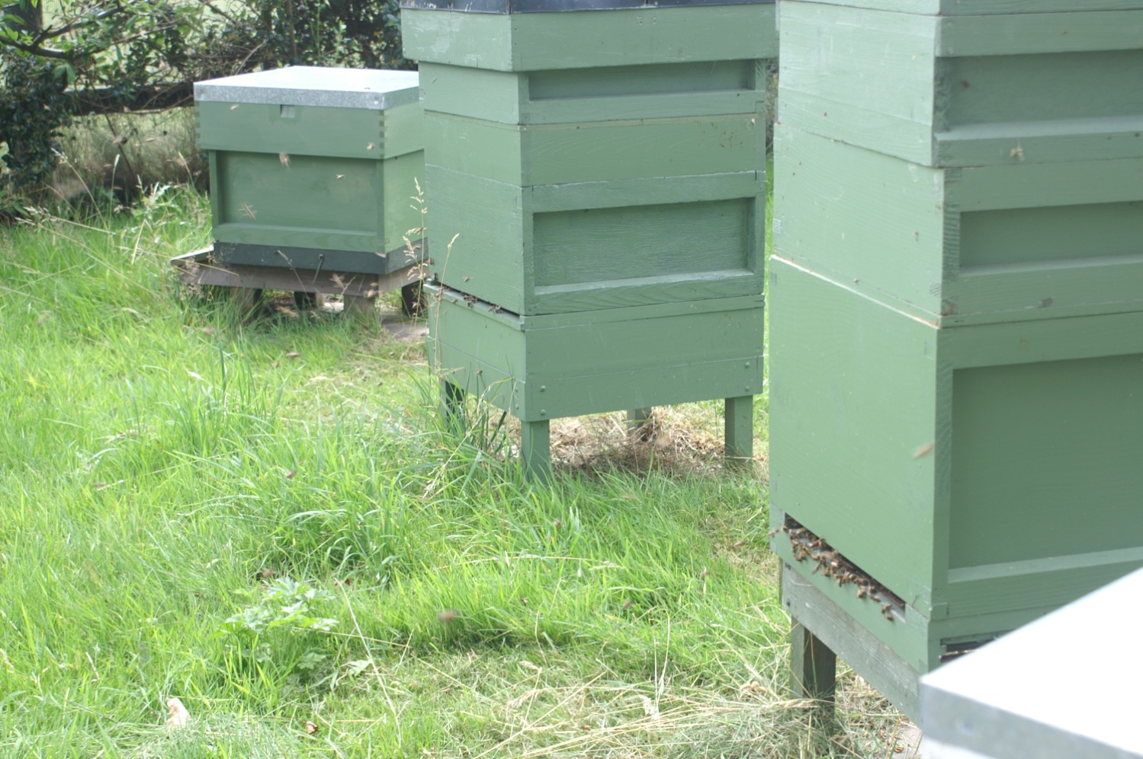
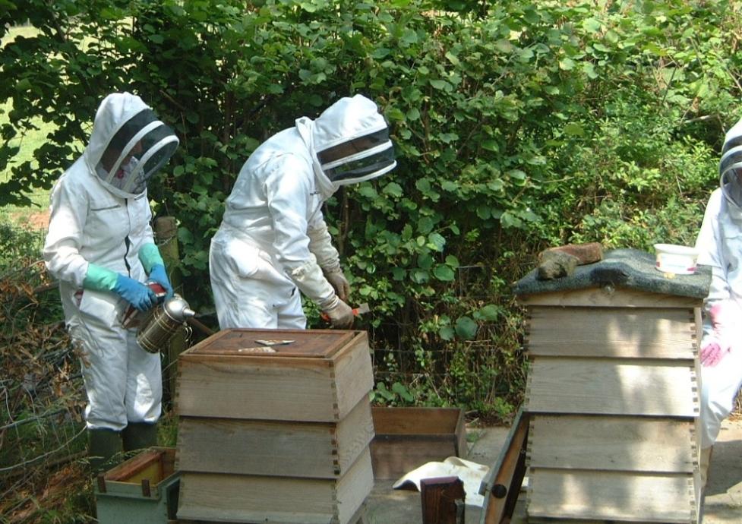
Beekeepers and Modern Hives
Session 4: The Hive

Slide 21
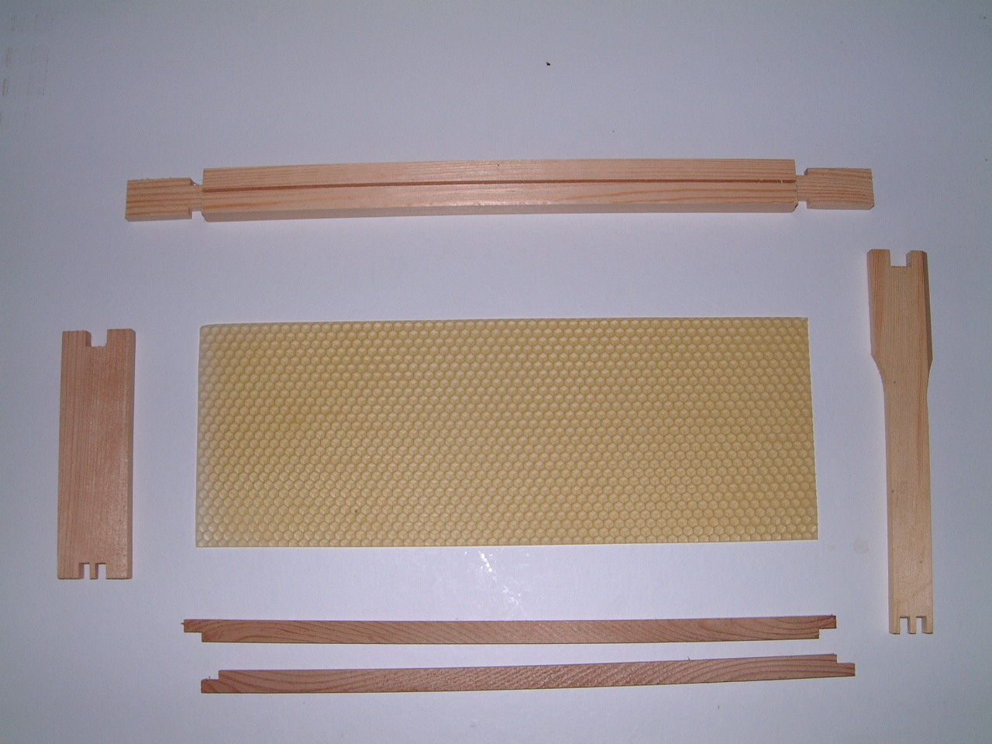
Frames
Foundation
Top bar
Manley Super
side bar
Hoffman Brood
side bar
Bottom Bars
Session 4: The Hive

Slide 22
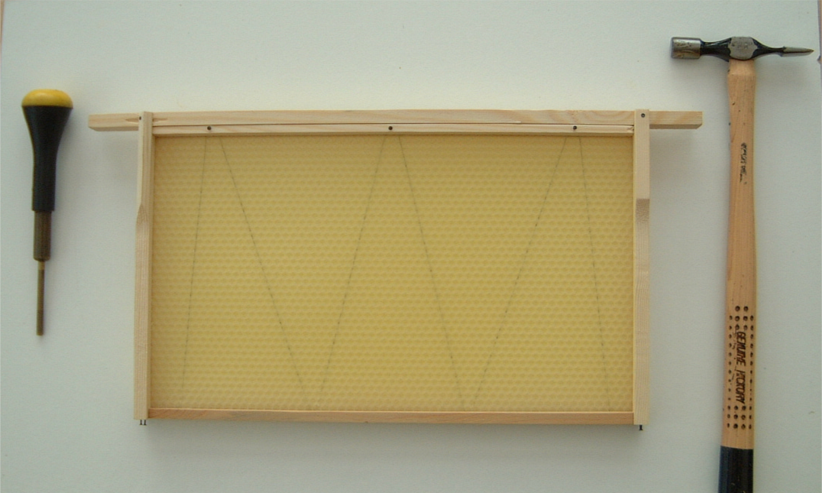
Frame with Correct Position of Pins
Pasition of pins are marked by arrows
Pin hammer
Punch
Session 4: The Hive

Slide 23
Quick Quiz
What is the approximate dimension of bee space?
  Answer = 6-8mm
How many frames in a WBC brood body?
  Answer = 10
What normally comes between a brood body and a super?
  Answer = A queen excluder
What are the two ways of aligning brood frames?
  Answer = Cold Way and Warm Way
What do the bees need to maintain temperature and humidity?
  Answer = Water and Honey
Session 4: The Hive

Slide 24
Closure
Read the following sections of your book for next session
  Page Chapter 8 - Bee and Colony Health
Next session is on Zoom next Wednesday
In session 8 there will be a detailed discussion about positioning a hive, setting up an apiary and the equipment you need
Session 4: The Hive

Slide 25

Questions?
Notes:
25

