Slide 1

Ludlow & District Beekeepers Association
Session 3 Book Chapter 5
An Introduction to Beekeeping:
The Beekeeping Year
Session 3: Beekeeping Year
1

Slide 2
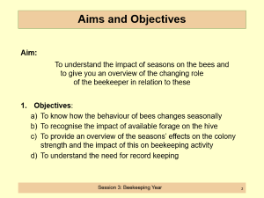
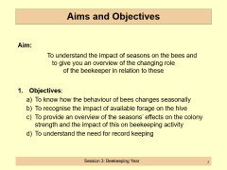
Aims and Objectives
Aim:
To understand the impact of seasons on the bees and
to give you an overview of the changing role
of the beekeeper in relation to these
Objectives:
  To know how the behaviour of bees changes seasonally
  To recognise the impact of available forage on the hive
  To provide an overview of the seasons’ effects on the colony strength and the impact of this on beekeeping activity
  To understand the need for record keeping
Session 3: Beekeeping Year

Slide 3
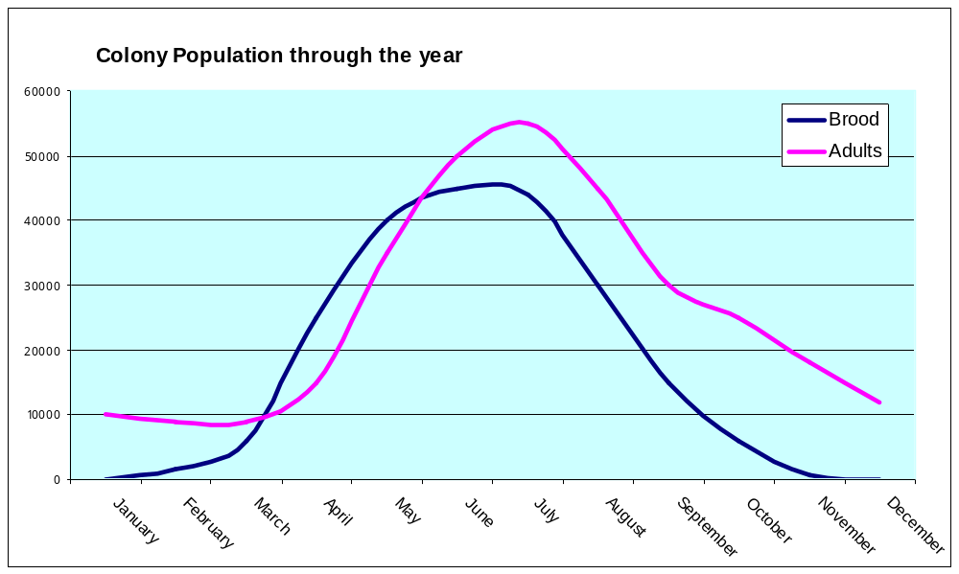
Seasonal Changes on Population
Session 3: Beekeeping Year

Slide 4
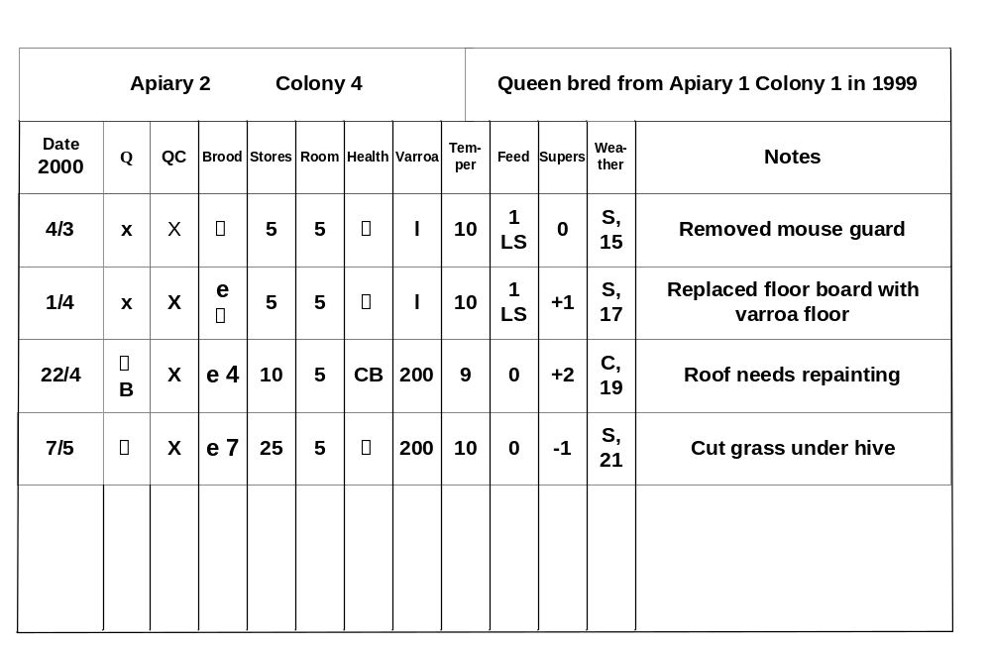
Record Card for Beekeeping
Session 3: Beekeeping Year

Slide 5
Autumn – September to November
Check food stores
Check for diseases
  Shake or brush
  off the bees
  Foulbrood
  Verroa.
Prepare for removal
of old combs
Colony demographics
30,000 workers
One queen
No drones
Session 3: Beekeeping Year

Slide 6
Other Autumn Operations
FEEDING:
  Assess stores for winter
  Assess type and number of feeders available
  Feed if necessary
UNITING:
  Assess hives which might need to be combined for winter (remove one queen).
  Decide which method for uniting hives to use
Session 3: Beekeeping Year

Slide 7
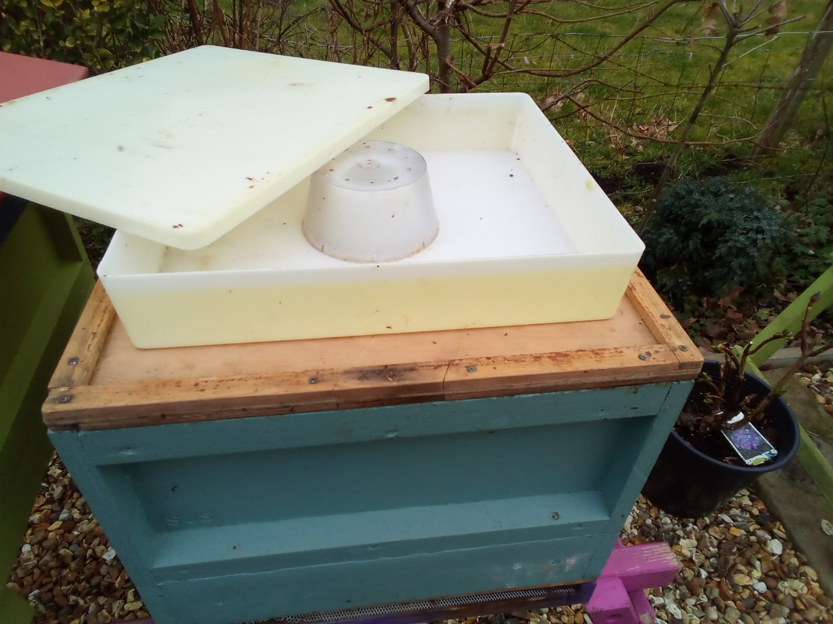
How a Feeder Works
Syrup in feeder is placed above the crownboard over the feed hole
Bees come up into the feeder and walk over the top because they can grip on the sides of the cone. They can then safely reach the syrup. As the bees take the feed, the syrup level falls until the feeder is empty
Miller type
Crown Board
Feed hole in crown board so bees can access syrup
Session 3: Beekeeping Year

Slide 8
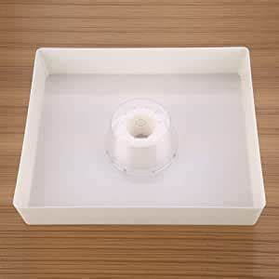
Hive Feeders for Autumn Bulk Feeding
1
2
3
Session 3: Beekeeping Year

Slide 9
Autumn – Winter Preparation
September
Drones are likely to disappear overnight
Hive population is vastly reduced
Start winter feeding towards the end of the month
October
Very little activity – Bees are preparing for winter
Finish winter feeding
Check hive is secure for winter
Add mouse guards
Session 3: Beekeeping Year

Slide 10
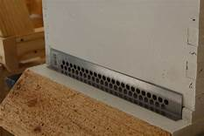
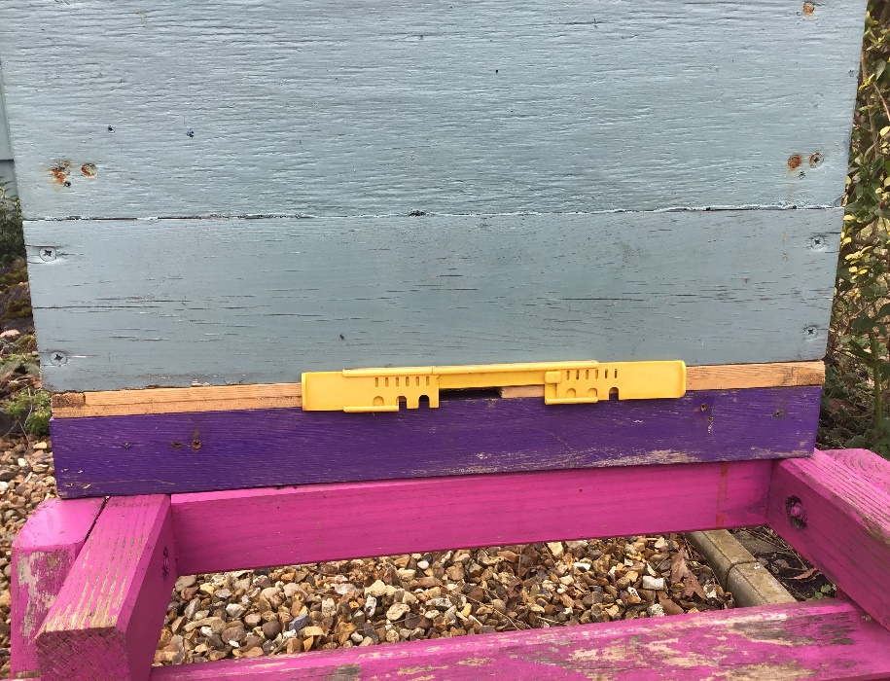
Mouse Guards
Session 3: Beekeeping Year

Slide 11
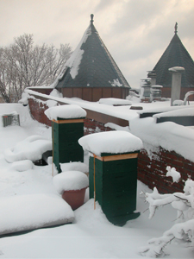
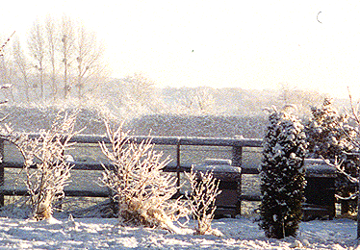
Prepare for poor weather!
Bees cluster to keep warm
Use honey and shiver to
generate heat
Roof Insulation
Wind, frost pockets
Protection (woodpeckers)
Session 3: Beekeeping Year

Slide 12
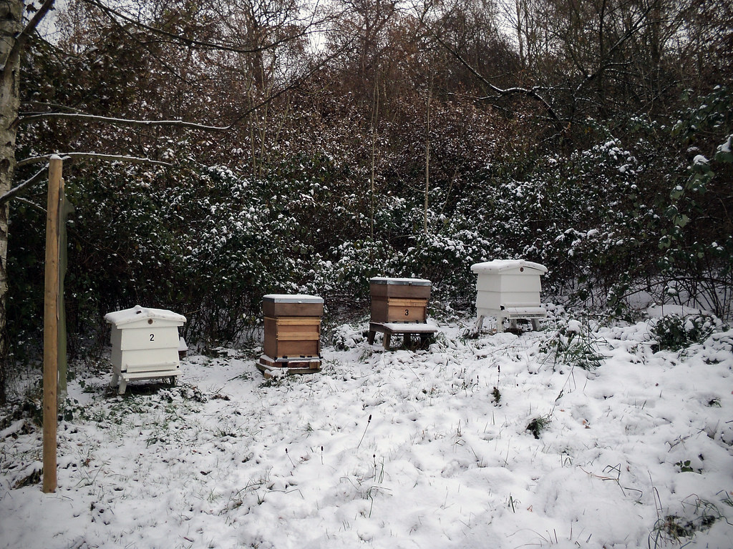
Winter
November
Even less activity
Bees will probably
go into a cluster
Store equipment
for winter
December
Bees are in
a cluster
Enjoy Christmas
Session 3: Beekeeping Year

Slide 13
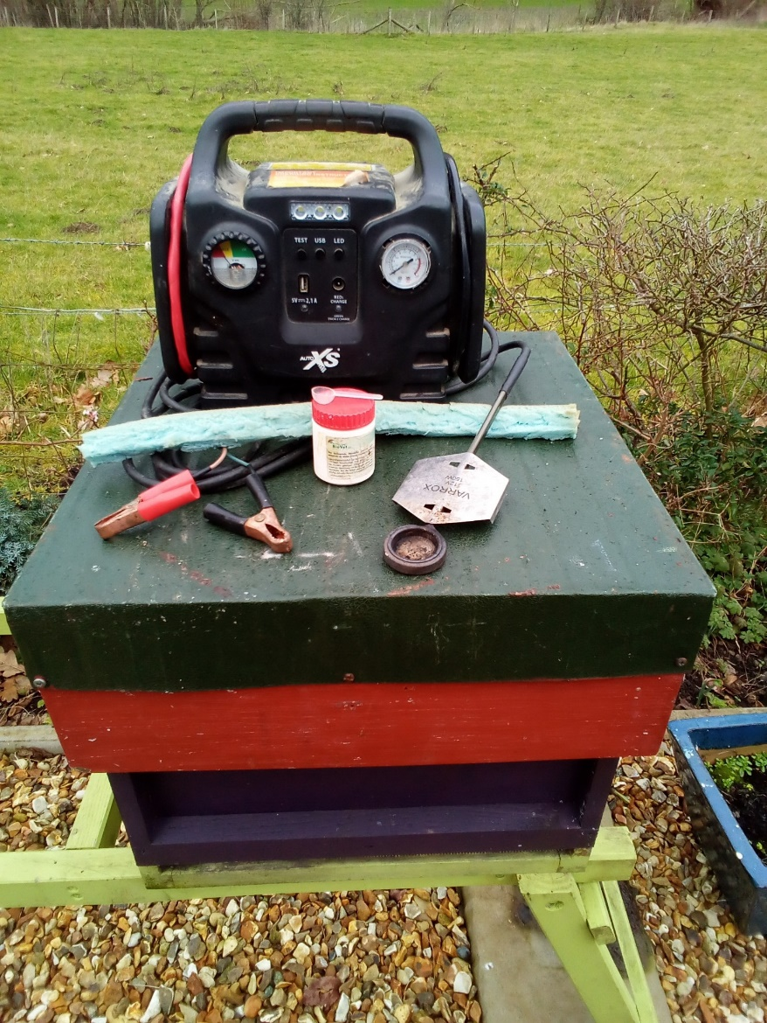
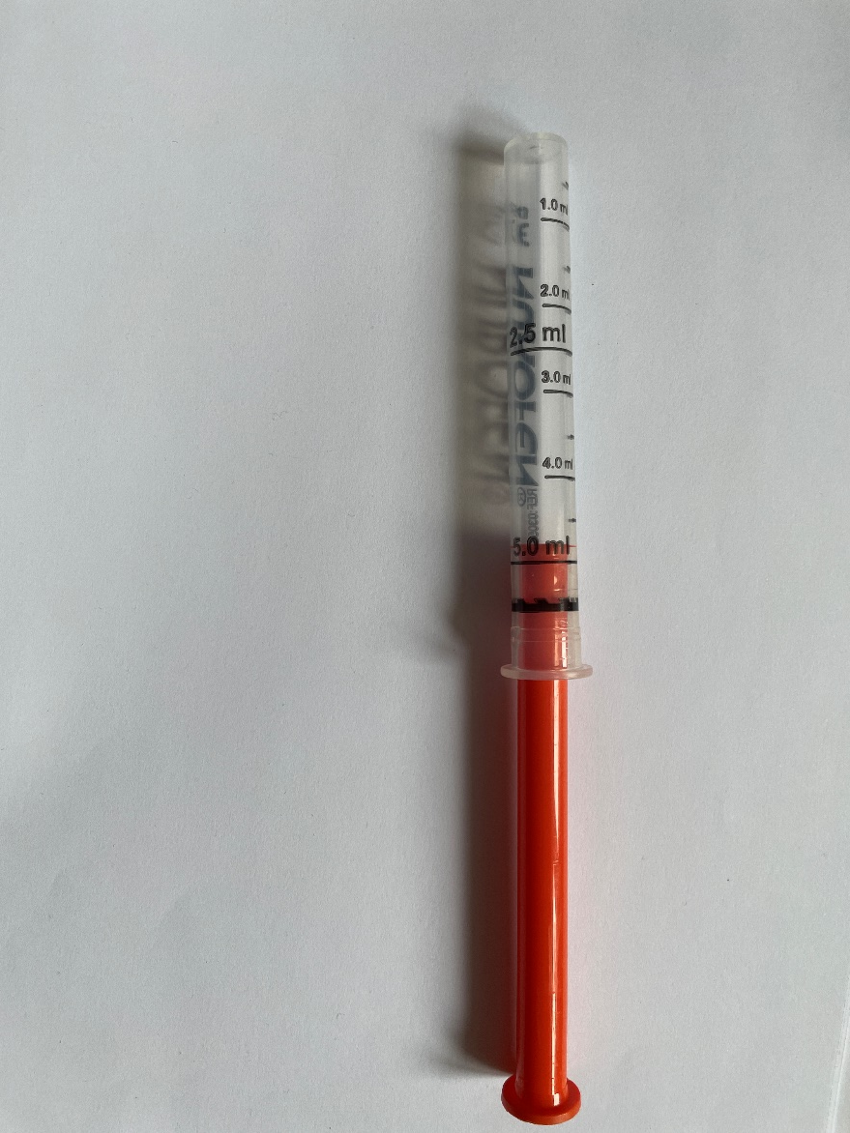
Winter Oxalic Treatment
Trickle treat –
solution trickled onto each
seam of bees
Sublimate using oxalic
acid crystals with specialist
equipment
(Practical demonstration
of this later in the season)
Sublimation
Verroa Slide Inspection
Session 3: Beekeeping Year

Slide 14
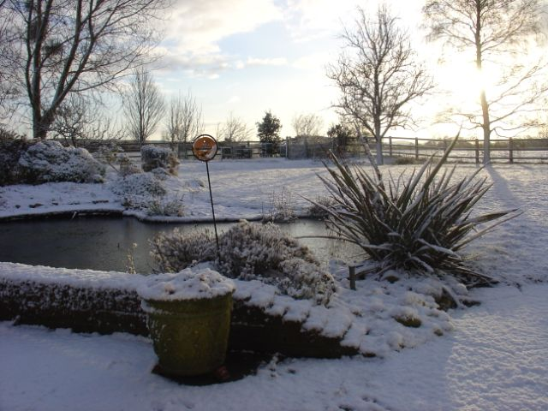
Winter: December to February
Go on holiday!
Crisis time for the colony
Starvation
Watch the entrance!
~ 10,000 workers
~ 1 queen
~ No drones
Session 3: Beekeeping Year

Slide 15

Coffee
Session 3: Beekeeping Year

Slide 16

Winter
January
The queen is tightly
clustered
Bees may fly to
defecate on a warm
day
No drones
Some worker brood
may be raised
February
Queen is still in a rugby ball cluster
A few more eggs are laid each day
Workers take cleansing flights
Session 3: Beekeeping Year

Slide 17
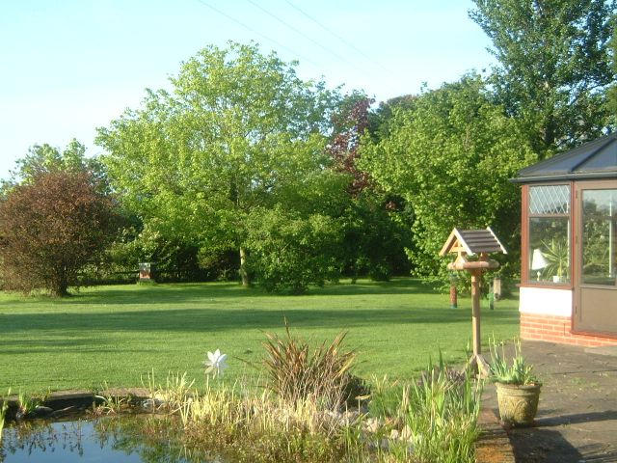
Spring: March to May
Colony increases rapidly
Monitor varroa levels
First inspection
Swarm control
1 x weekly inspections
~ 40,000 workers
~ 1 queen
~ 400 drones
Session 3: Beekeeping Year

Slide 18
Other Spring Tasks
March:
Colonies can die of starvation
  Queens increase laying
  More bees = more stores consumed
  Stores are not replaced as there is too little nectar available
On a warm day check for stores
Feed some syrup if necessary
April
Flowering currant and oil seed rape become available for nectar
Drones appear and increase in brood is significant
Find and mark the queen if necessary
Put on a queen excluder and super
Session 6: Seasonal Management

Slide 19
The Beekeeper’s Year – Busy months…
May:
Nectar and Pollen will come in thick and fast
The Queen will be reaching her greatest rate of laying
There will be brood across most of the brood box
Add Supers as necessary
Some Honey can be removed
Inspect for preparation for swarming
Inspect weekly
Have a spare hive to hand
Session 6: Seasonal Management

Slide 20
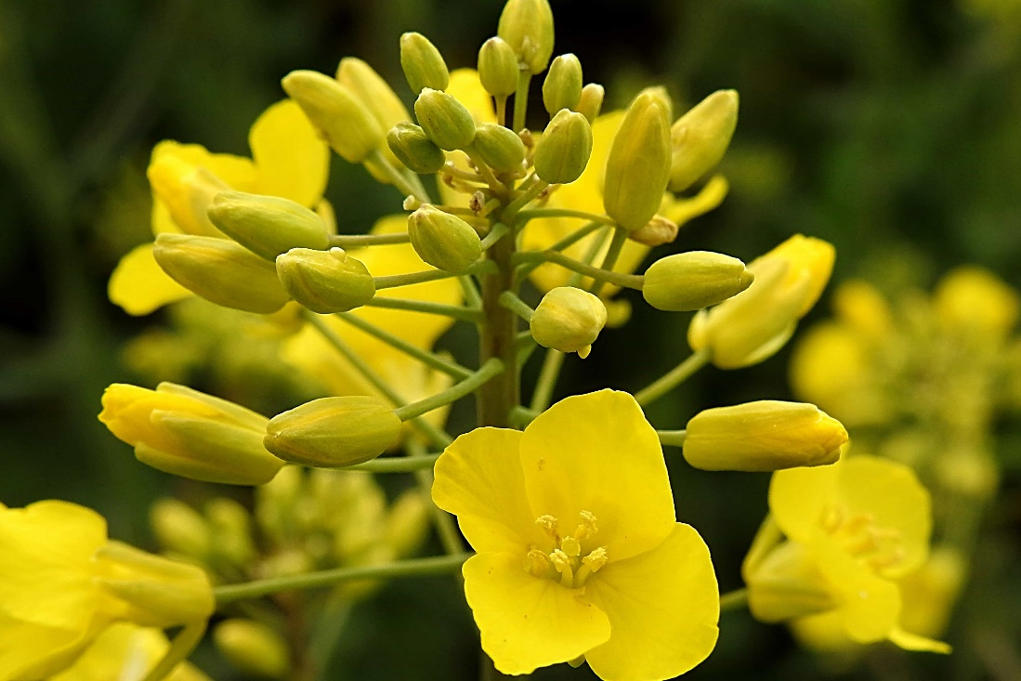
The Beekeeper’s Year – Busy months…
June
Unswarmed colonies
will be populous
The Queens rate
of lay should drop
If Oil Seed Rape
is worked by the
bees then extraction
is necessary
  Consider the ‘June Gap’
Maintain inspections for swarming
  Artificially swarm if necessary
Session 6: Seasonal Management

Slide 21
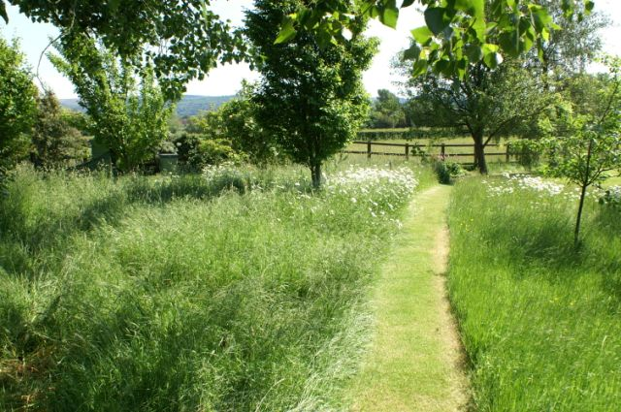
Summer: June to August
Many bees = excess honey
crop
Remove crop in early August
Ensure hives are bee-tight
  Robbing by bees
  and wasps
Extract the honey and store
~ Up to 60,000 workers
~ 1 queen
~ 400 drones
Session 3: Beekeeping Year

Slide 22
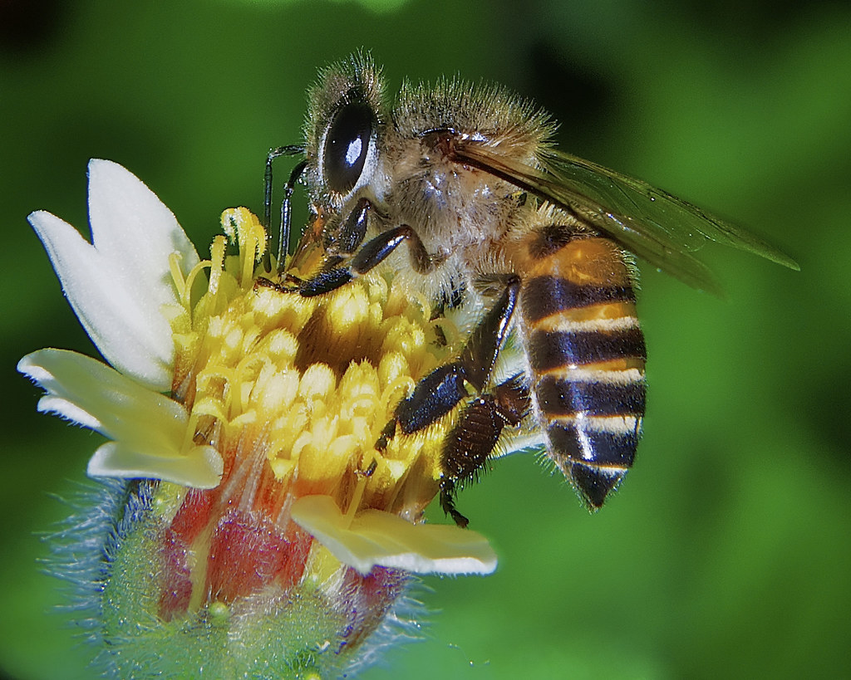
The Beekeeper’s Year – Still Busy!
July
Continued nectar flow
The hive population
diminishes
Drones will still
be present
Add Supers
as necessary
Continue swarm
control inspections
Session 6: Seasonal Management

Slide 23
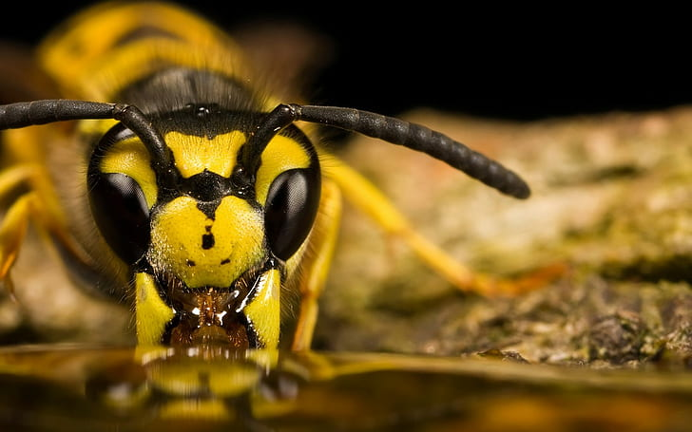
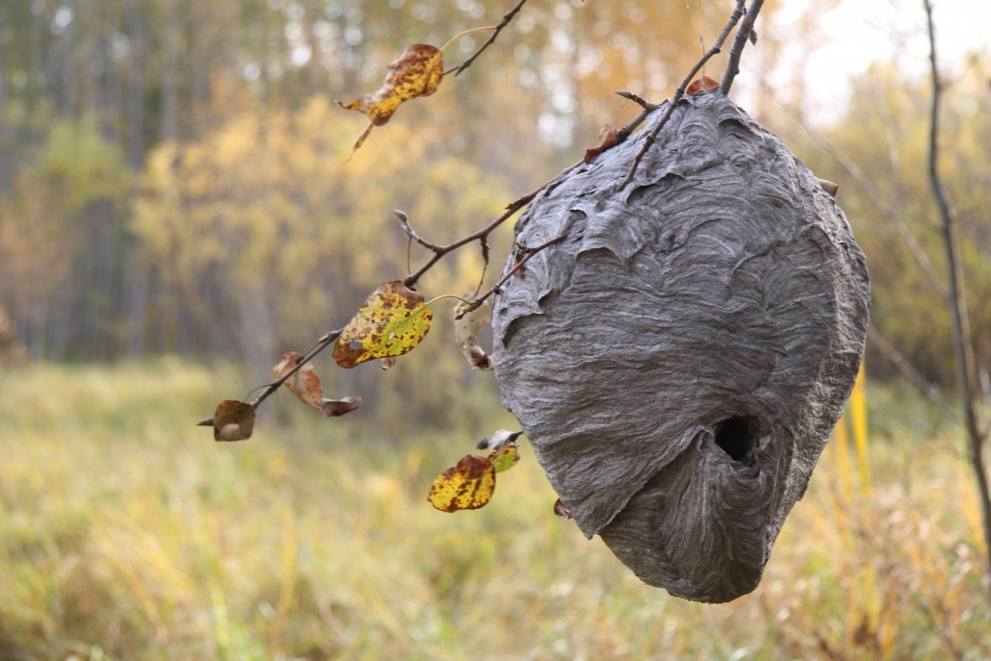
The Beekeeper’s Year – Still Busy!
August
Colony Strengths
diminishes fast
Drones are still around
Outside activity is
reduced as nectar
availability is reduced
Continue swarm
control inspections
Watch for wasps and potential of robbing
  Consider restricting the entrance
Replace the old queen if you have reared a new one
Session 6: Seasonal Management

Slide 24
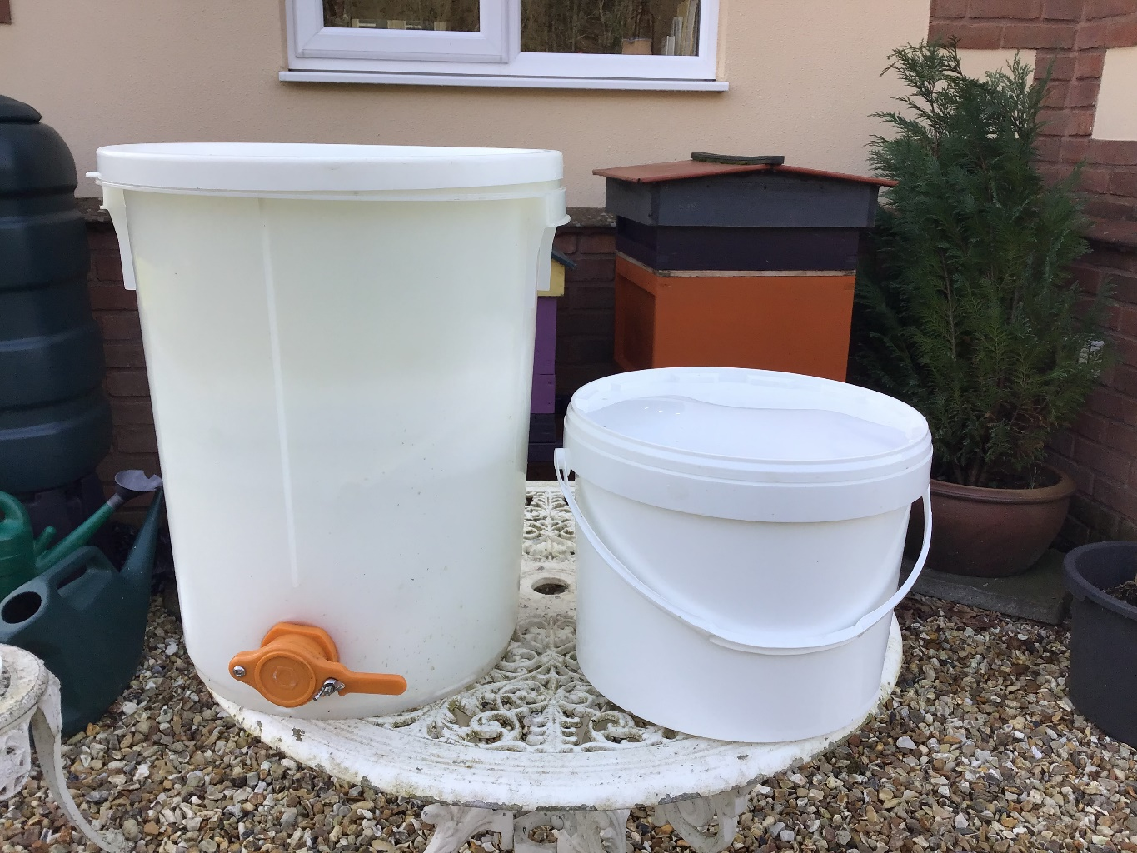
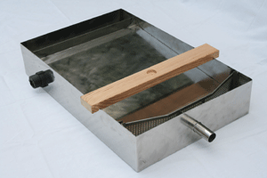
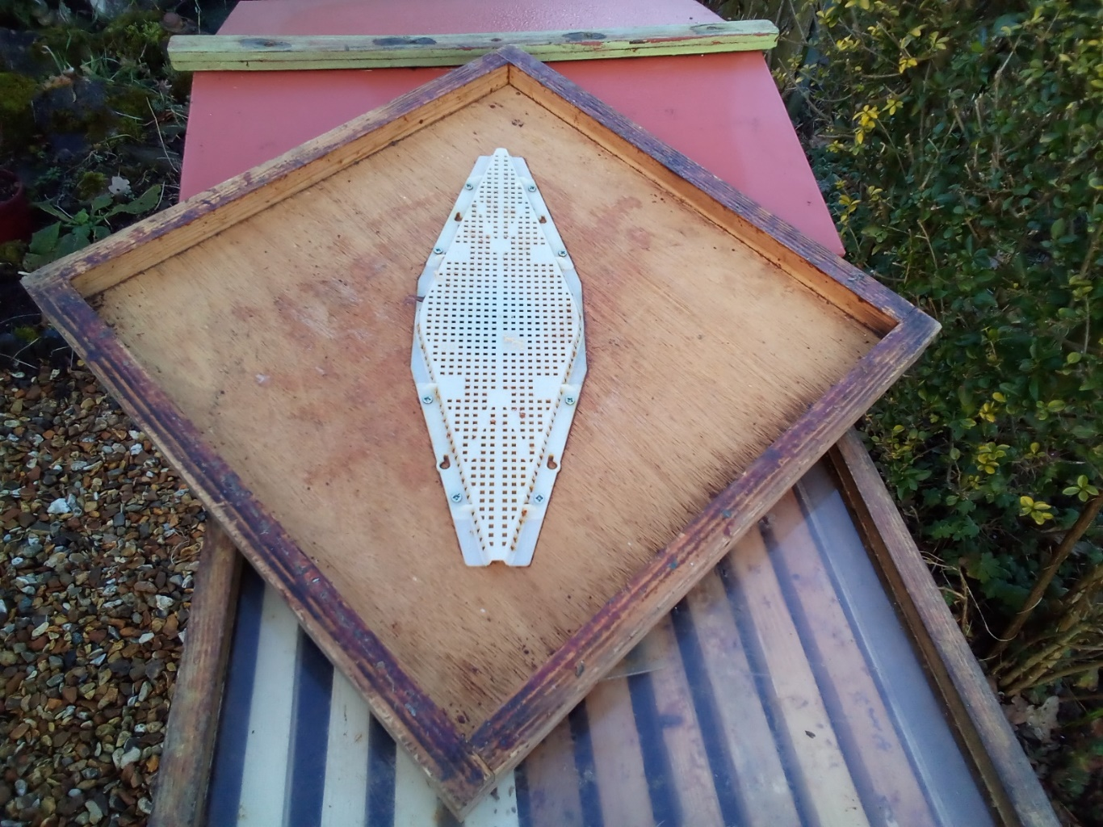
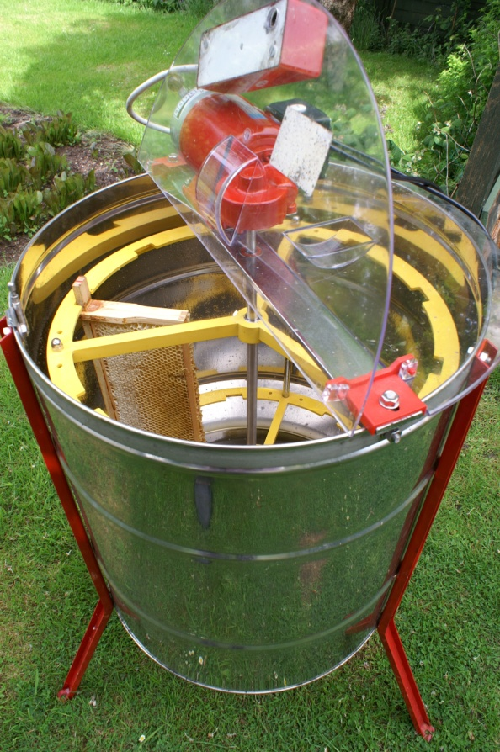
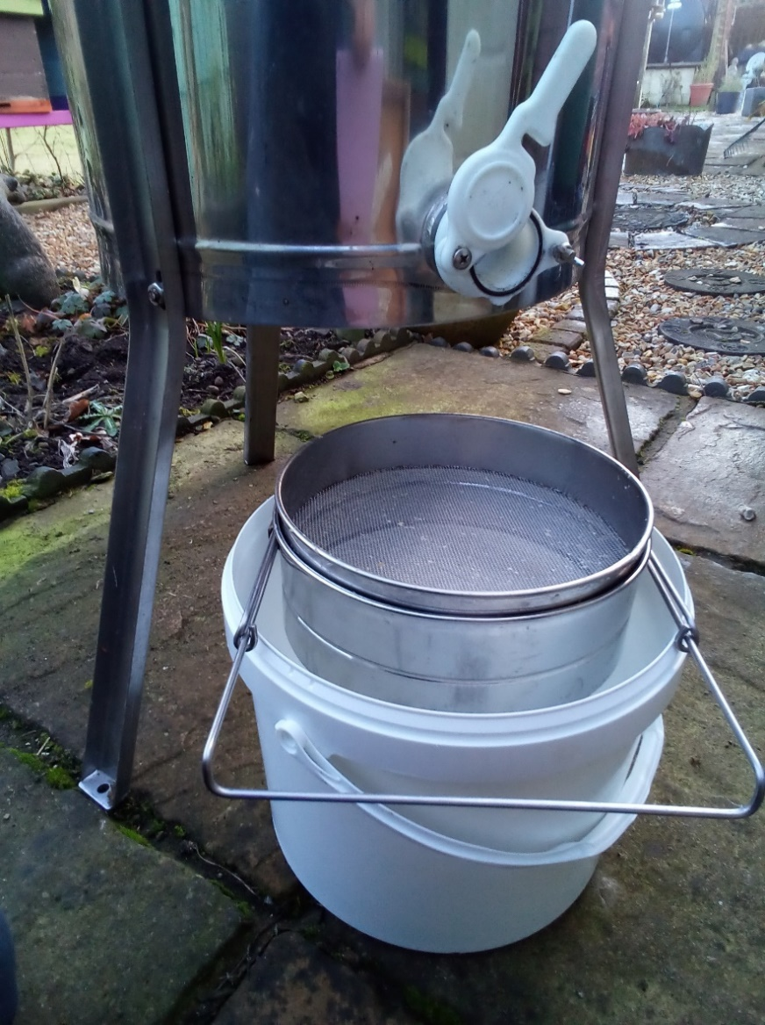
Extraction and Storage
Removing
Frames
Clearer Board
Uncapping
Extractors
Filters
Storage
Session 3: Beekeeping Year

Slide 25
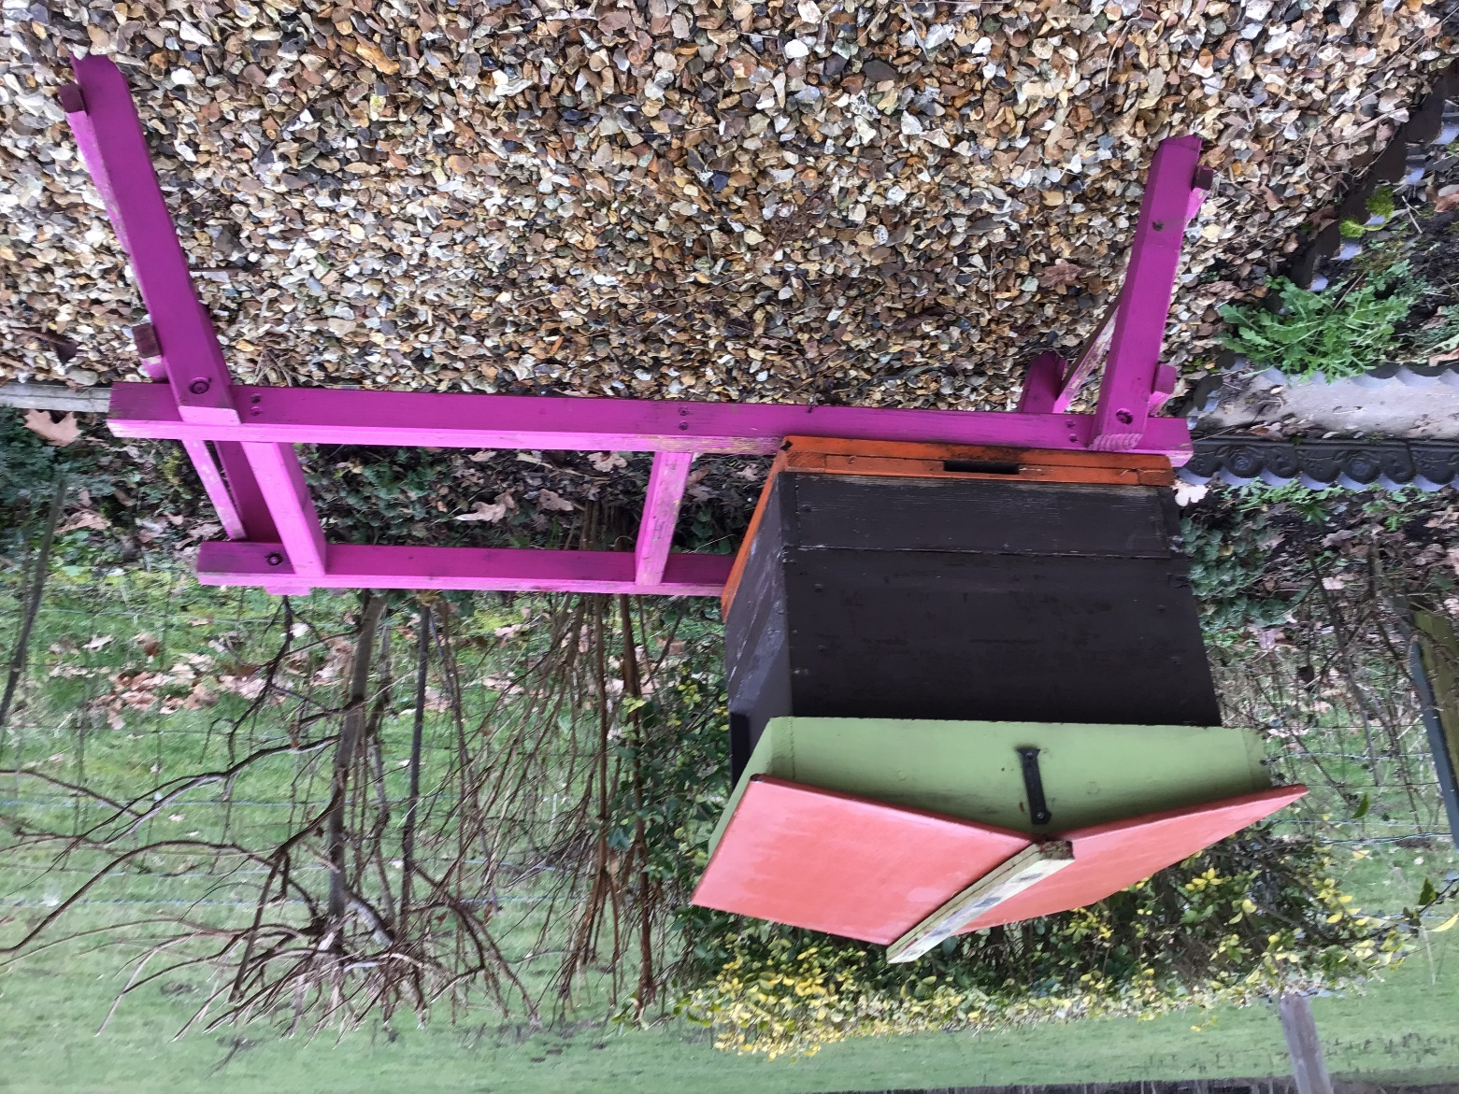
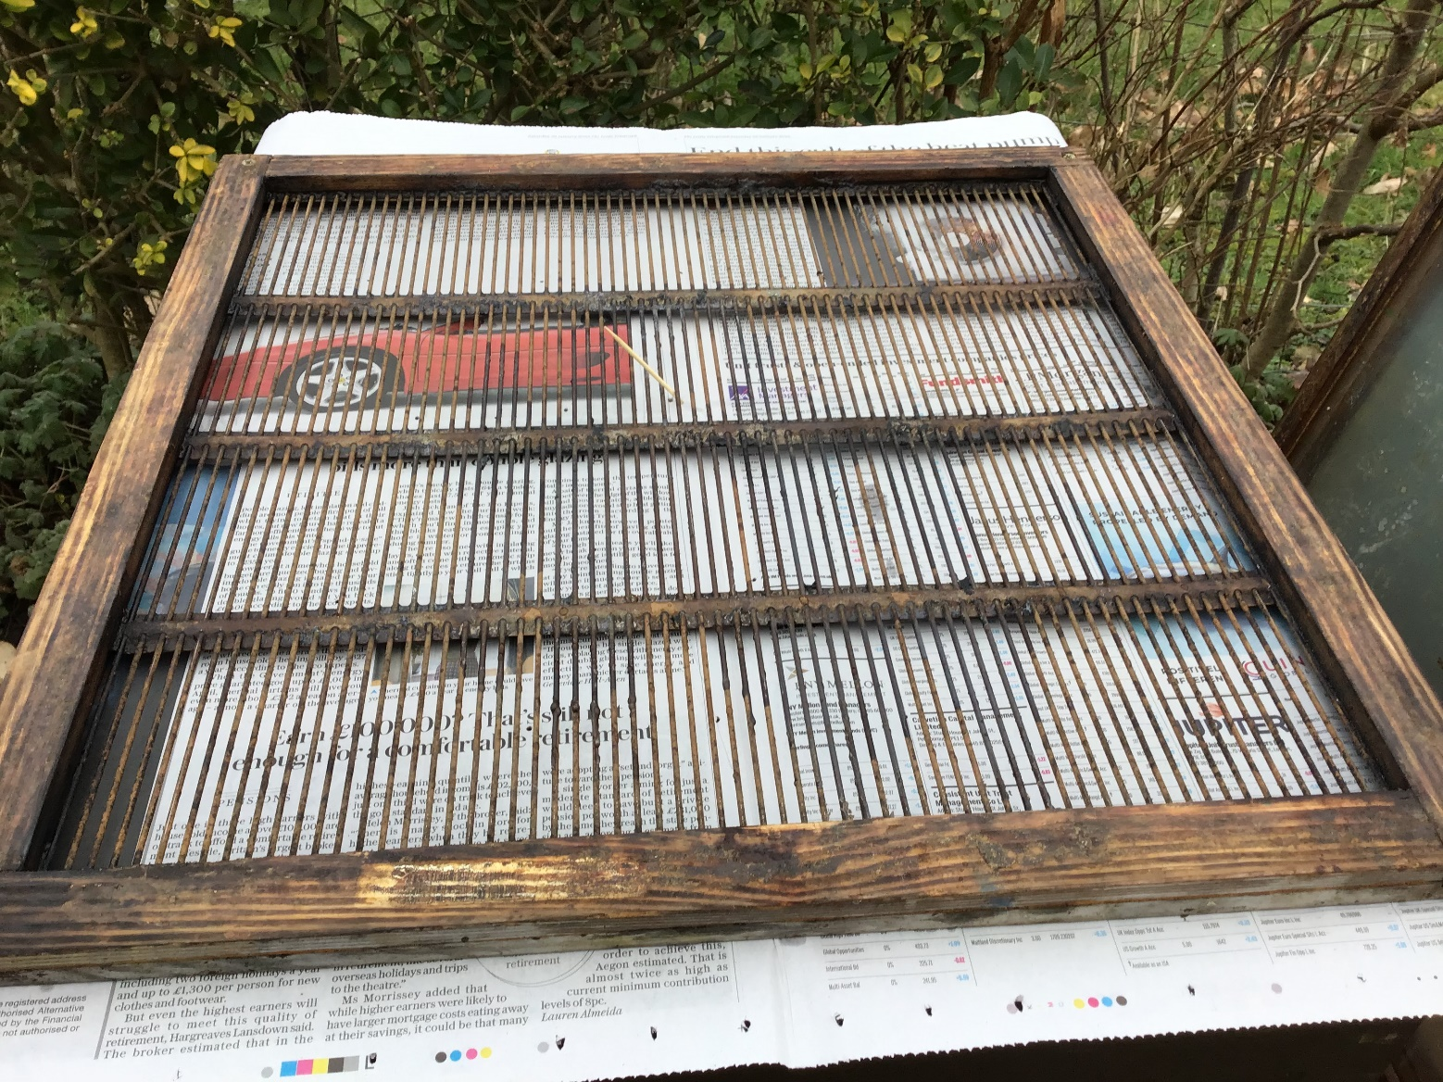
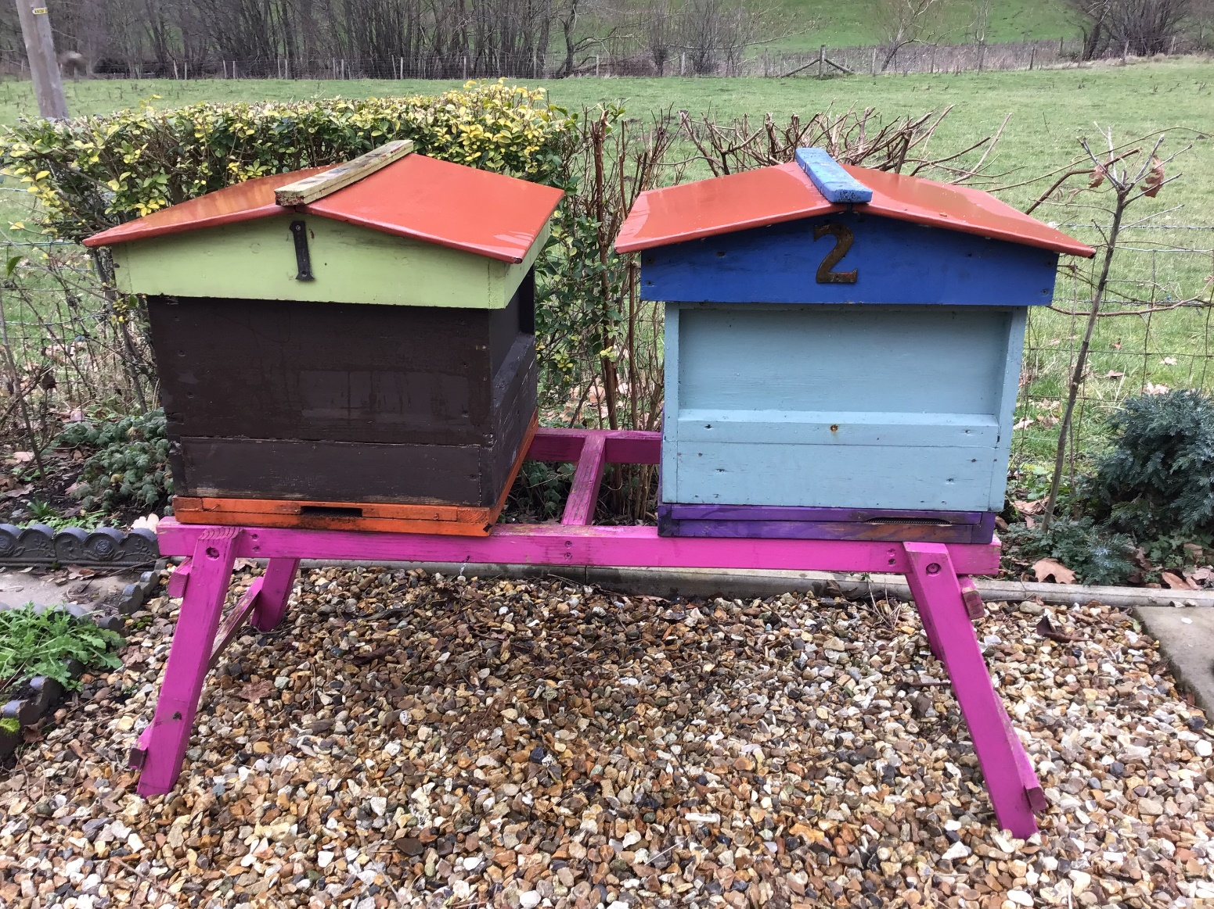
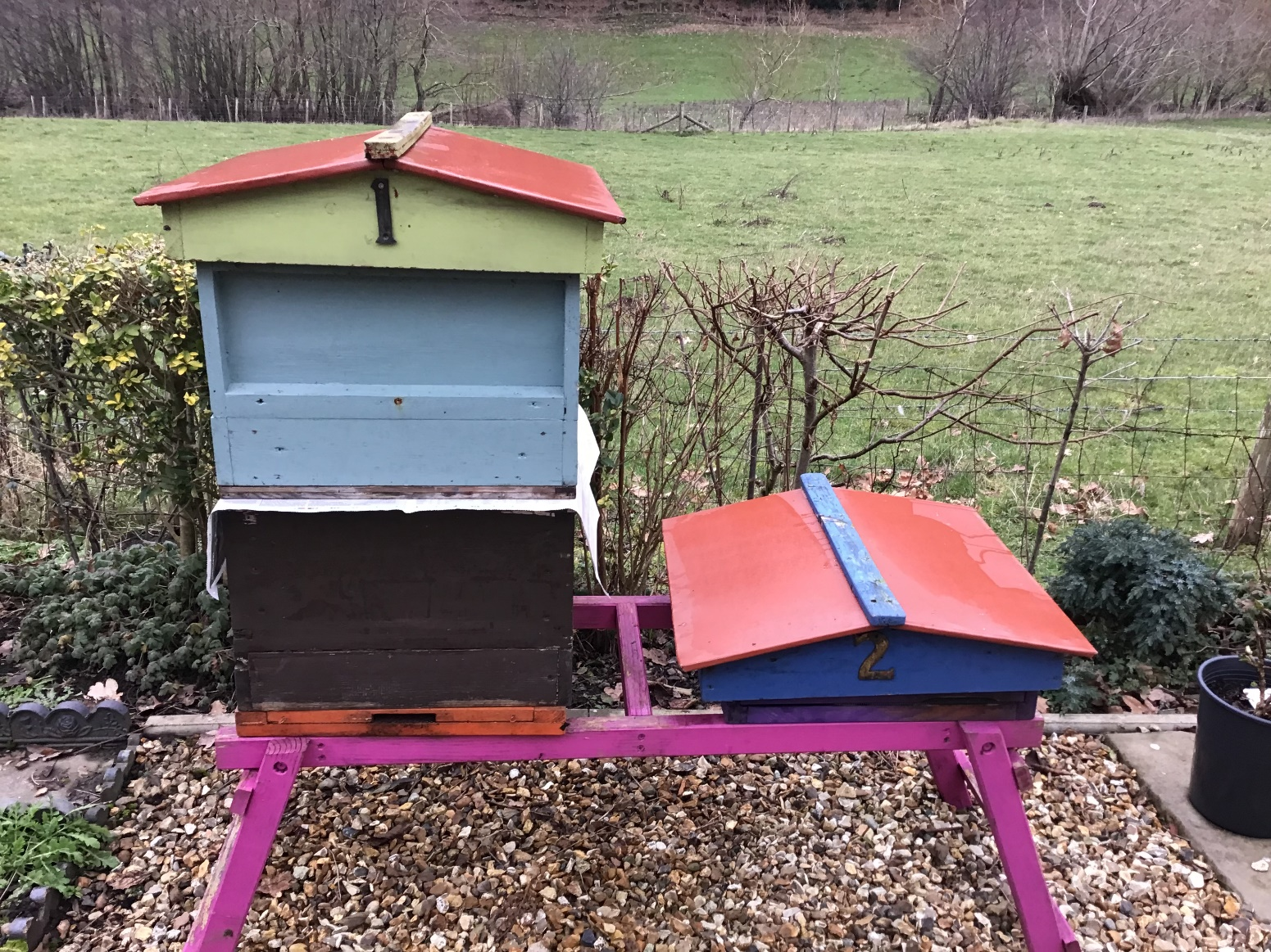
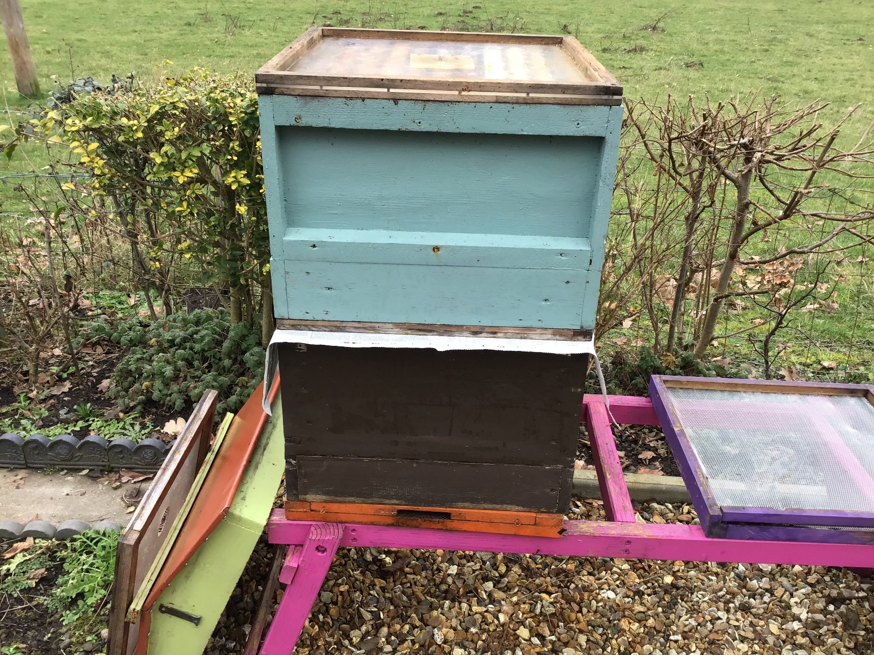
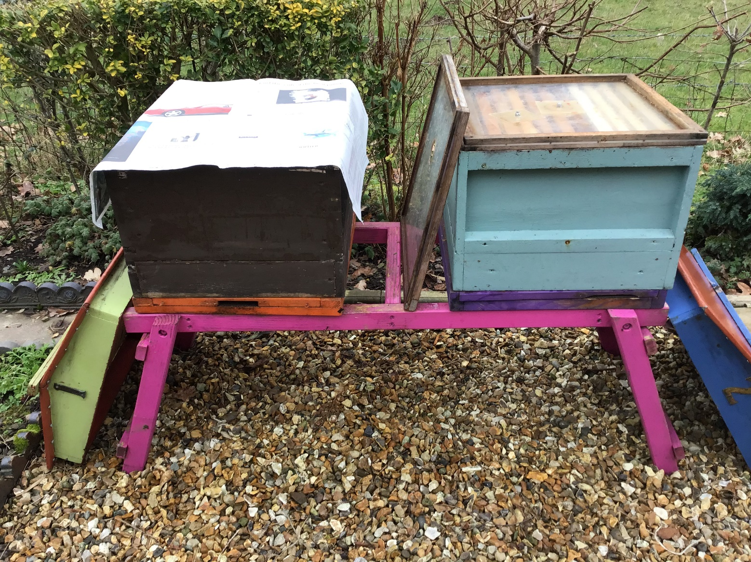
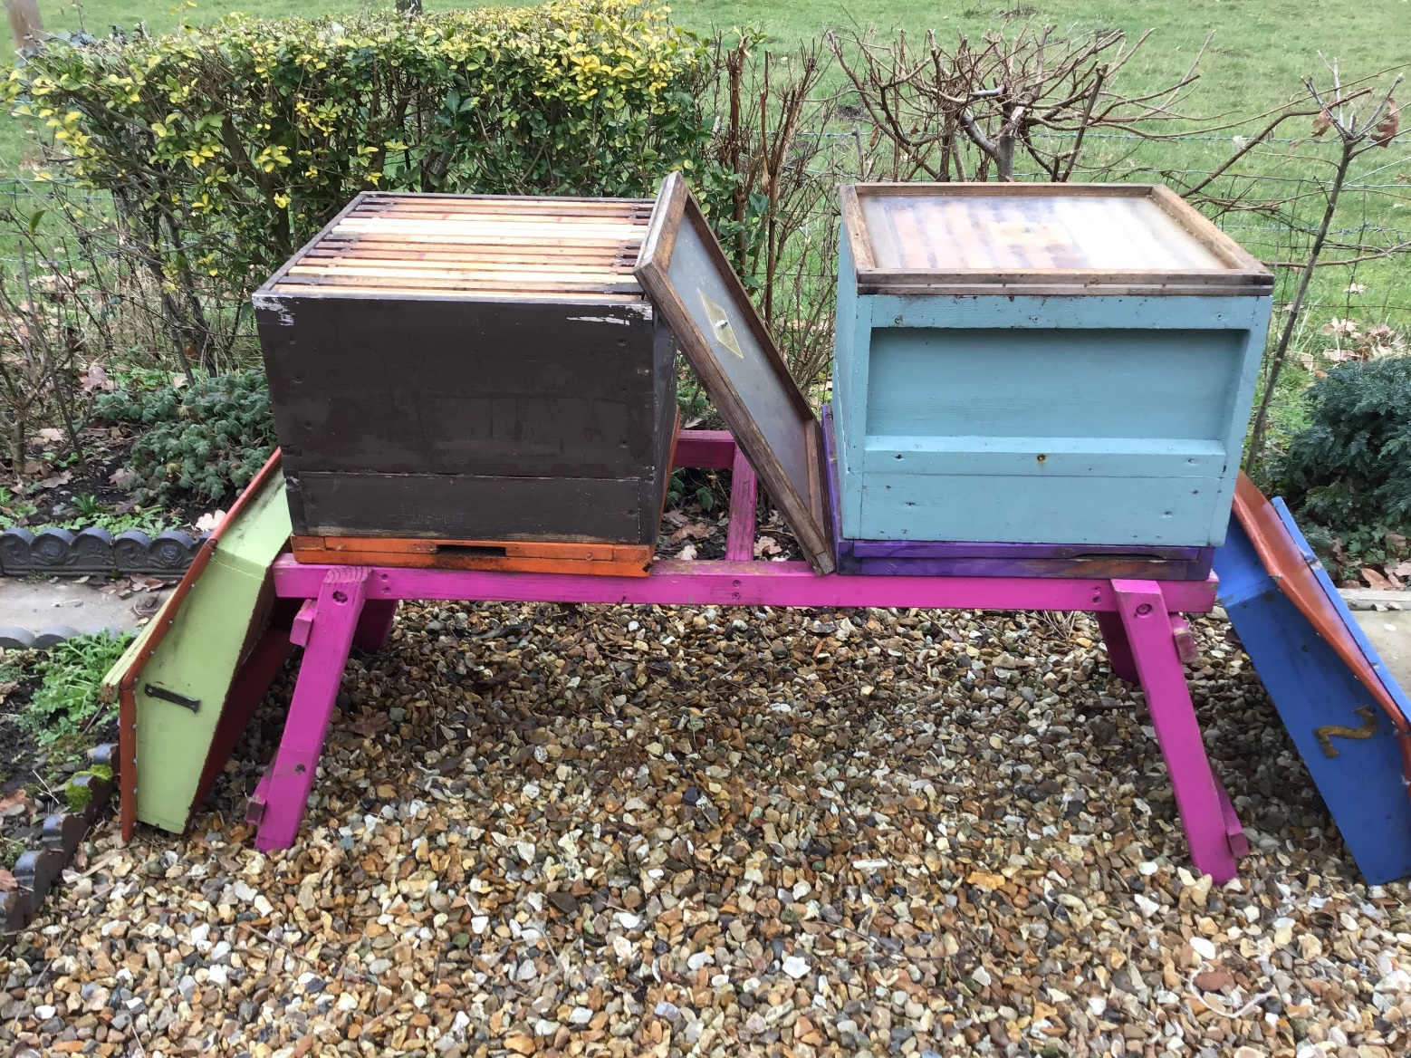
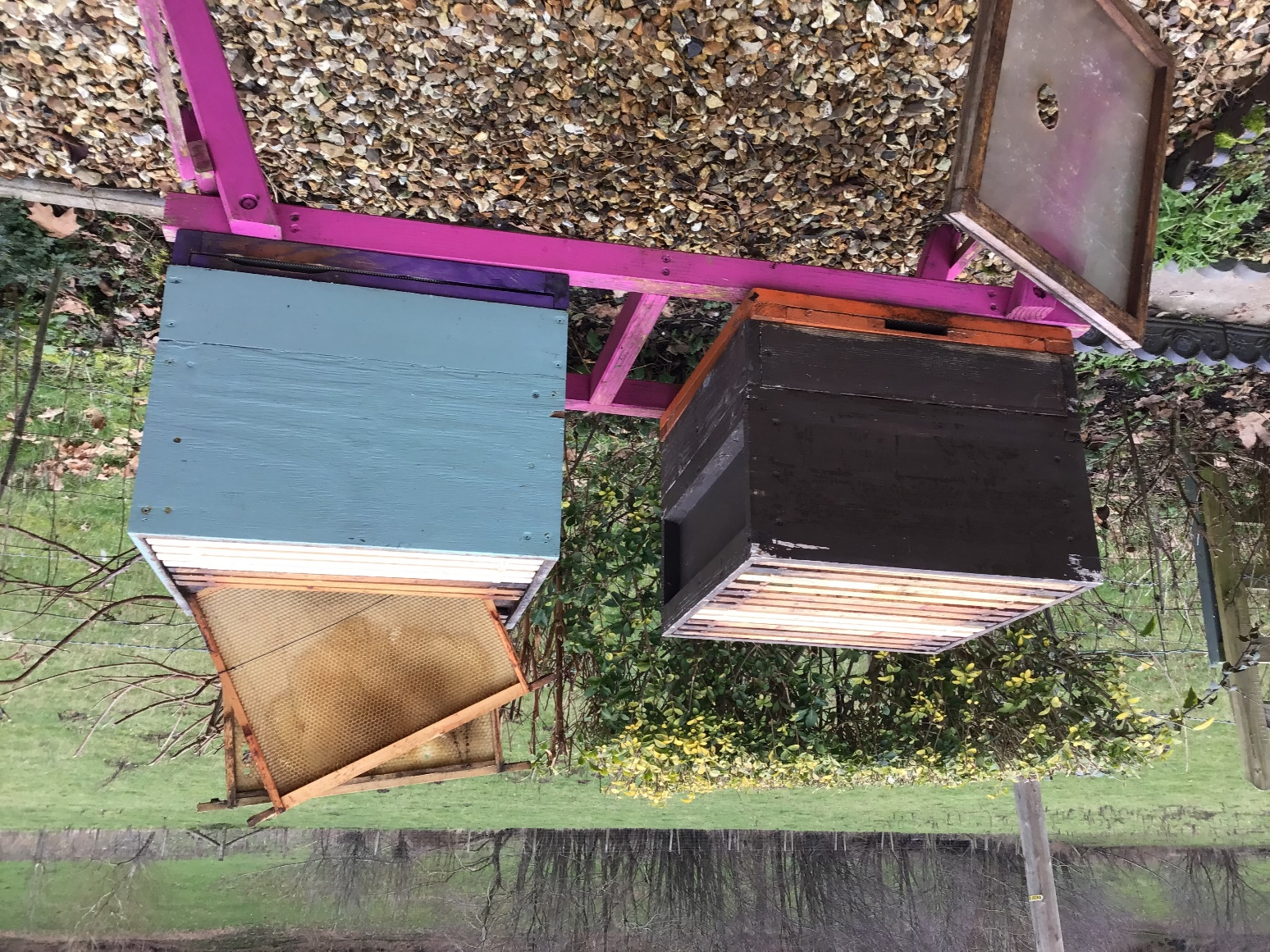
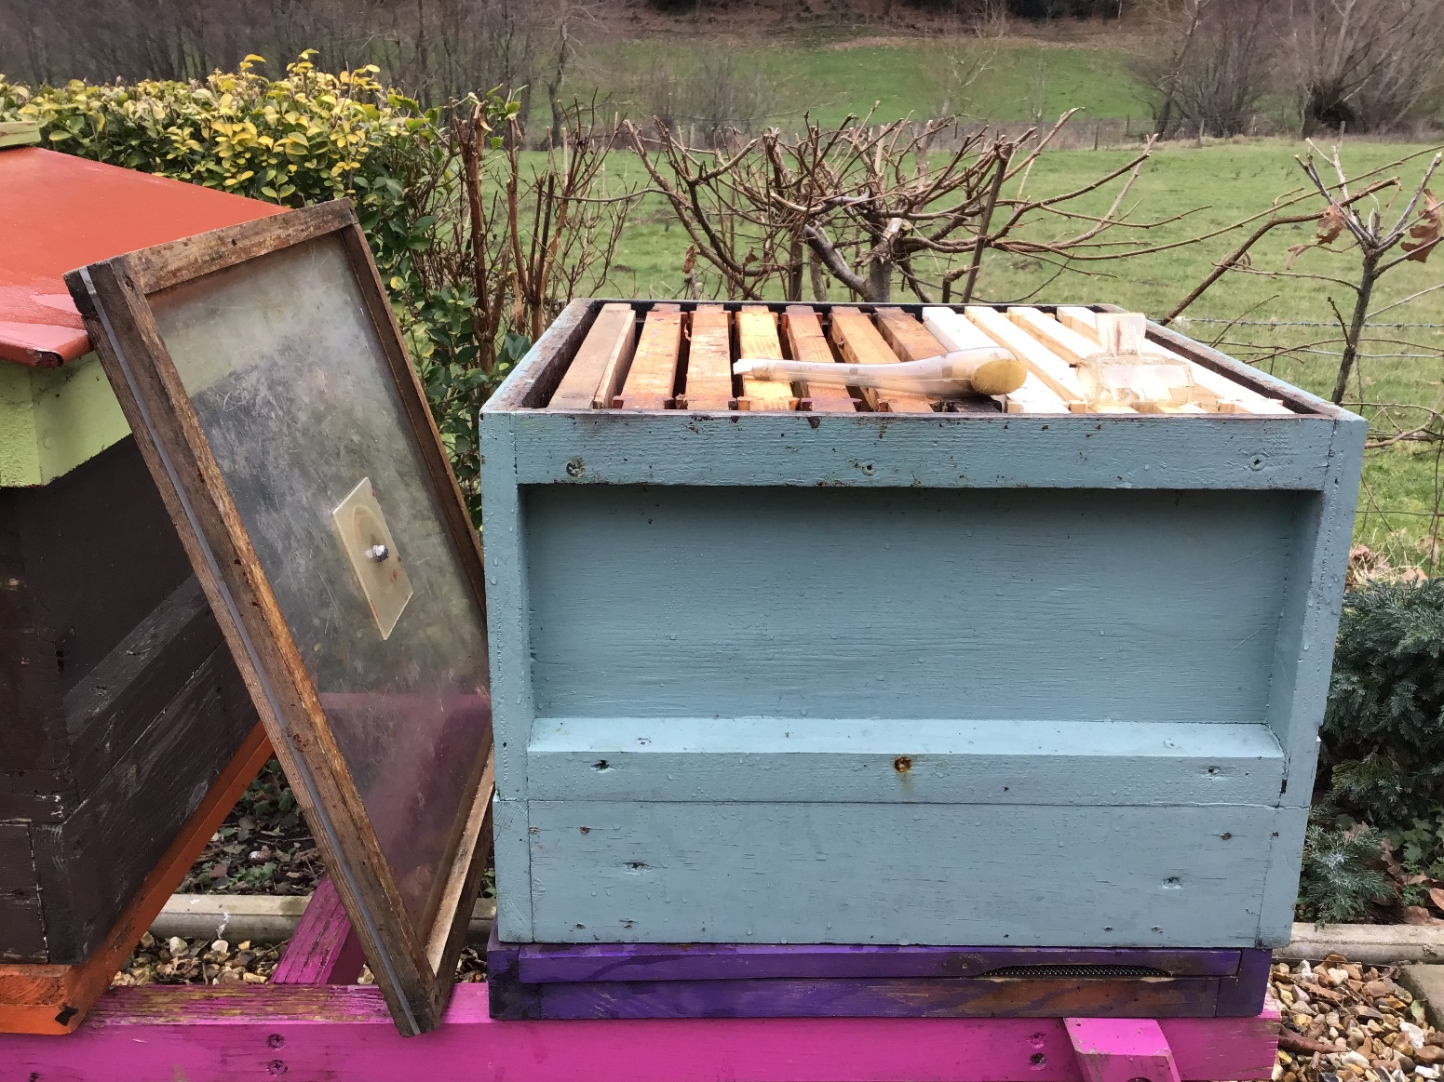
Uniting Two Colonies
Unite healthy colonies –
NB not always best solution
for a weak colony
Queenright colony shown as
top box in this diagram –
can be top or bottom
Gradually move colonies
closer until day of uniting
Session 3: Beekeeping Year

Slide 26
Quick Quiz
Why would you consult a record card in July?
To see if you need to replace the queen?
What do you need to see on your first inspection?
Once you have checked the stores and seen brood- box it up.
Session 3: Beekeeping Year

Slide 27
Next Session
Read the following sections of your book for the next session
  Chapter 3: The Hive
  We are going to be learning about the parts and workings of the beehive
Date of next session – 1/3/23 In Ashford Carbonel Hall
Session 3: Beekeeping Year

Slide 28

Questions?
Notes:
28

