Slide 1
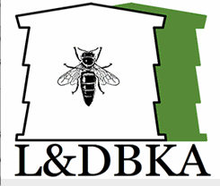
Ludlow & District Beekeepers Association
Session 1
An Introduction to Beekeeping:
Bees and Beekeeping
Session 1: Bees and Beekeeping
1

Slide 2
Introduction – Getting to know you….
Please give a brief introduction of yourself:
  What do you like people to call you?
  Where do you live?
  What prompted your initial interest in beekeeping?
  Why do YOU want to keep bees? – Whiteboard exercise
  Why do people stop beekeeping?
Session1: Bees and Beekeeping
2

Slide 3
Aims and Objectives
Aim:
To put beekeeping in context and to provide a realistic perspective on ups and downs of the pastime
on which you are engaging
Objectives:
  To give you an overview of the bee and beehives
  To outline the structures and support for beekeepers
  Enable you to reflect on bees and beekeeping in its contexts
  You will understand the structure of the hive and the basic equipment you will need as beekeepers
  To look at a hive and the key parts so you know what terminology is applied and can recognise them
Session 1: Bees and Beekeeping

Slide 4
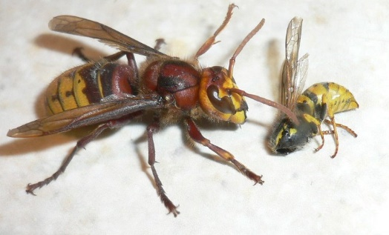
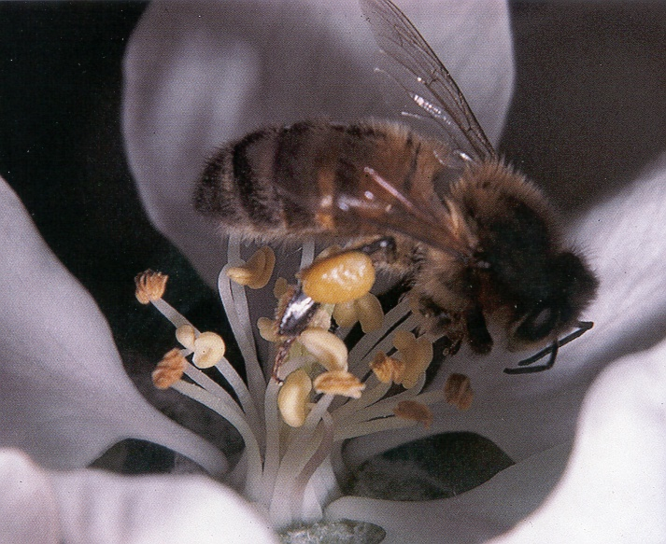
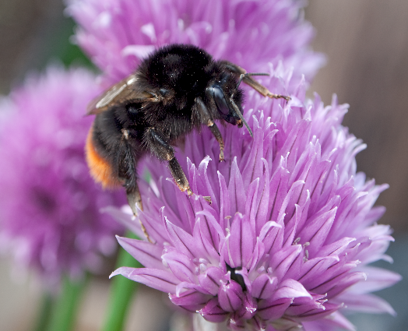
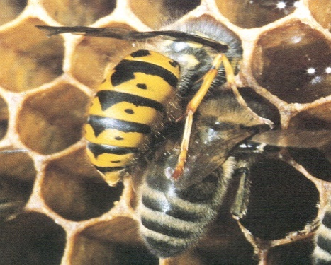
Honey bees and other insects
Hornet
Wasp
Bumble bee
Honey bee
< - Carnivorous - >
< - Vegetarian - >
< - Queen overwinters alone - >
< Queen overwinters in colony >
Session1: Bees and Beekeeping

Slide 5
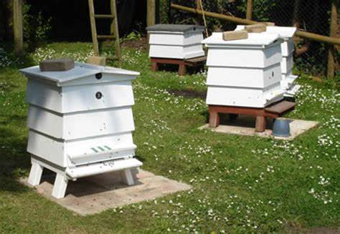
How many animals?
Session1: Bees and Beekeeping

Slide 6
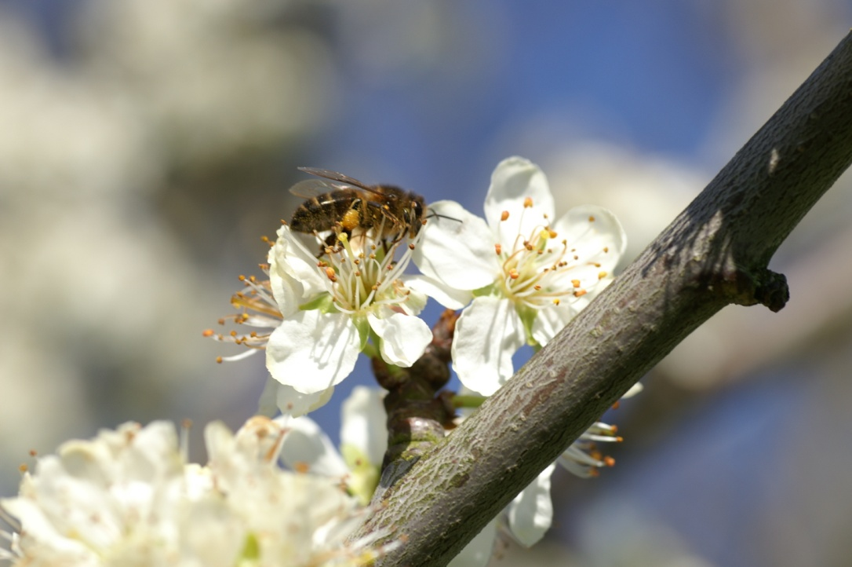
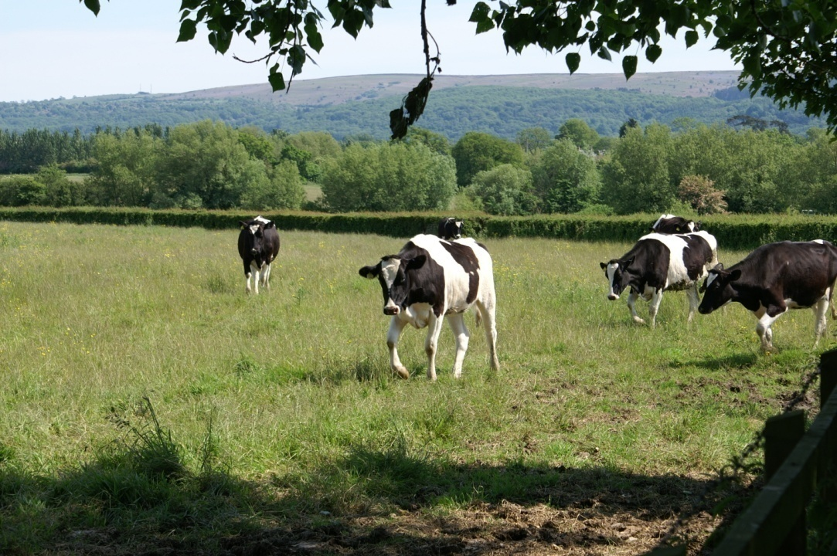
Social Animals
Bees
  Female society
  Not domesticated
  Individual sacrifice
  Evolved with flowers
Cattle
  Male society
  Herd animals
  Domesticated
  Breeds developed by man
Session1: Bees and Beekeeping

Slide 7
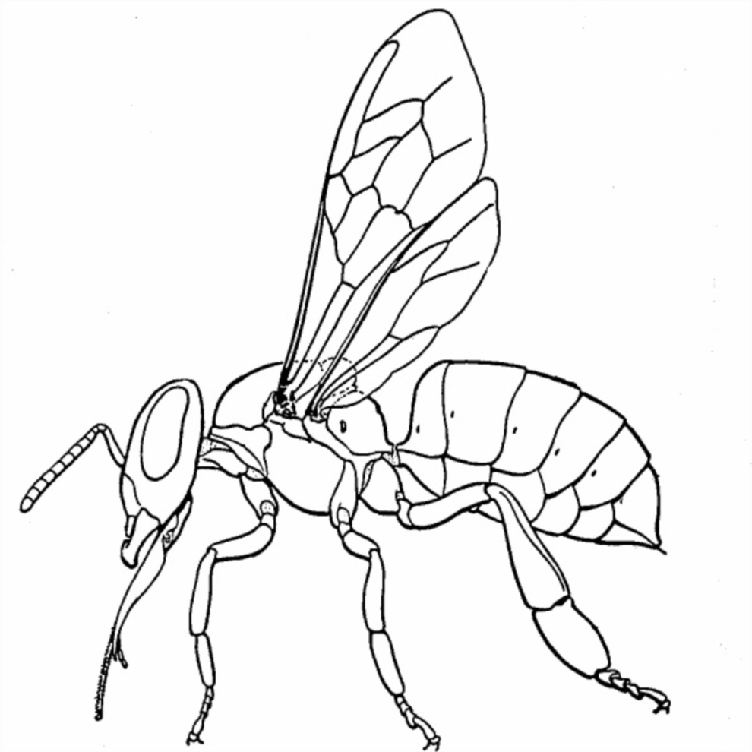
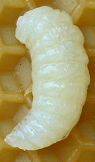
Anatomy of a Honey bee
Thorax
Wings (pairs)
Hypopharyngeal
Gland
Spiracle (breathing aperture)
Compound eyes
Abdomen
Head
Nasonov Glands
Antenna
Sting
Mandibles
Wax Glands
Tongue (glossa)
Pollen Basket
(corbicula)
Session1: Bees and Beekeeping

Slide 8
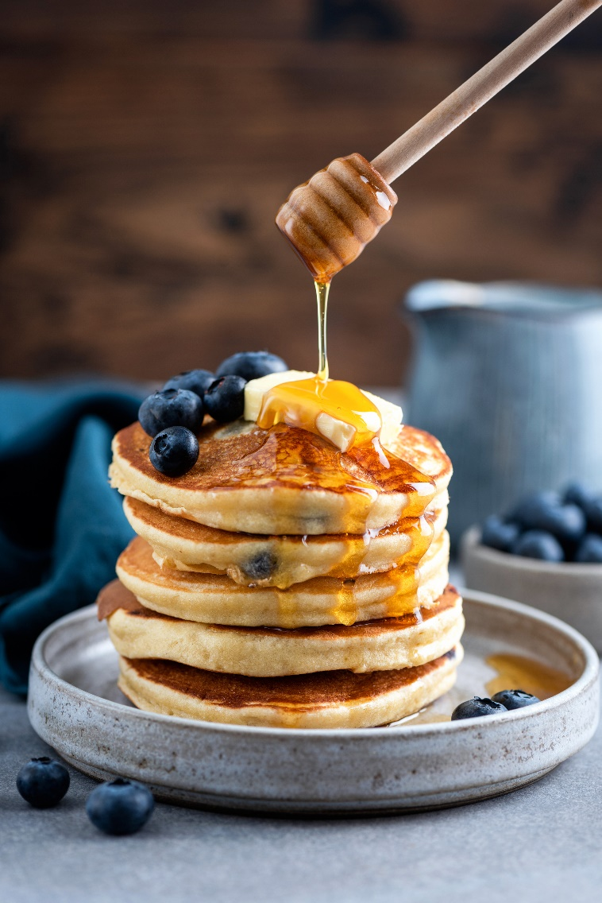
No hibernation means……?
Energy during the winter
Food
Use of space
Navigation
Staying warm
Management of moisture
Hygiene
Maintenance of numbers
Session1: Bees and Beekeeping

Slide 9
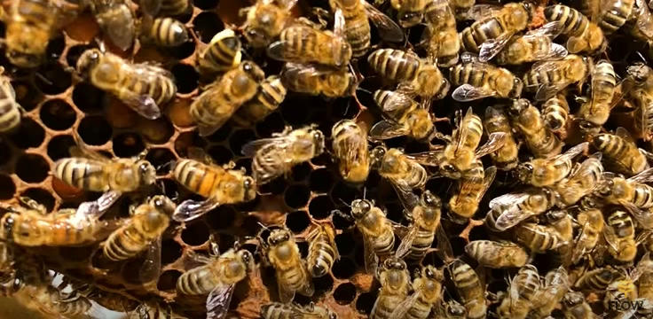
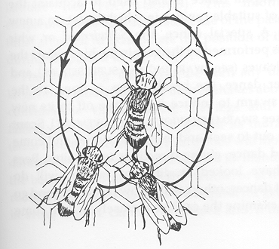
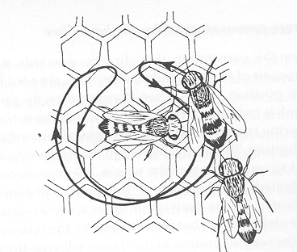
Bee Dances
Round Dance –
(General location)
food nearby
Session1: Bees and Beekeeping

Slide 10
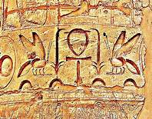
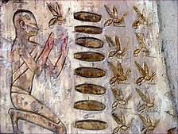
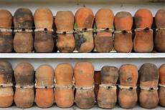
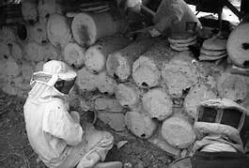
Bees have been kept since around 3000 BCE
Session1: Bees and Beekeeping

Slide 11
Bees and the GDP
Value to UK agriculture of insect pollinators – est. £700m pa
(85% of food crops rely on pollinators incl honeybees)
Value to the environment – ???
UK consumption of honey – 95m lbs pa
UK production of honey ( apx.14% consumption) – 13m lbs pa
Number of beekeepers in UK – 40,000
Number of bee farmers (BFA) – 500
Number of managed colonies (Beebase) – 272,000
Number of wild colonies – ???
Session1: Bees and Beekeeping

Slide 12
Bees and plants
Plants give:
  Pollen = Protein
  Nectar = Carbohydrate for energy, stored as honey
  Resin = Propolis used for hygiene, draft exclusion
  Bees also need water for:
  Temperature and humidity regulation
  To dilute stores
THOUGHT: We once grew food without chemicals, but never without bees…
Session1: Bees and Beekeeping

Slide 13
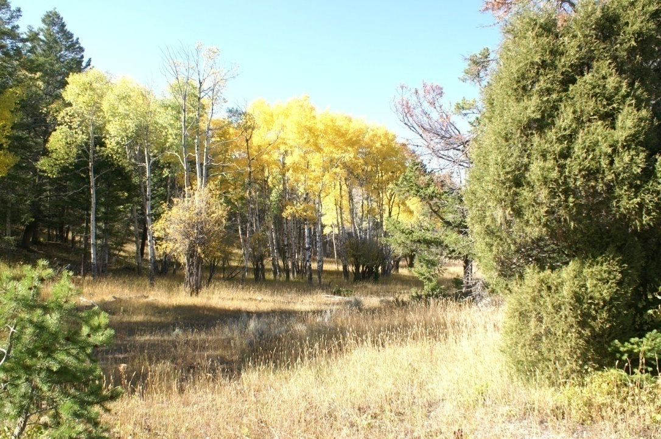
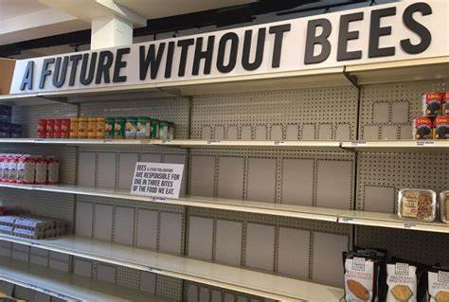
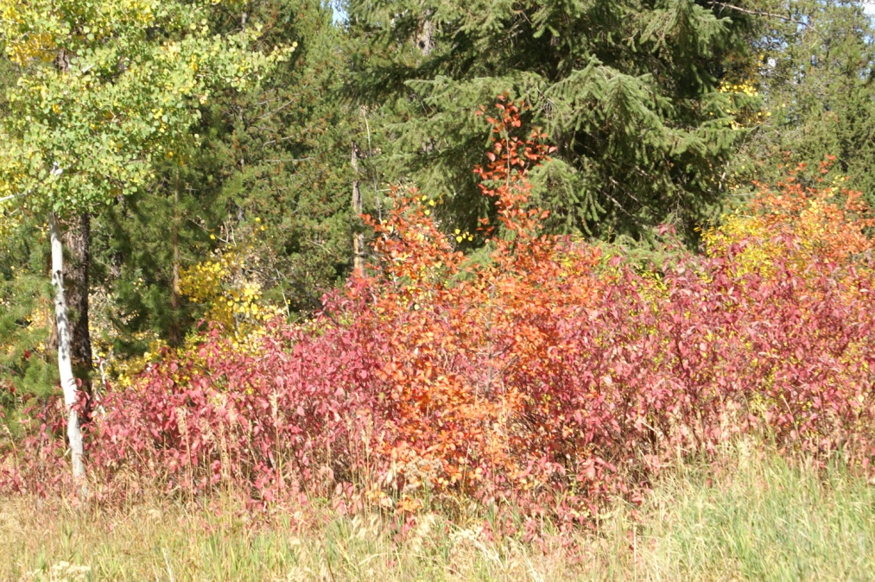
Environmental Impact of No Bees
No honey bee =
no early pollinators
Less winter feed for birds
Changes in flora
  Increase in grasses
  Late pollinated plants
Session1: Bees and Beekeeping

Slide 14
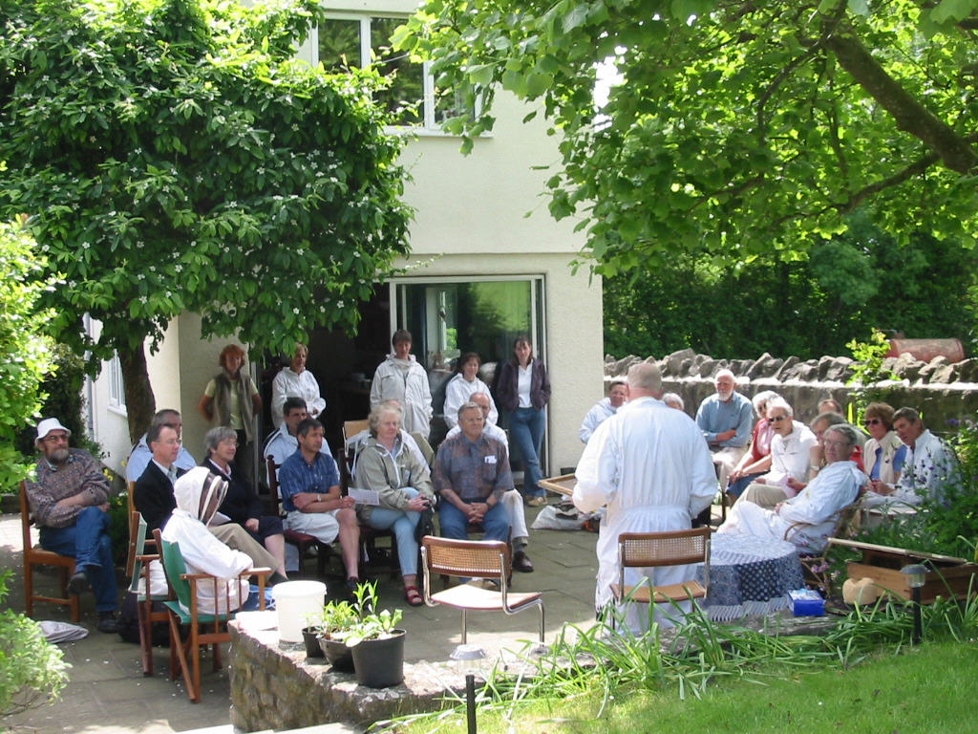
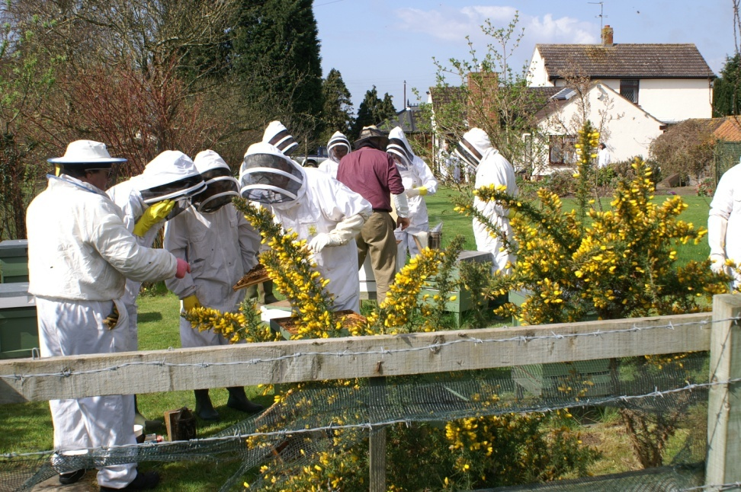
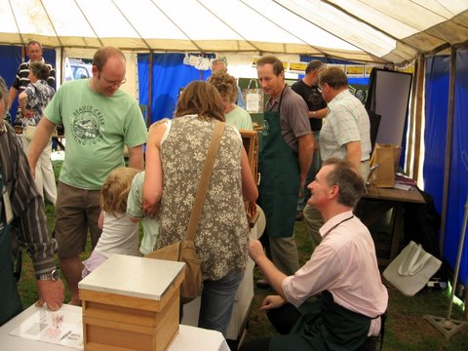
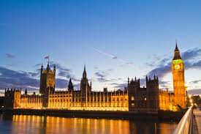

Beekeeping Support
Can I keep bees?
Local Branches
  Training
  Mentoring
County Associations
  Representation
National (BBKA)
  Assessments
  Insurance
  Policy
  Government liaison etc.
Session1: Bees and Beekeeping

Slide 15
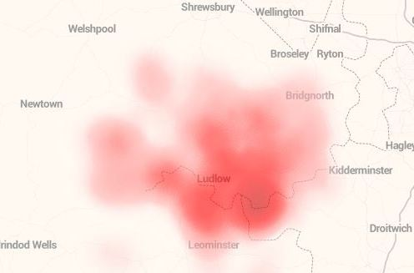
Your Beekeeping Association
L&DBKA currently has around 190 members in the area from Church Stretton to Leominster and from Bridgnorth to the Welsh border.
Session1: Bees and Beekeeping

Slide 16
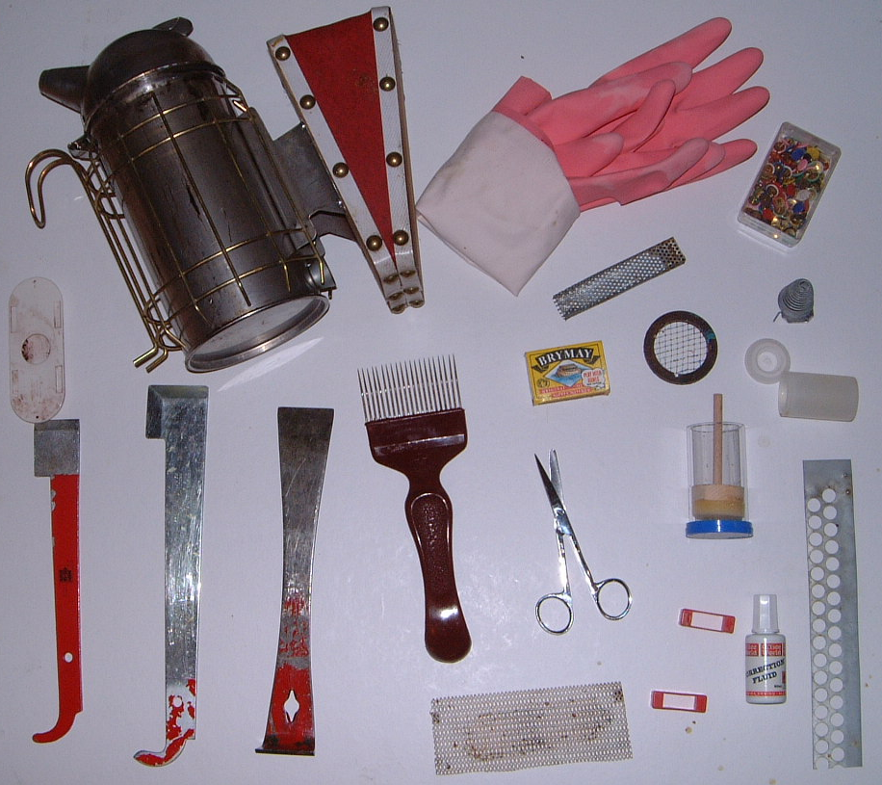
Basic Equipment
Smoker
Gloves
Butler Cage
Drawing Pins
Porter bee
escape
Queen cell cage
2 Queen marking cages
Matches
Scissors
Uncapping
Tool
3 Hive tools
Mouse Guard
Marking Fluid
‘Ends’
Mesh
Session1: Bees and Beekeeping

Slide 17
Quick Quiz
Which social insects are carnivorous?
  A. = Wasp and hornet
Why is Karl famous?
  A = Waggle dance
What do you put in a smoker?
  A = Material that will make smoke, not flame – talk about this
What is the ADM?
  A = Annual Delegates Meeting (Beekeeping national meeting)
Where are spiracles?
  A = On each segment of larva and adult – breathing holes.
Session1: Bees and Beekeeping

Slide 18
Next Session – On Zoom!
Read the following sections of your book for the next session
  Chapter 1 that covers what we have taught today
  Chapter 2 – The Colony for the next session
  Also read Chapter 6 Pages 98 to 107 as Chapter 6 is not covered full in its own right as it is more advanced beekeeping
  We are going to be learning about Bees and their relationship with each other and their environment
  If you are interested also read History of Bees Chapter 4 as relatively little of this will be covered during the course
Date of next session: Wednesday 15/2/23 at 7.00pm – 9pm on Zoom
Session1: Bees and Beekeeping

Slide 19
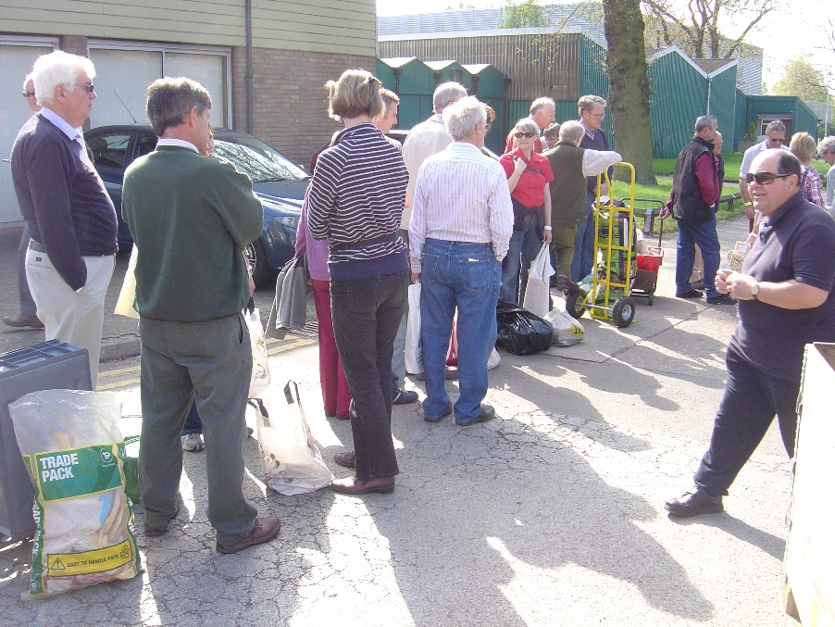
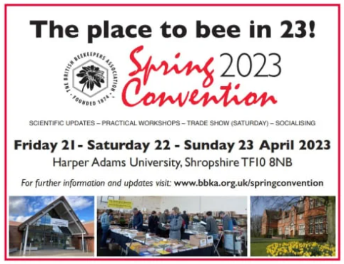
Closing thoughts
Practical opportunities to take:
  Plan what equipment you need and explore where to buy
  Consider attending Harper Adams Spring Convention - tickets
  Consider what you want to spend and where you want to buy
Session1: Bees and Beekeeping

Slide 20

Questions?
Notes:
20

Slide 21
Hands on…………
A practical look at the hive and equipment
Session 2: A Life’s work and comb

